Slide 1



From Restricted Data to Accessible AI Services in Cultural Heritage
A Platform Approach for Sharing Derivative Knowledge
Ventsislav Polimenov
Krassimira Ivanova
Institute of Mathematics and Informatics
Bulgarian Academy of Sciences
Mathematics Days in Sofia 2026, 6-10.07.2026, Sofia, Bulgaria

Slide 2
Digitized Cultural Heritage
(images, manuscripts, audiovisual archives, metadata)
Huge research potential
ML / DL Applications
(handwriting recognition, object detection, semantic annotation, restoration support, intelligent search)
BUT …
Significant amount of valuable information cannot be freely used for research, education and AI development.
©
Copyright restrictions
🔒
Privacy regulations
📋
Institutional
policies
⚖️
Ethical
considerations
How can we share knowledge without sharing protected data?
Notes:
The rapid digitization of Cultural Heritage collections has resulted in the creation of large-scale digital repositories containing images, manuscripts, audiovisual archives, and descriptive metadata.
These collections provide valuable resources for applying ML and DL techniques to tasks such as handwriting recognition, object detection, semantic annotation, restoration support, and intelligent search.
Despite these opportunities, many cultural datasets remain inaccessible because of copyright restrictions, privacy regulations, institutional policies, or ethical considerations. As a consequence, significant amounts of valuable information cannot be directly reused for research, education, or AI development.
Here we discuss how derivative data and trained ML/DL models can serve as alternative mechanisms for knowledge sharing while preserving legal and institutional constraints.
We first analyze different categories of cultural heritage data and their sharing models, and then present a platform-oriented approach for publishing AI services based on reusable ML/DL models.

Slide 3
Types of Cultural Heritage Data
1. Raw
Digital copies of artifacts in their original format
+ + +: ensures maximum authenticity, making it suitable for detailed research, and allows for reprocessing with new improved technologies
– – – : the size of the files require powerful storage infrastructure and slow access, and are also often subject to copyright protection
Example: the British Library provides RAW scans of medieval manuscripts in TIFF format for academic research
Notes:
1. Raw Data – It includes digital copies of artifacts in their original format, such as scanned documents, photographs, audio/video recordings. The advantages of this type of data are that it ensures maximum authenticity, making it suitable for detailed research, and allows for reprocessing with new improved technologies. For example, the British Library provides RAW scans of medieval manuscripts in TIFF format for academic research. The disadvantages are the size of the files, which require more powerful storage infrastructure and slow access, and are also often subject to copy-right protection.

Slide 4
Types of Cultural Heritage Data
2. Preprocessed
Data optimized for specific purposes:
  normalized images (color corrected, straightened pages),
  text transcriptions of hand-written documents,
  segmented data (e.g. objects in a picture)
+ + +: significantly reduces the computational requirements for ML models
– – – : highly dependent on the quality of the pre-processing and often has a risk of losing details
Example: dataset DEArt containing 15K+ historical paintings (12th–18th c.) with manually annotated objects (69 classes) and human poses (12 types) for CH object detection and pose classification
Notes:
2. Pre-processed Data – includes data optimized for specific purposes, such as: normalized images (color corrected, straightened pages), text transcriptions of hand-written documents, segmented data (e.g. objects in a picture). This type of processing significantly reduces the computational requirements for ML models, but is highly dependent on the quality of the pre-processing and often has a risk of losing detail.
Example of such collections include: DEArt, which provides a dataset for object detection and pose classification, containing over 15,000 images of paintings between the 12th and 18th centuries, aligned with manual annotations for the bounding boxes identifying all instances of 69 classes as well as 12 possible poses for boxes identifying human-like objects, specific for CH [Resh-2022].

Slide 5
Types of Cultural Heritage Data
3. Metadata
descriptive information about the artifacts, including technical characteristics, semantic information, structural metadata
+ + +: facilitated search of information in large collections
Using standards – Dublin Core or CIDOC-CRM, EDM… - facilitates the integration of data between different institutions and systems
– – – : heterogeneity in manual entry, omissions or inaccuracies, as well as the need for relevant expertise for their correct structuring and use
– – – : the creation of rich metadata is often a time-consuming process
Notes:
3. Metadata – They contain descriptive information about the artifacts, including technical characteristics (dimensions, resolution, etc.), semantic information (author, date of creation, etc.), as well as structural metadata to describe the relationships with other objects. The advantages of metadata are related to the facilitated search of in-formation in large collections and the possibility of semantic connectivity. They are often structured according to internationally accepted standards such as Dublin Core or CIDOC-CRM, which facilitates the integration of data between different institu-tions and systems. For example, Europeana uses the Europeana Data Model (EDM) standard, which allows for rich semantic description of objects, supports complex relationships between artifacts and contextual elements (such as authors, places, and periods), and provides high interoperability with external dictionaries and platforms, thanks to its foundation on Linked Data technologies [EuropeanaDM]. The main dis-advantages include heterogeneity in manual entry, omissions or inaccuracies, as well as the need for relevant expertise for their correct structuring and use. In addition, the creation of rich metadata is often a time-consuming process.

Slide 6
Types of Cultural Heritage Data
4. Anonymized
data from which all elements that allow the identification of specific individuals or sensitive information have been removed or masked
(names, addresses, identifiers, voice recordings or visual features)
Anonymization is key to complying with ethical norms and data protection legislation.
+ + +: allows public sharing and reuse of cultural content for research or educational purposes without violating personal privacy
– – – : the process can lead to the loss of context or details important for interpretation
Specific subtype – pseudonymized data, where sensitive data is replaced with pseudonyms so that the data can be reverted to its original state by applying a key that is kept separately (GDPR treats pseudonymized data as personal information)
Notes:
4. Anonymized data – includes data from which all elements that allow the identification of specific individuals or sensitive information have been removed or masked. This includes names, addresses, identifiers, voice recordings or visual features in images and videos. Anonymization is key to complying with ethical norms and data protection legislation. The advantages of this type of data are that it allows for the public sharing and reuse of cultural content for research or educational purposes without violating personal privacy. The disadvantage is that the anonymization process can lead to the loss of context or details important for interpretation. A specific subtype of data is pseudonymized data, where sensitive data is replaced with pseudonyms so that the data can be reverted to its original state by applying a key that is kept separately. Unlike anonymized data, which is not considered personal, the GDPR treats pseudonymized data as personal information because there is a mechanism by which it can be linked back to the individual.

Slide 7
Types of Cultural Heritage Data
5. Synthetic
artificially generated versions that resemble real artifacts
+ + +: Can be shared securely while preserving the confidentiality of the original data.
+ + +: Particularly useful as an opportunity to create large training sets for ML in the absence of sufficient resources
– – – : carries risks of amplifying bias inherent in real data, missing small but important details, and generating plausible-looking but fundamentally false data (“hallucinations”).
Example: the “Artificial Past” project, aimed at deciphering historical documents, applies a data augmentation strategy using GANs to generate handwritten lines in order to massively produce data for a given style (such as very cursive Maghribi Arabic script) or under-resourced character class (as Armenian texts).
Notes:
5. Synthetic Data – artificially generated versions that resemble real artifacts (e.g., paintings that emulate the style of a particular artist or synthetic texts that imitate historical styles). Such data can be shared securely while preserving the confidentiality of the original data. Also, they are particularly useful as an opportunity to create large training sets for machine learning in the absence of sufficient resources. For example, the “Artificial Past” project [Vid-2024], aimed at deciphering historical documents, applies a data augmentation strategy using generative adversarial net-works (GANs) to generate handwritten lines in order to massively produce data for a given style (such as very cursive Maghribi Arabic script) or under-resourced character class (as Armenian texts). The application of synthetic data in ML also carries risks of amplifying bias inherent in real data, missing small but important details that are characteristic of authentic artifacts, and generating plausible-looking but fundamental-ly false data (so-called “hallucinations”).

Slide 8
Types of Cultural Heritage Data
6. Derivative
new data derived from existing real data through transformation, aggregation, or analysis
It is based on real observations or measurements, with value added through transformation, aggregation, feature extraction, or modeling of the original information.
Two main subgroups:
  direct derivatives – produced from other data, through calculations, transformations, aggregations, etc.
  complex derivatives – results of applied ML algorithms containing structured information extracted from the training data.
Notes:
6. Derivative Data – This is new data derived from existing real data through transformation, aggregation, or analysis (e.g. extracting metadata such as categories, style or era from digitized images, or generating 3D models of artifacts from photogrammetric images). It is based on real observations or measurements, with value added through transformation, aggregation, feature extraction, or modeling of the original information. Contrary to the synthetic data, they maintain the connection to the original data and its credibility.
Depending on the complexity of the applied procedures for information extraction, this group can be divided into two subgroups:
direct derivatives, which are produced from other data, through calculations, transformations, aggregations, etc.
and complex derivatives, which are results of applied machine learning algorithms containing structured information extracted from the training data.
An example of a project actively using direct derivative data is the VISIONE project, which aims to search and analyse video content, including cultural events, lectures, performances and archival videos using computer vision algorithms, feature extraction and machine learning. The derivative data here takes the form of extraction of colour histograms, textures, contours, optical character recognition and face/object recognition extracted from the original video material, as well as individual keyframes from the scenes, as well as automatically generated annotations extracted by processing the original raw videos. This data significantly facilitates the search and filtering of content by objects, scenes or topics and supports the training of ML models for automatic classification and scene recognition, without affecting the original video files [Amato-2024].
Among the complex derivatives, trained ML/DL models have recently emerged as one of the most significant forms of computational knowledge. They can be regarded as a new type of digital artifact that encapsulates patterns and semantic information learned from primary cultural heritage collections while remaining independent of the original protected datasets. Positioned between the primary data and the resulting inferences, these models provide a reusable representation of knowledge that supports information extraction, transfer learning, and the development of AI-assisted applications. Since trained models can be distributed without necessarily exposing the underlying copyrighted or sensitive data, they offer a practical mechanism for sharing AI capabilities while preserving legal and ethical constraints. This makes them particularly suitable as reusable components of platform-based AI services for Cultural Heritage.

Slide 9
Types of Cultural Heritage Data
6. Derivative data - Example
VISIONE project
VISIONE enables advanced search and analysis of video content (cultural events, lectures, performances and archival materials) using computer vision and machine learning
The project extracts metadata such as:
  colour
  texture and contour features
  OCR text recognition
  face and object detection
  keyframes and automated annotations
This derived data improves content search, filtering and classification while preserving the original video files.
Notes:
6. Derivative Data – This is new data derived from existing real data through transformation, aggregation, or analysis (e.g. extracting metadata such as categories, style or era from digitized images, or generating 3D models of artifacts from photogrammetric images). It is based on real observations or measurements, with value added through transformation, aggregation, feature extraction, or modeling of the original information. Contrary to the synthetic data, they maintain the connection to the original data and its credibility.
Depending on the complexity of the applied procedures for information extraction, this group can be divided into two subgroups:
direct derivatives, which are produced from other data, through calculations, transformations, aggregations, etc.
and complex derivatives, which are results of applied machine learning algorithms containing structured information extracted from the training data.
An example of a project actively using direct derivative data is the VISIONE project, which aims to search and analyse video content, including cultural events, lectures, performances and archival videos using computer vision algorithms, feature extraction and machine learning. The derivative data here takes the form of extraction of colour histograms, textures, contours, optical character recognition and face/object recognition extracted from the original video material, as well as individual keyframes from the scenes, as well as automatically generated annotations extracted by processing the original raw videos. This data significantly facilitates the search and filtering of content by objects, scenes or topics and supports the training of ML models for automatic classification and scene recognition, without affecting the original video files [Amato-2024].
Among the complex derivatives, trained ML/DL models have recently emerged as one of the most significant forms of computational knowledge. They can be regarded as a new type of digital artifact that encapsulates patterns and semantic information learned from primary cultural heritage collections while remaining independent of the original protected datasets. Positioned between the primary data and the resulting inferences, these models provide a reusable representation of knowledge that supports information extraction, transfer learning, and the development of AI-assisted applications. Since trained models can be distributed without necessarily exposing the underlying copyrighted or sensitive data, they offer a practical mechanism for sharing AI capabilities while preserving legal and ethical constraints. This makes them particularly suitable as reusable components of platform-based AI services for Cultural Heritage.

Slide 10
Types of Cultural Heritage Data
6. Derivative data – ML/DL models
Trained models represent a new type of digital artifact that captures patterns and semantic knowledge learned from cultural heritage collections.
They act as an intermediate layer between primary data and AI-generated insights.
Enable:
  knowledge reuse and transfer learning
  information extraction
  AI-assisted cultural heritage applications
Can be shared without exposing protected or sensitive datasets.
Notes:
6. Derivative Data – This is new data derived from existing real data through transformation, aggregation, or analysis (e.g. extracting metadata such as categories, style or era from digitized images, or generating 3D models of artifacts from photogrammetric images). It is based on real observations or measurements, with value added through transformation, aggregation, feature extraction, or modeling of the original information. Contrary to the synthetic data, they maintain the connection to the original data and its credibility.
Depending on the complexity of the applied procedures for information extraction, this group can be divided into two subgroups:
direct derivatives, which are produced from other data, through calculations, transformations, aggregations, etc.
and complex derivatives, which are results of applied machine learning algorithms containing structured information extracted from the training data.
An example of a project actively using direct derivative data is the VISIONE project, which aims to search and analyse video content, including cultural events, lectures, performances and archival videos using computer vision algorithms, feature extraction and machine learning. The derivative data here takes the form of extraction of colour histograms, textures, contours, optical character recognition and face/object recognition extracted from the original video material, as well as individual keyframes from the scenes, as well as automatically generated annotations extracted by processing the original raw videos. This data significantly facilitates the search and filtering of content by objects, scenes or topics and supports the training of ML models for automatic classification and scene recognition, without affecting the original video files [Amato-2024].
Among the complex derivatives, trained ML/DL models have recently emerged as one of the most significant forms of computational knowledge. They can be regarded as a new type of digital artifact that encapsulates patterns and semantic information learned from primary cultural heritage collections while remaining independent of the original protected datasets. Positioned between the primary data and the resulting inferences, these models provide a reusable representation of knowledge that supports information extraction, transfer learning, and the development of AI-assisted applications. Since trained models can be distributed without necessarily exposing the underlying copyrighted or sensitive data, they offer a practical mechanism for sharing AI capabilities while preserving legal and ethical constraints. This makes them particularly suitable as reusable components of platform-based AI services for Cultural Heritage.

Slide 11



Data Sharing Models
Public
✔ open collections
Restricted
🔒 controlled access
Non-accessible
❌ legal
✔ reusable
✔ selected researchers
❌ ethical
❌ copyright
valuable historical documents, photographs and recordings that contain personal information, sacred cultural knowledge or unresolved copyright issues
Most valuable collections are not fully accessible.
Notes:
In the world of digitization of cultural heritage, data sharing is a key element for collaborative research and educational initiatives. Providing access to valuable historical archives, however, sometimes comes up against the need to maintain confidentiality or respect copyright. Depending on the level of accessibility, three categories can be distinguished: public data, data with limited access, without access.
Public Data – Some collections (such as scanned manuscripts, historical photographs or metadata about artifacts) are published without restrictions and become publicly available. On platforms such as Europeana and Wikimedia Commons, data is uploaded in open formats and researchers, educators and hobbyists can freely use the materials. This also allows for their use and reuse for training ML models.
Restricted Data – When data is very valuable or sensitive, cultural institutions use specialized repositories with controlled access, thus limiting the use of the data only to certain researchers or partner organizations. This is achieved with access control tools such as CollectiveAccess [CAccess], through which access can be set by user, by role, or by individual collection / object / object type. Of course, the advantage of being able to control who uses a given object and when comes at the cost of the administrative burden of rights management, as well as the reduction of the visibility of the collections.
Non-accessible Data – Some datasets remain completely inaccessible to the public due to legal, ethical or institutional restrictions. These may include culturally sensitive materials, personal data protected by privacy laws (such as GDPR), or collections that are still in the process of digitization or rights settlement. In some cases, data may be restricted indefinitely due to unresolved copyright status, donor agreements, or because their publication could cause harm to individuals or communities. Such data still contain valuable information for internal research, preservation or cataloguing purposes, but of course their unavailability limits their potential for wider use.

Slide 12
From Data Sharing to Knowledge Sharing
Restricted Datasets
ML/DL Training
Trained Models
Derivative Knowledge
AI Services
Instead of sharing
❌ datasets
we share
✅ models
✅ annotations
✅ embeddings
✅ AI services
Notes:
To mitigate the limitations associated with limiting access and ensure wider use while respecting ethical and legal norms, institutions sometimes apply data transformation techniques, such as anonymization, pseudonymization, or data noising. In some cases, synthetic data is also used, which simulates the structure and statistical characteristics of the original set, without containing sensitive information. Such approaches help to find a balance between protecting personal and cultural sensitivities and the need for access to data for scientific and educational purposes.
More recently, derivative data and trained ML/DL models have emerged as an additional mechanism for enabling knowledge sharing. Instead of publishing protected datasets, institutions can distribute computational knowledge encoded in AI models, allowing other organizations to benefit from advanced analysis while preserving control over the original collections.

Slide 13
AI Knowledge Adaptation
Embedded Knowledge
Retrieved Knowledge
Composed Knowledge
Fine Tuning
Transfer Learning
Continual Learning
Parameter-Efficient Fine-Tuning
Knowledge structuring layer
(Knowledge Graphs / Linked Open Data)
Application layer
(RAG / GraphRAG)
AI Workflows
AI Pipelines
Tool Integration
Representation layer
(Embeddings -> Vector Databases)
Complementary rather than competing approaches
Notes:
Category - Knowledge stored in
Embedded - Model parameters
Retrieved - External repositories
Composed - AI services & workflows

Slide 14
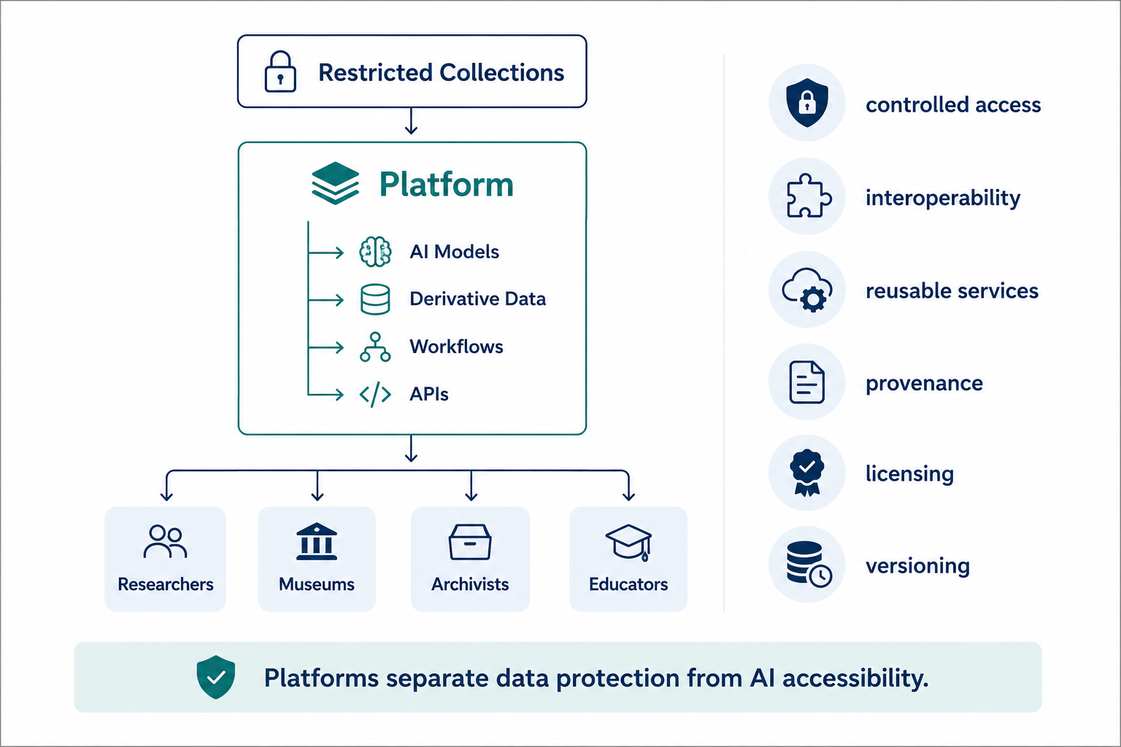
Why Platform-Based AI Services?
AI becomes accessible without exposing protected collections.

Slide 15
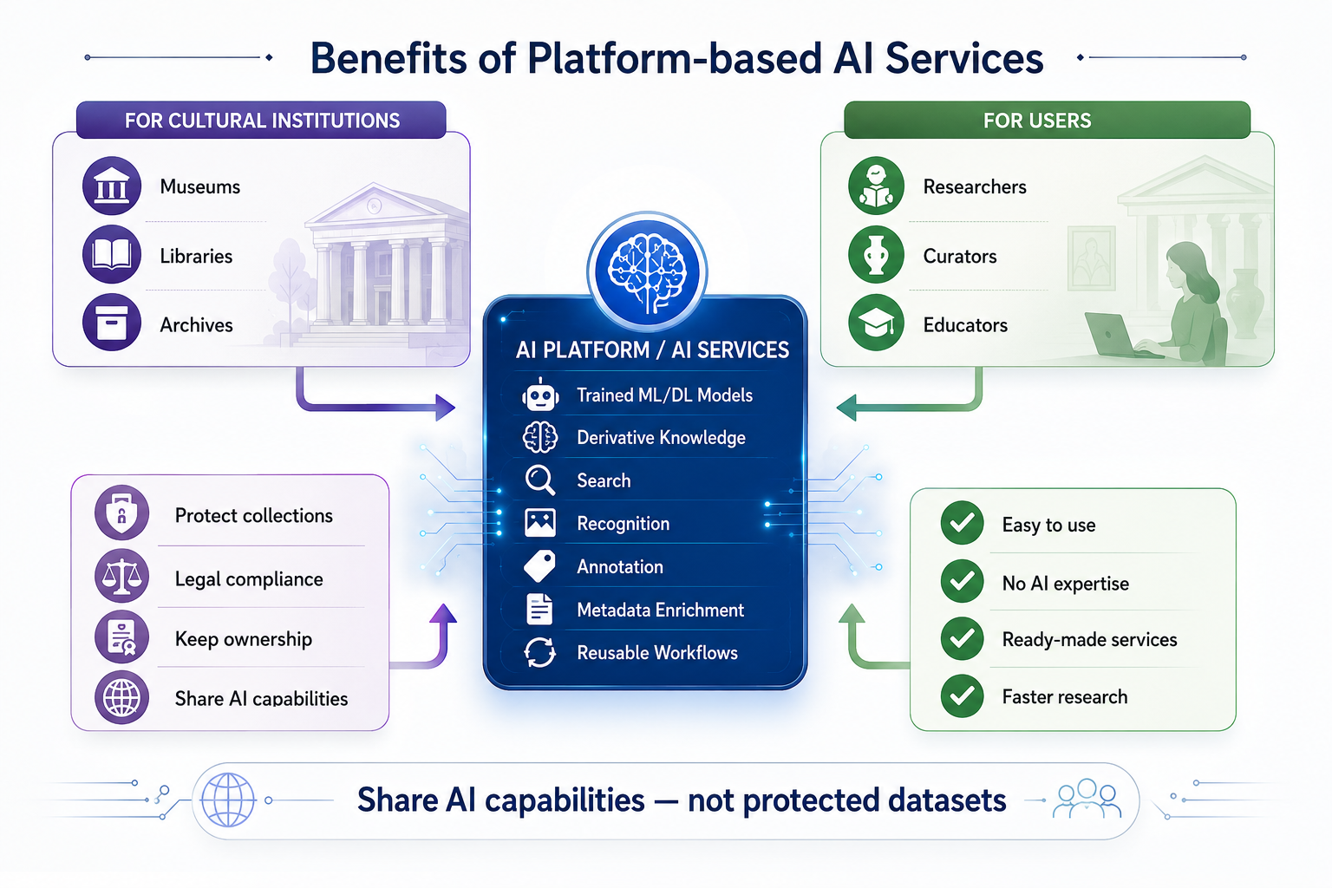
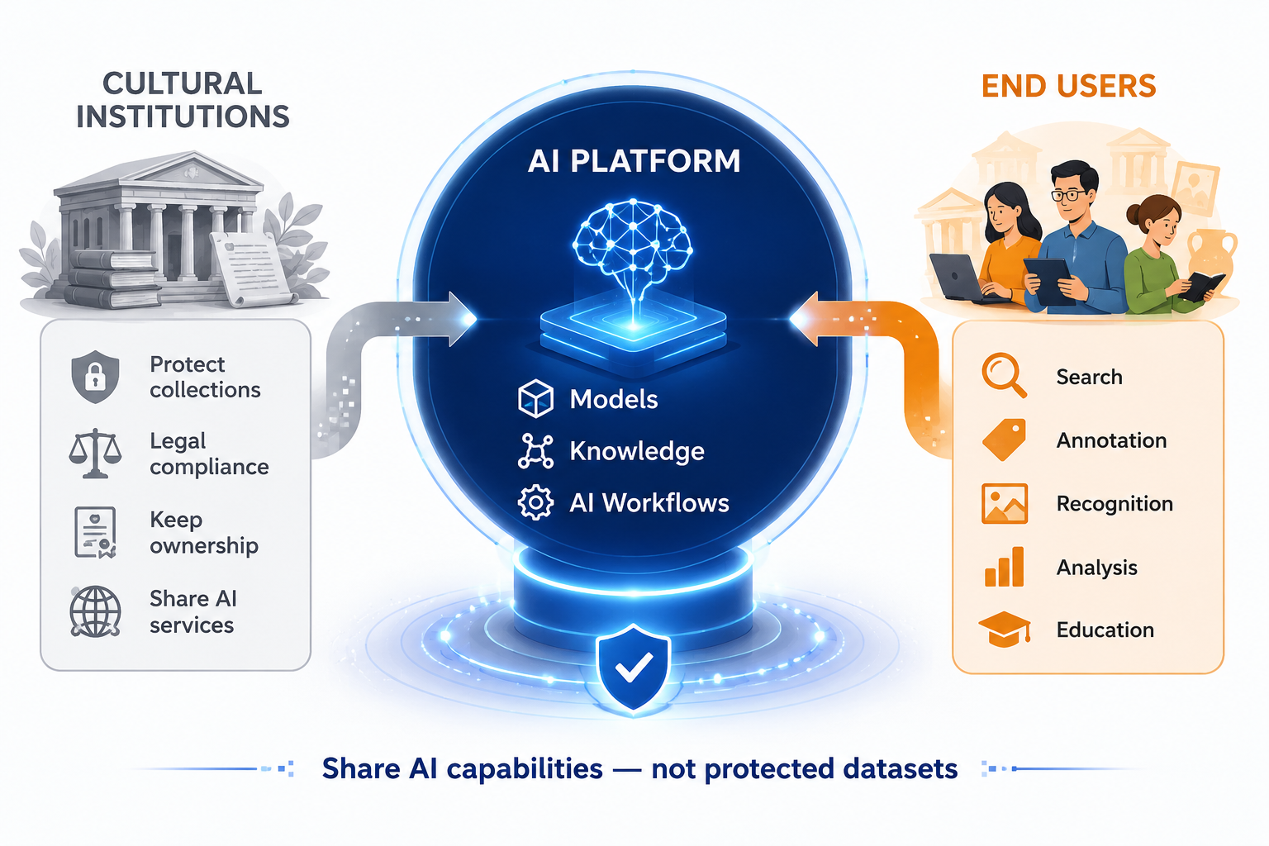
Benefits
Notes:
This slide summarizes the main value of the platform-based approach.On the left are the cultural institutions—museums, libraries, and archives. Their primary objective is to preserve control over their collections. They need to comply with copyright regulations, privacy requirements, and institutional policies, while still being able to contribute to the broader AI ecosystem.Instead of exposing their protected datasets, they publish AI capabilities through the platform. These capabilities include trained machine learning models, derivative knowledge, and reusable AI workflows.The platform acts as an intermediary layer between restricted collections and end users. It transforms protected data into accessible AI services without revealing the original content.On the right are the users—researchers, curators, educators, and other cultural heritage professionals. They do not need advanced AI expertise. Through a simple interface, they can use services such as semantic search, image recognition, annotation, metadata enrichment, and analysis.In this way, the platform creates value for both sides: institutions retain ownership and control over their data, while users gain access to advanced AI functionality.The key message is simple: we are no longer sharing protected datasets—we are sharing AI capabilities.

Slide 16
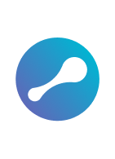


Utilink v1
Turning AI Models into Accessible Services
an AI platform focused on making machine learning and AI models easy to use, configure and deploy.
designed for users who need AI functionality but do not necessarily have technical expertise.
In the context of cultural heritage, this approach supports a practical alternative to direct data sharing.
Institutions can make AI capabilities available through models, services and derivative outputs, while maintaining control over sensitive, copyrighted or restricted collections.
www.utilink.xyz

Slide 17
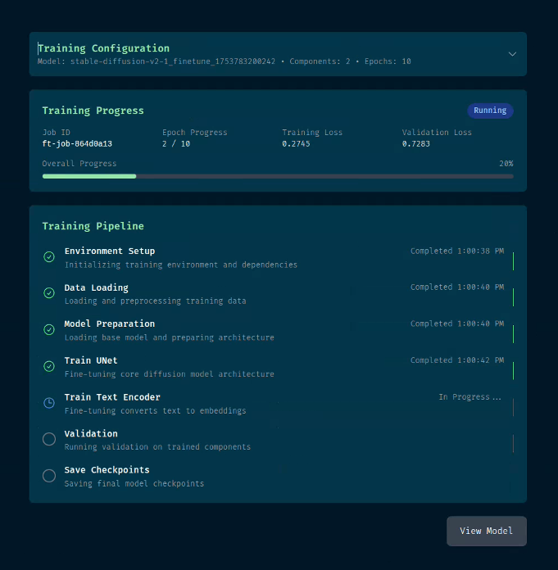
Utilink Functionalities
Model Hub
Users can share, discover and access ready-to-use AI models from one place.
For cultural heritage, this could mean models for image recognition, document analysis, object classification, visual similarity, handwriting recognition or derivative knowledge base.
Fine-Tuning Workflows
Where appropriate, users can configure and contextualise models through guided steps rather than technical pipelines.
This allows institutions to improve model relevance for their own needs, while keeping control over what data is used and how.
No-Code Model Use
Users can run AI models through a simple interface, without writing code or setting up technical environments.
This is especially important for museum professionals, archivists, educators and researchers who understand the cultural material but are not AI specialists.
Simple Inference
The platform handles the actual running of the models, including compute resources and processing.
Users can focus on choosing the task, providing the content and reviewing the results through a simplified interface, without needing to manage the technical setup behind it.
*Fine-Tuning process on staging environment
Notes:
Utilink turns AI models into accessible services that researchers, museums, archives and cultural organisations can use through guided platform workflows. It makes trained AI models usable as practical tools, not just technical assets.

Slide 18
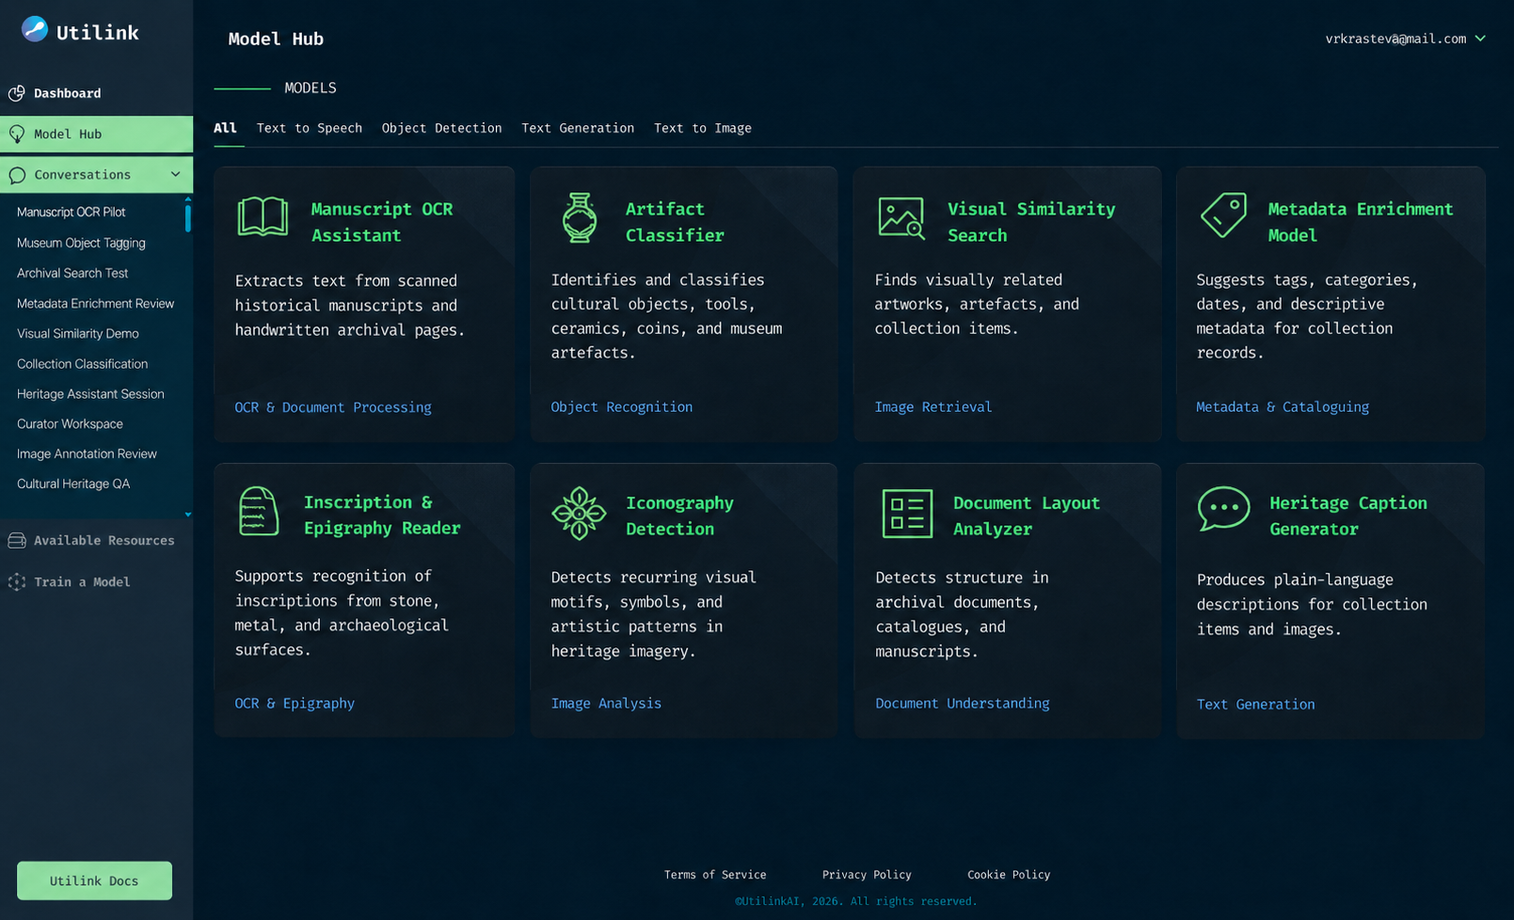
Notes:
A practical interface for accessing, testing and applying AI models without requiring technical expertise.

Slide 19
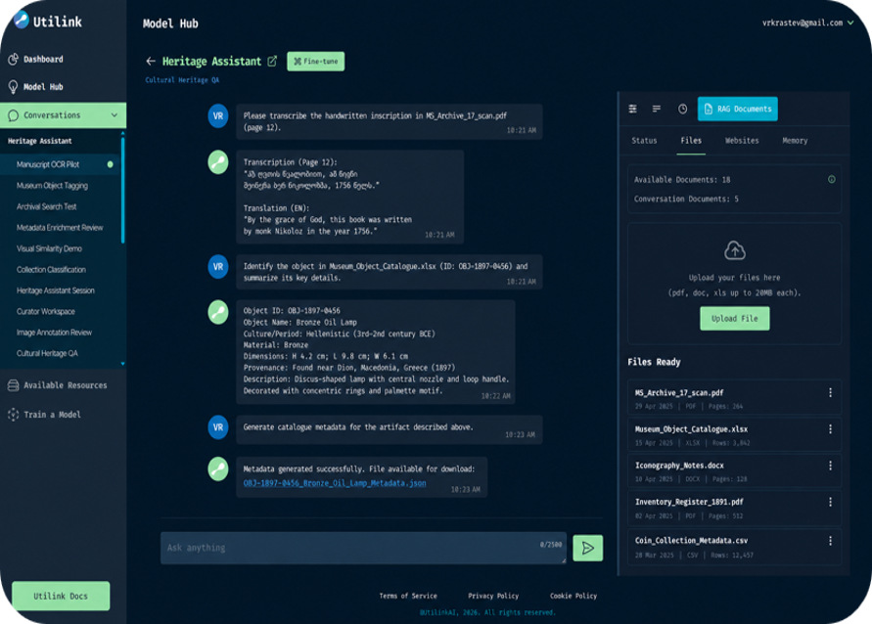
Mock up of the Model Hub and Model Inference
Notes:
A practical interface for accessing, testing and applying AI models without requiring technical expertise.

Slide 20
Thanks to the team of Utilink Ltd. –
Viktor Krastev, Denis Marinov, Yasen Andreev
Thank you for the attention!
Ventsi and Krassi

