Slide 1

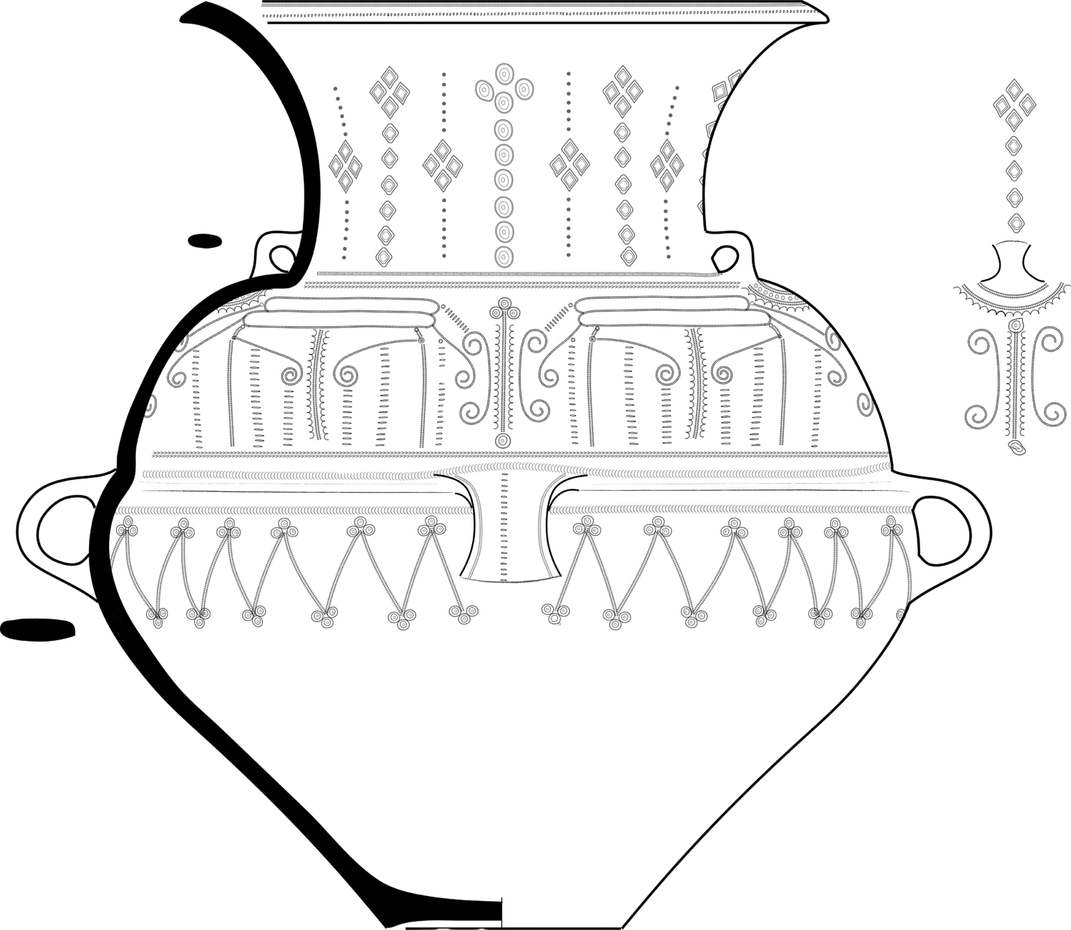

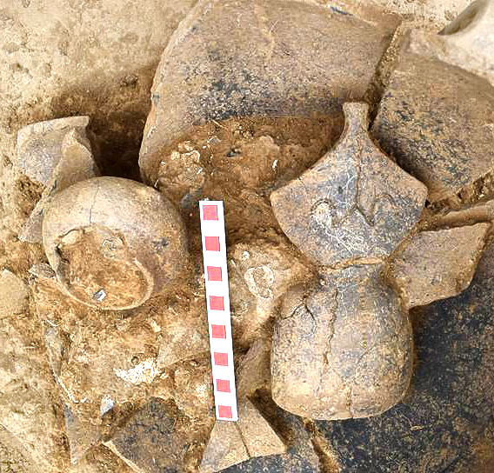






DIGITAL DOCUMENTATION
AND RECONSTRUCTION
OF A LATE BRONZE AGE URN BURIAL
FROM THE NECROPOLIS NEAR BALEY, NORTH-WEST BULGARIA
Miglena Raykovska, Miryana Raykovska, Nikolay Petkov, Martin Tsvetkov, Rositsa Manova, Tanya Hristova,
Georgi Ivanov, Svetlana Trifonova, Ivan Georgiev,
Stefan Alexandrov
Institute of Information and Communication Technologies, BAS
Institute of Mathematics and Informatics, BAS
National Archaeological Institute with Museum, BAS
Presented by: Martin Tsvetkov

Slide 2


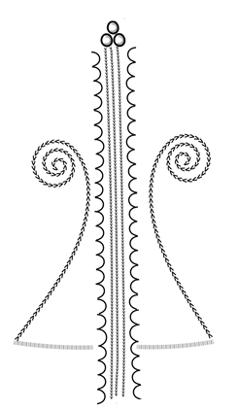
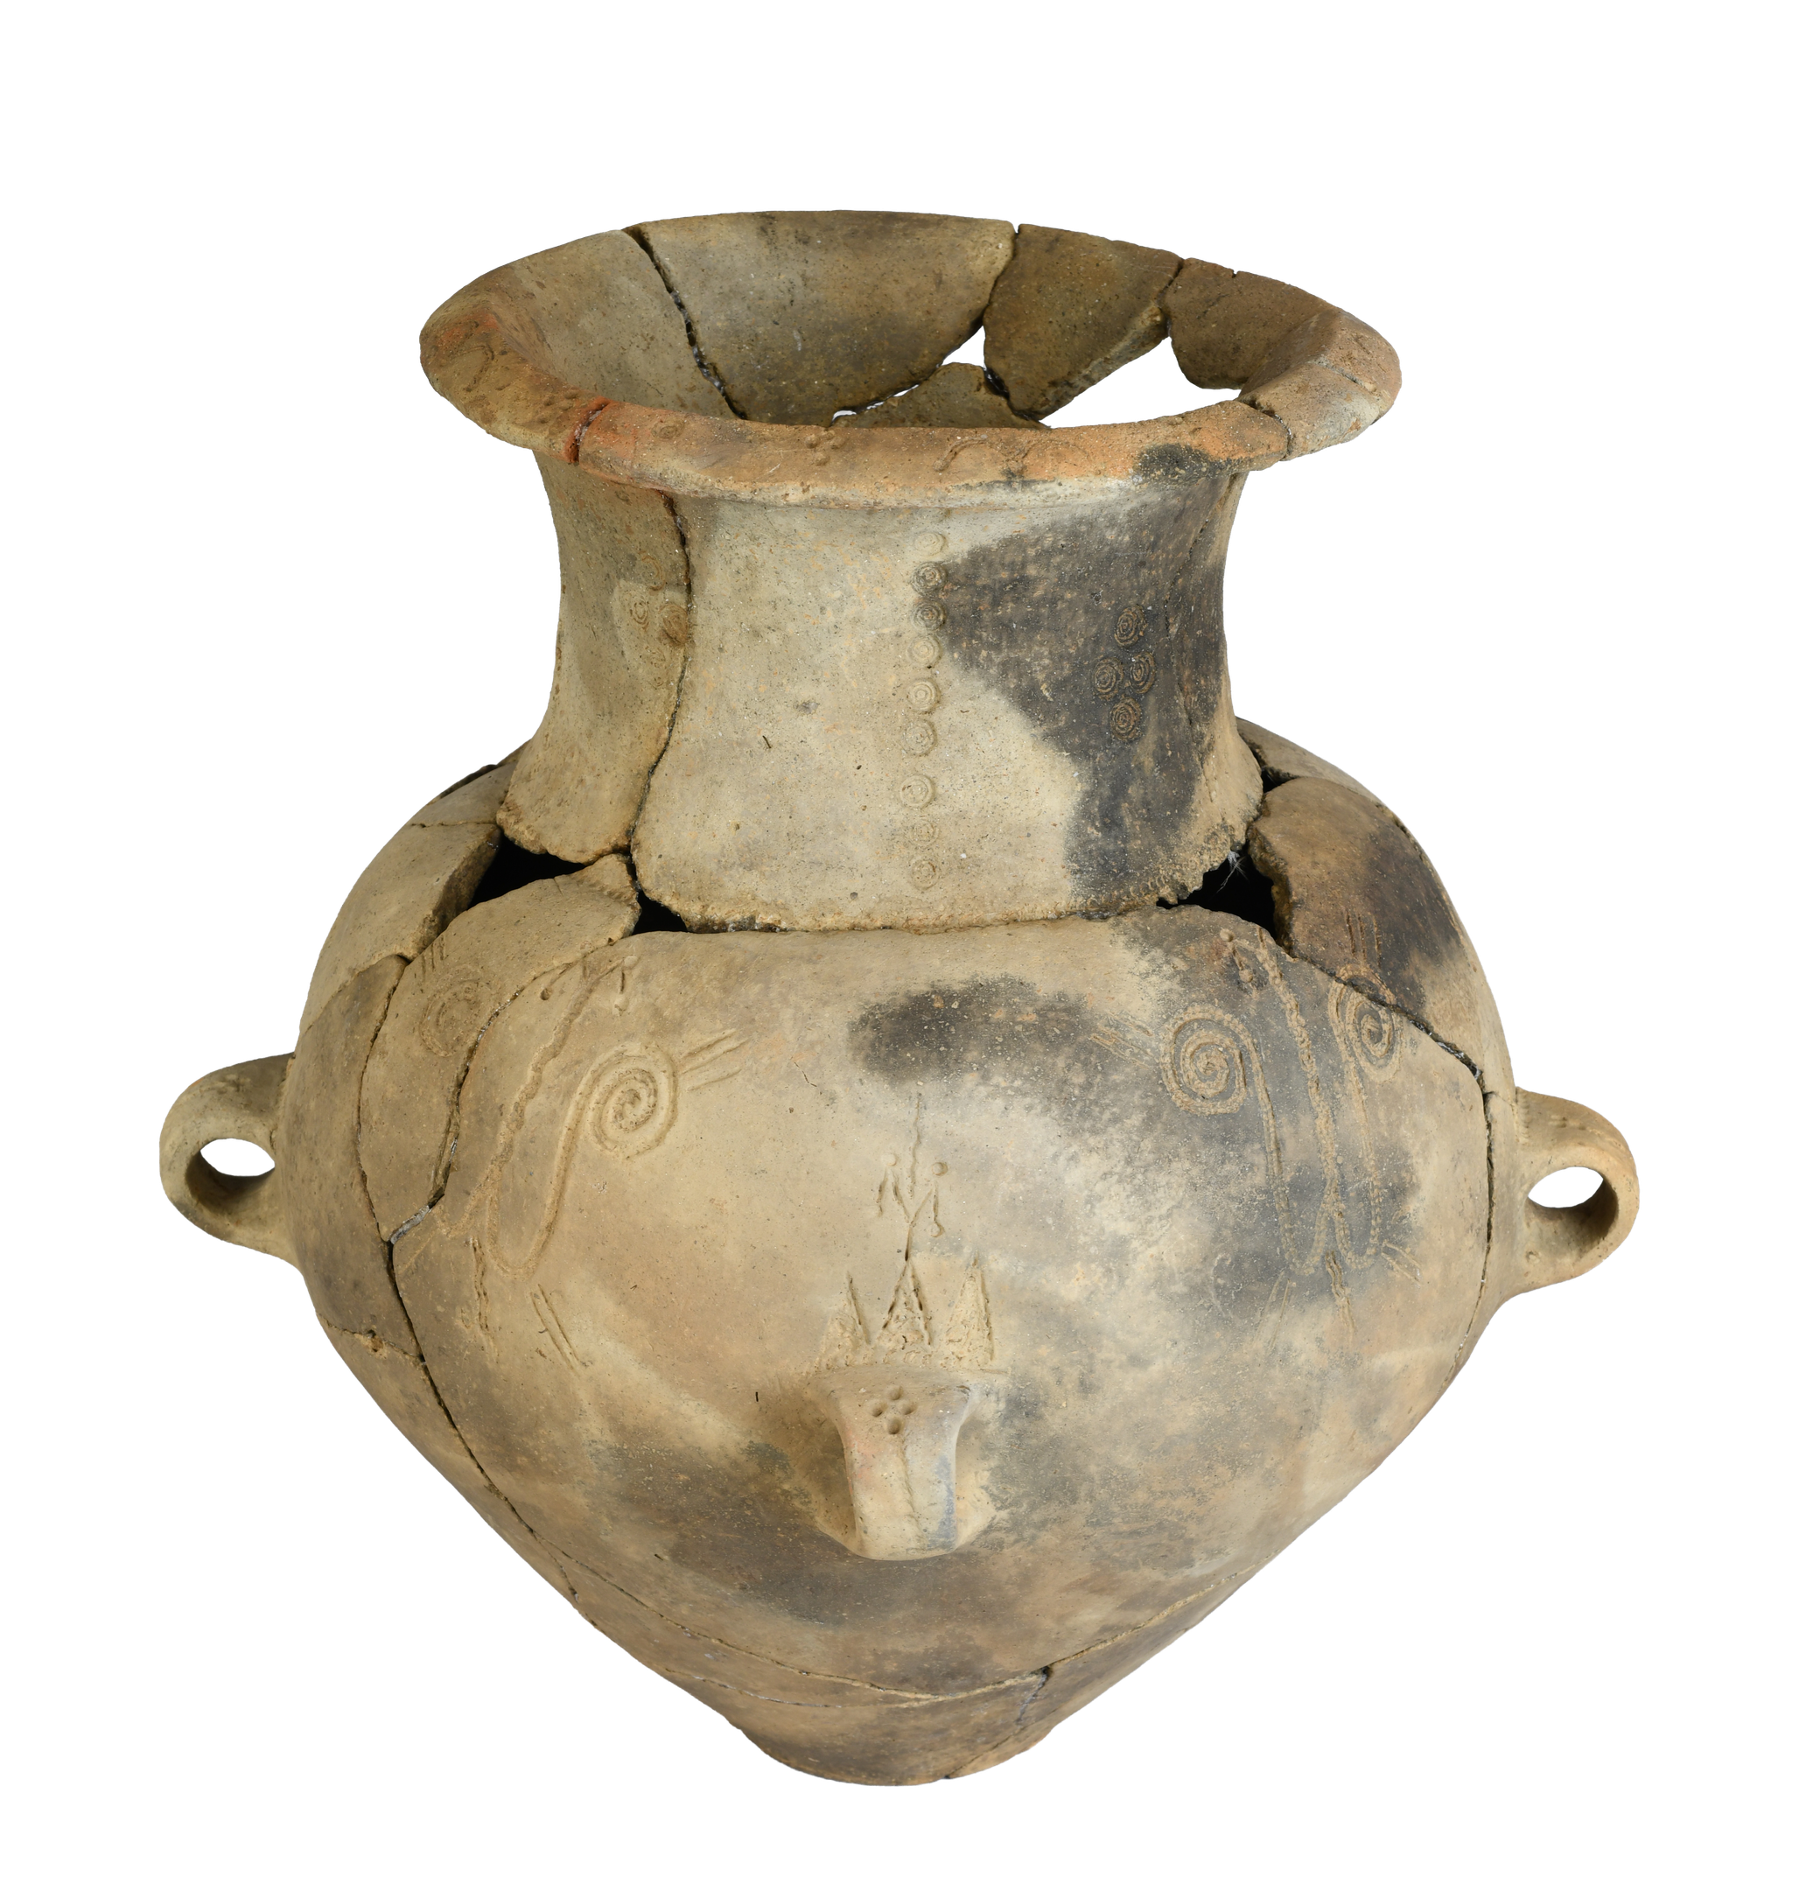



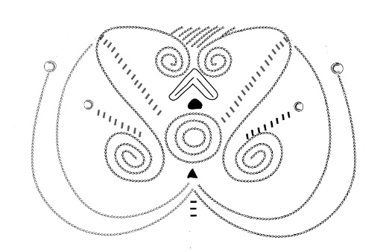


Colours of Prehistory
Bronze Age Anthropomorphic and Zoomorphic Figurines
About
the Project
The Colors of Prehistory. Anthropomorphic and Zoomorphic Sculptures from the Bronze Age
Bulgarian National Science Fund
КП-06-Н100/4
https://colorsofprehistory.bas.bg

Slide 3
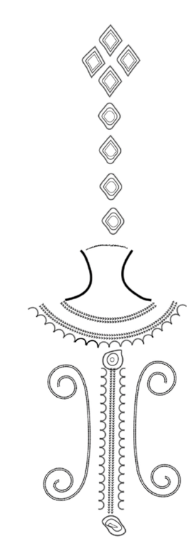
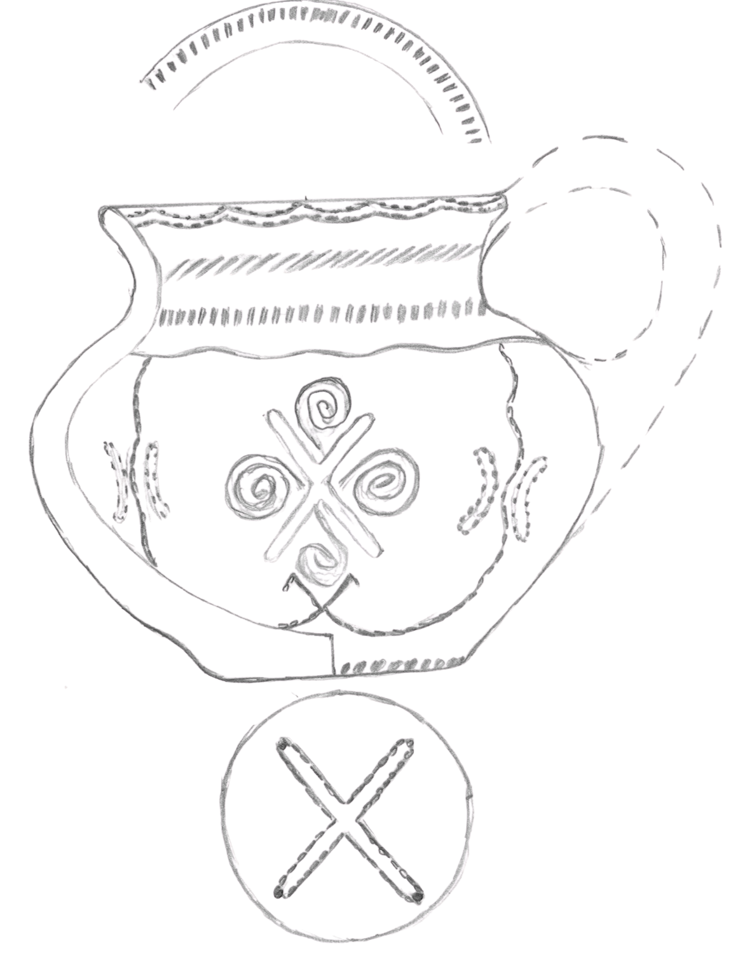


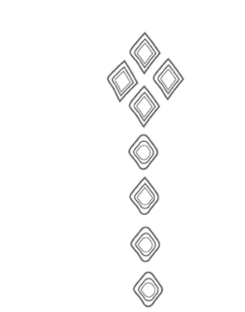
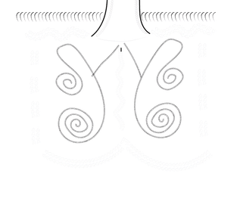
Background & Motivation
  Importance of preserving fragile archaeological contexts
  Challenges of documenting complex urn burials
  Value of non-destructive digital technologies

Slide 4




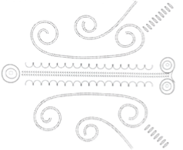
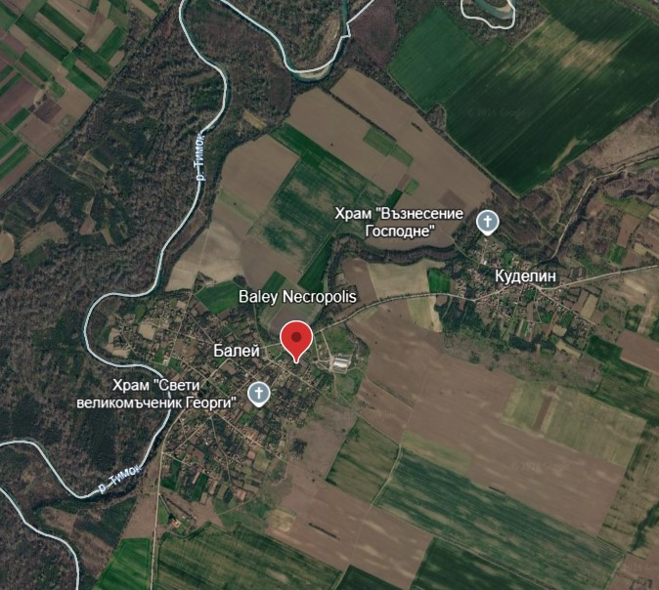

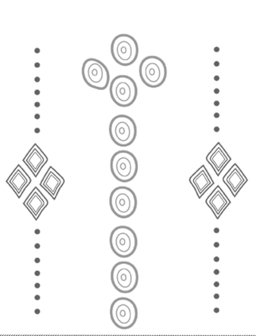

Archaeological Context
The Baley Necropolis
  Location: North-West Bulgaria
  Period: Late Bronze Age
  Reconstruction Focus: Feature 107, Triple grave
  Reconstruction material: Nine ceramic urns
  Radiocarbon determination date:
  1405–1220 cal BC (95.4%)

Slide 5



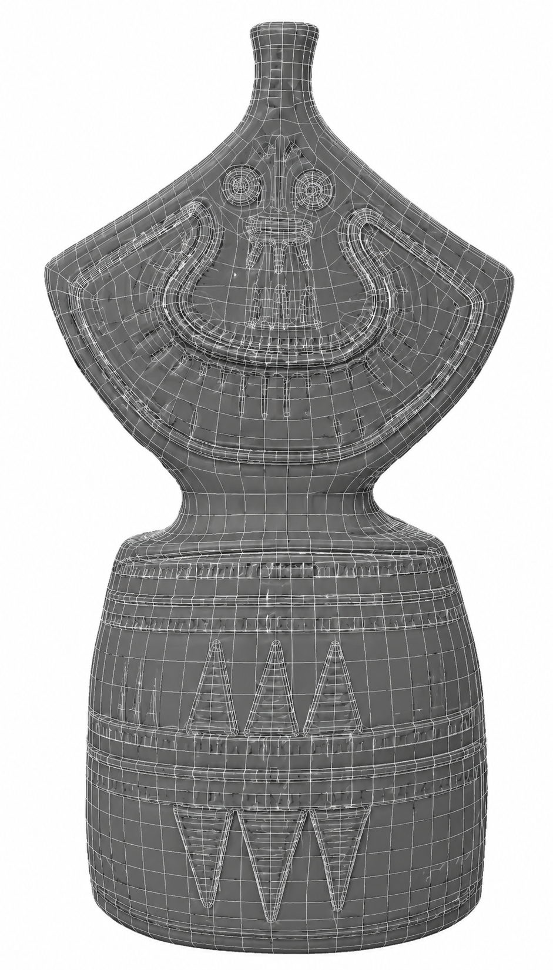



Digitally document all vessels
  Precise 3D digital records of each ceramic vessel to preserve their geometry, surface details, and condition
Examine internal structures
  Use micro-computed tomography to non-destructively investigate the vessels’ internal features and contents.
Research Objectives
Reconstruct the original burial arrangement
  Reposition the vessels digitally based on archaeological evidence to recreate their original spatial organization within the grave.
Produce an accurate digital heritage model
  Develop a scientifically reliable 3D reconstruction that supports archaeological analysis, conservation, education, and virtual heritage presentations.

Slide 6







Excavation
3D Acquisition
Registration & Integration
Visualization
Documentation
Data Processing
Digital Reconstruction
Virtual Presentation
Digital Documentation and Reconstruction Workflow
Workflow
An integrated workflow combines archaeological documentation with micro-CT, laser scanning, and photogrammetry to capture the burial vessels. The datasets are merged to create an accurate digital reconstruction of the original funerary context.

Slide 7

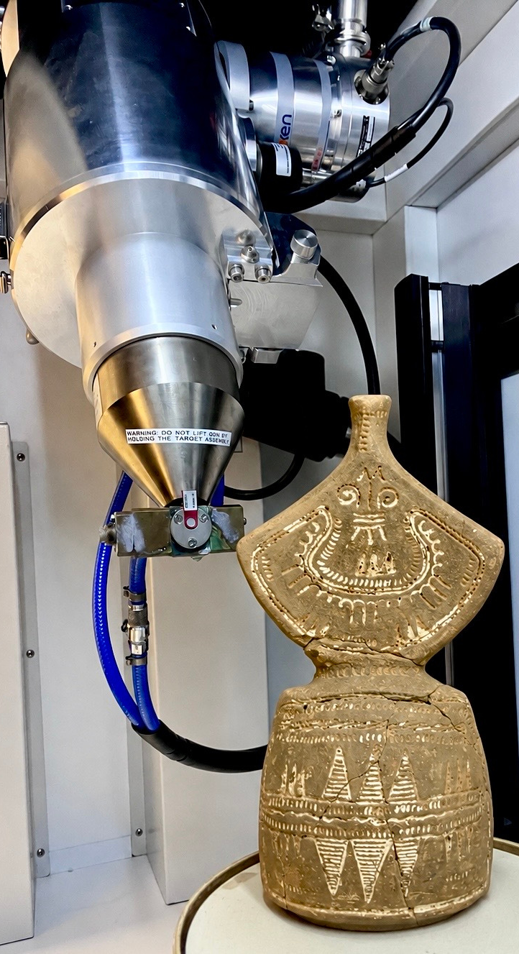


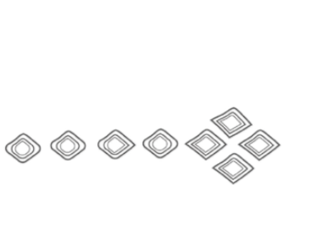
3D Documentation Methods
Micro-CT
Laser Scanning
Photogrammetry
  Internal structure
  Vessel contents
  Non-destructive imaging
  Accurate geometry
  High precision
  Texture
  Surface color
  Cost-effective

Slide 8

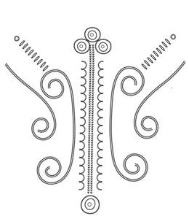
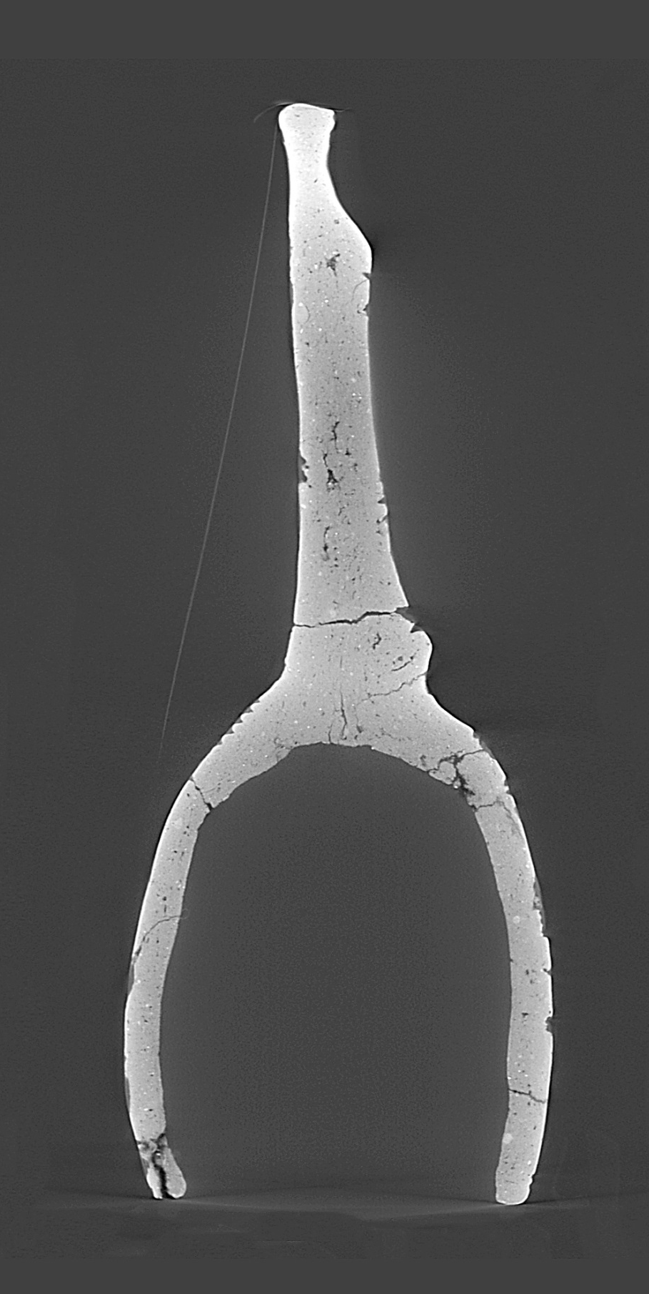
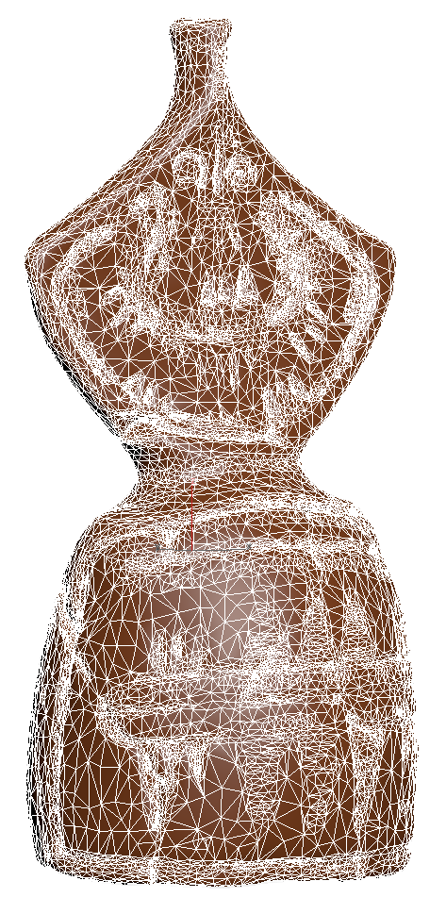

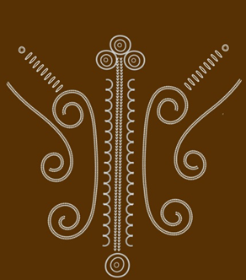

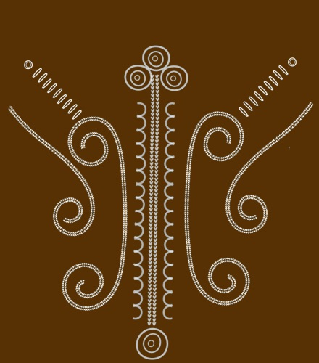
Micro-CT
Non destructive X-ray imaging
Resolution: under 100 microns
Provides both external geometry and internal structure geometry.
Produce a volumetric dataset composed of voxels
Enables segmentation, porosity analysis and defect detection

Slide 9
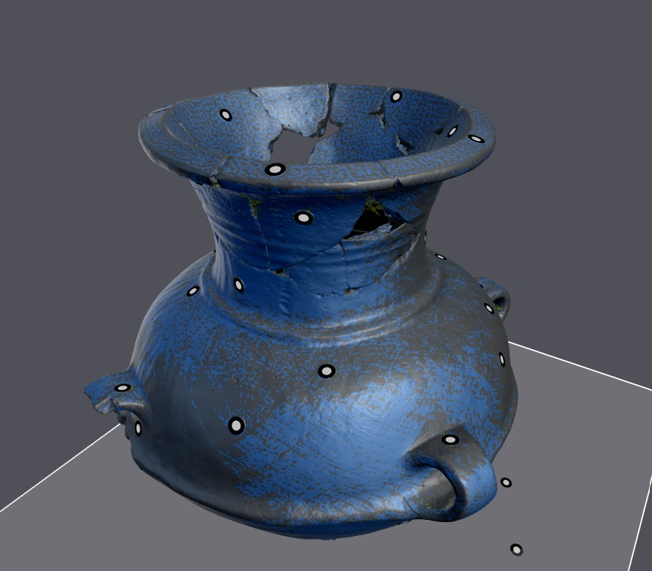

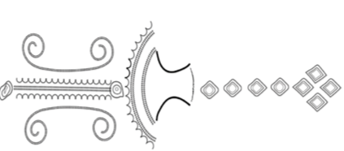
Laser Scanning
Optical measurement technique
Captures accurate external surface geometry. Resolution: 100-200 microns
Produce point clouds and polygonal meshes
Suitable for larger objects where internal imaging is not required

Slide 10

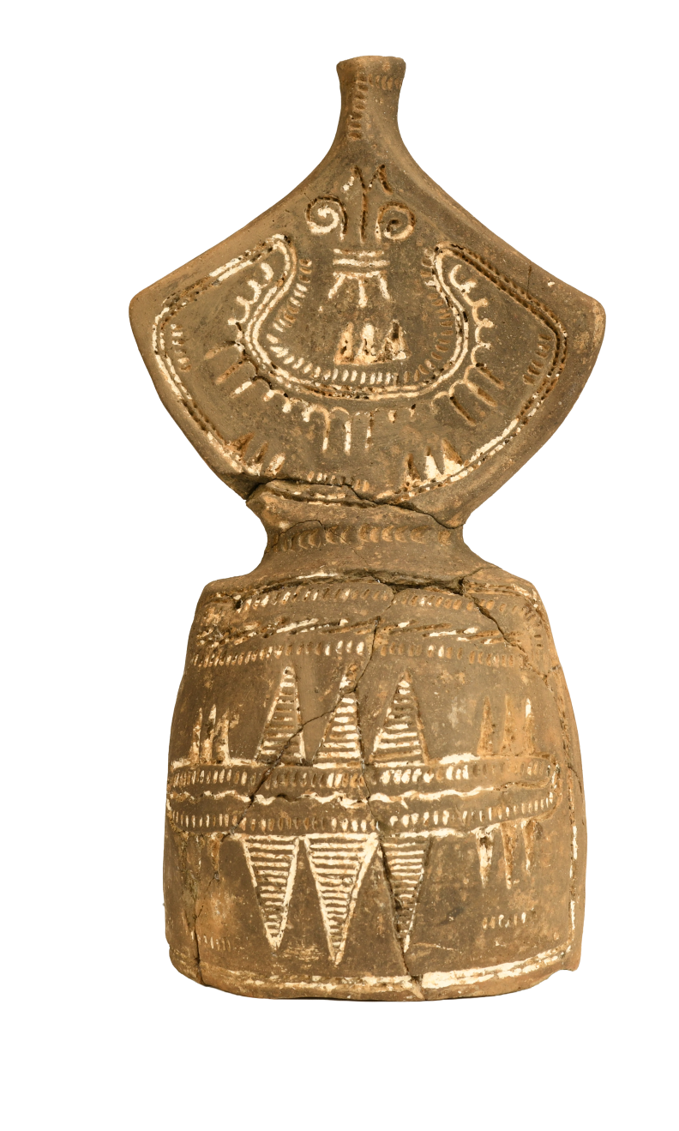
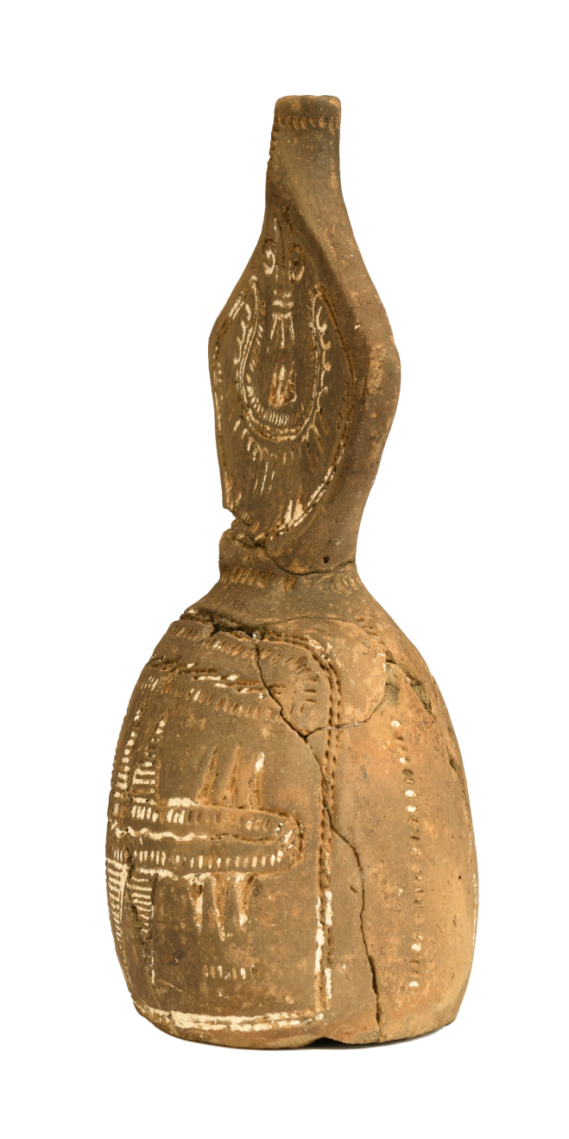
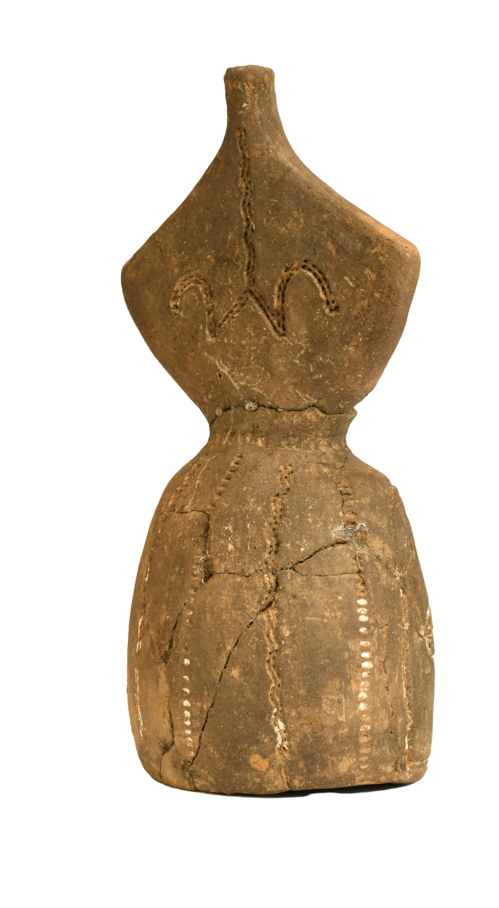
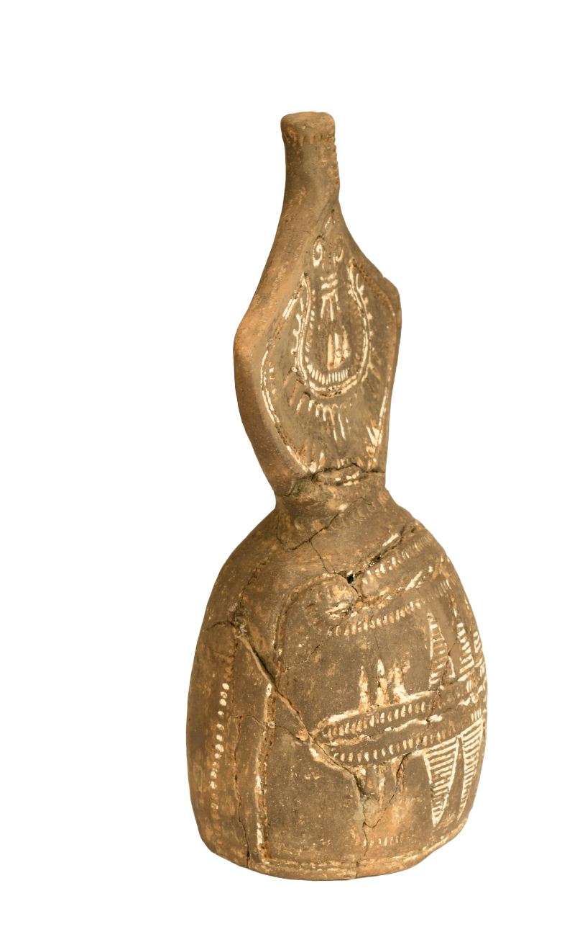


Photogrammetry
Image based 3D documentation
Uses overlapping photographs form multiple angles
Generates realistic colour and surface texture

Slide 11



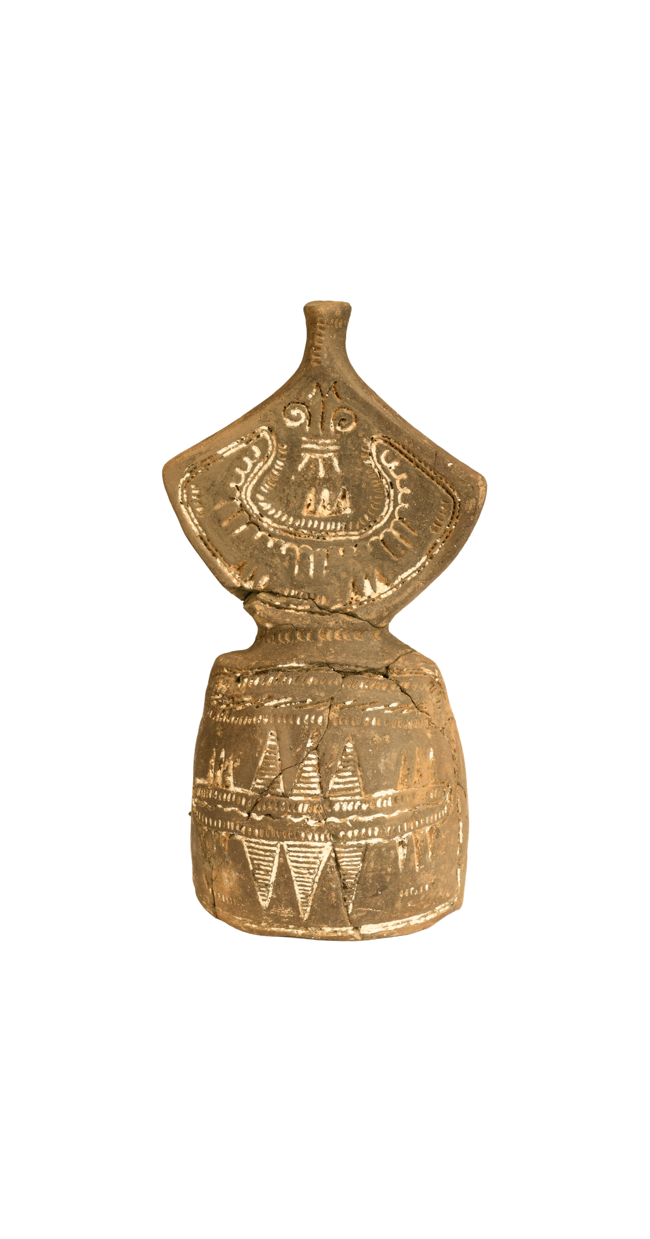
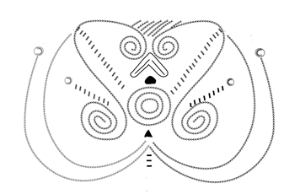
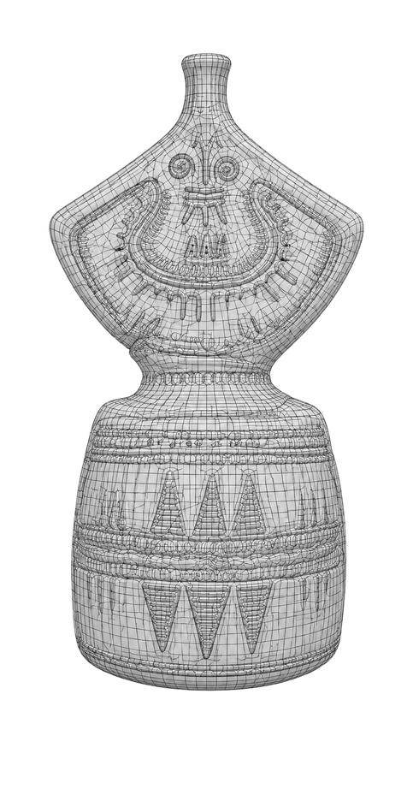
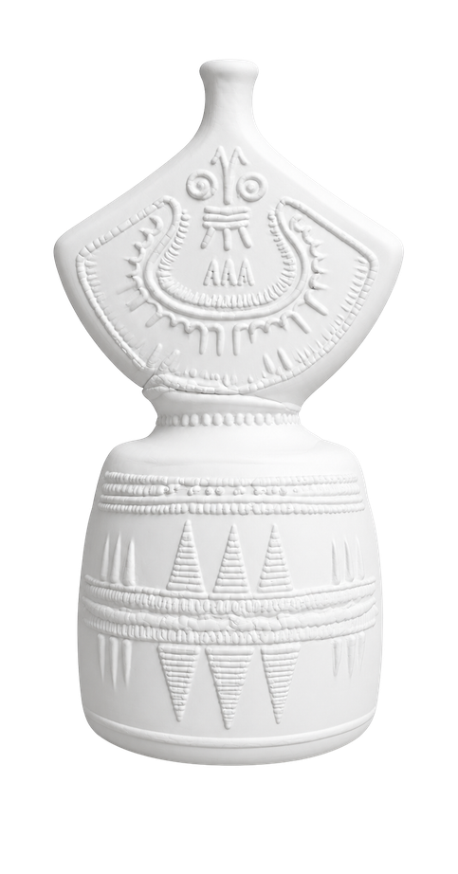

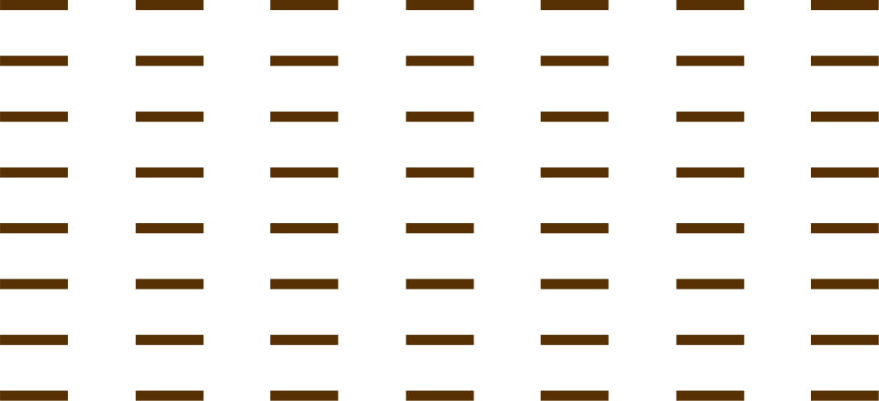

The 3D datasets from micro-CT, laser scanning, and photogrammetry were aligned and integrated into unified digital models. This process combines accurate geometry, detailed surface textures, and internal structural information to create comprehensive representations of the burial vessels.
Data Integration
Documentation & Registration
Alignment &
Mesh generation
Texture Mapping
Visualization

Slide 12
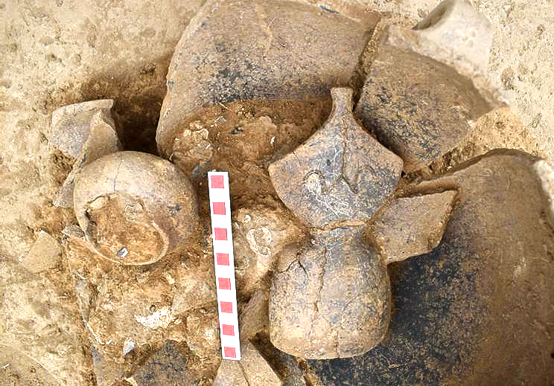



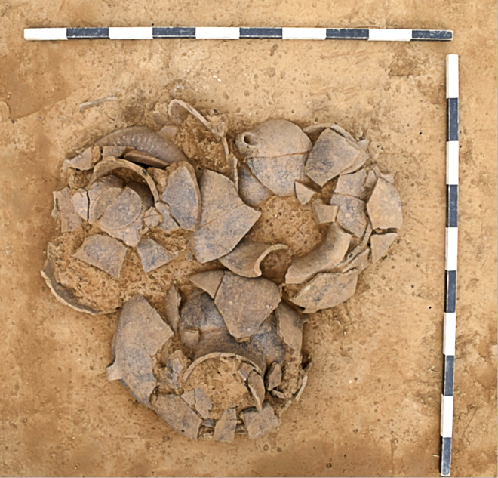



The in situ positions of the vessels
Digital Reconstruction of the Burial
The original funerary context was digitally reconstructed by repositioning the nine ceramic vessels according to archaeological excavation records and spatial analysis. This reconstruction recreates the original arrangement of the triple burial, providing a scientifically accurate visualization that supports the interpretation of Late Bronze Age funerary practices.

Slide 13
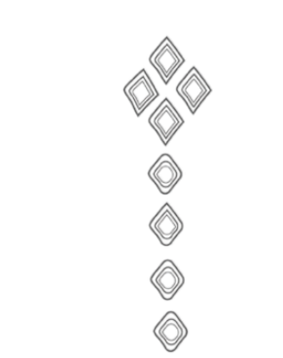
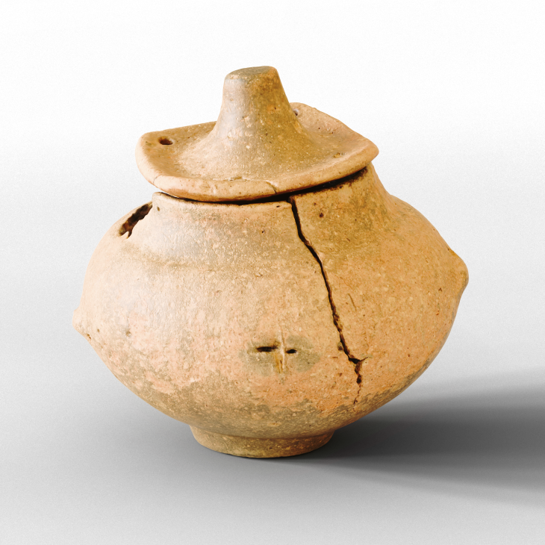
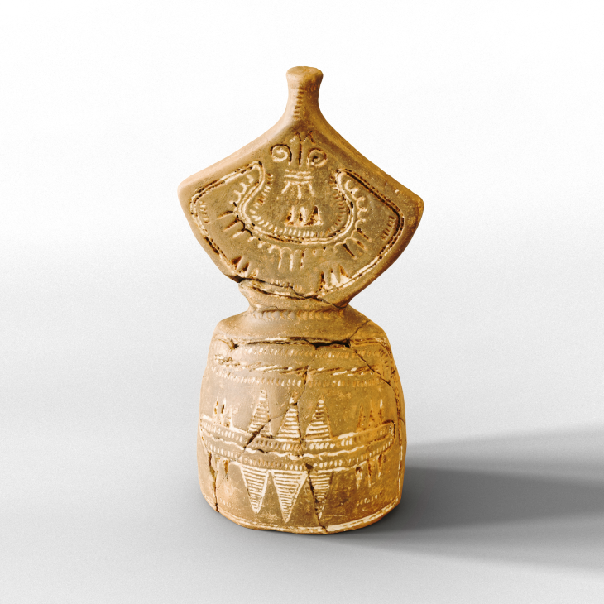
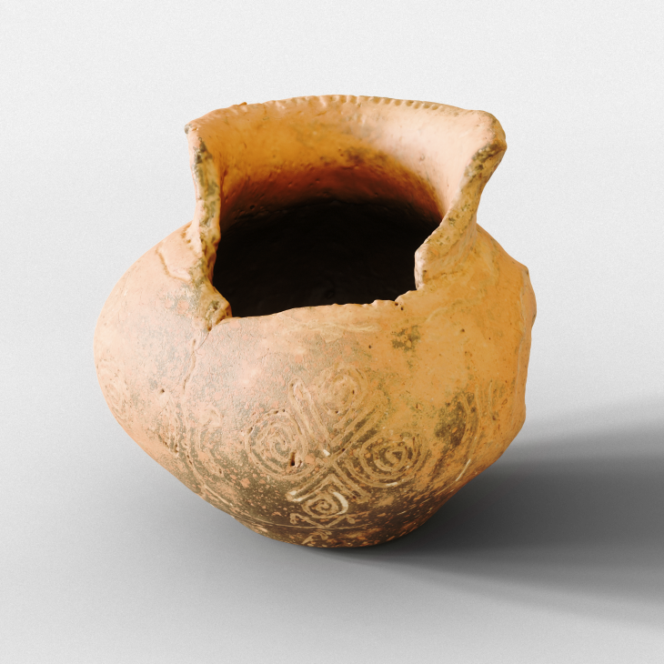
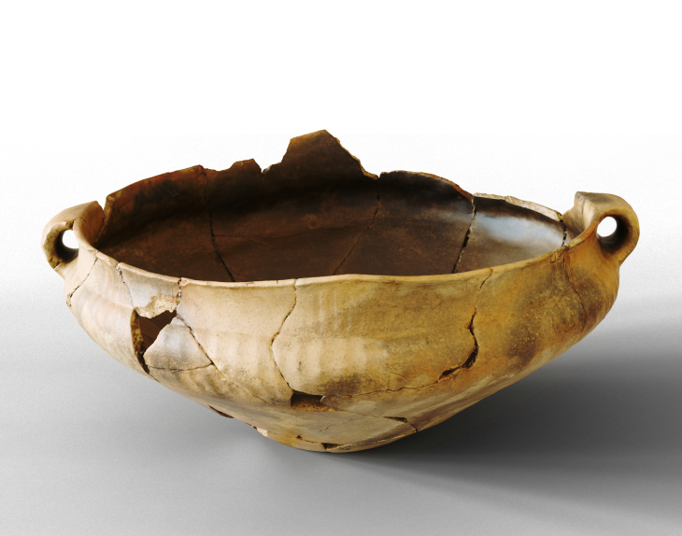
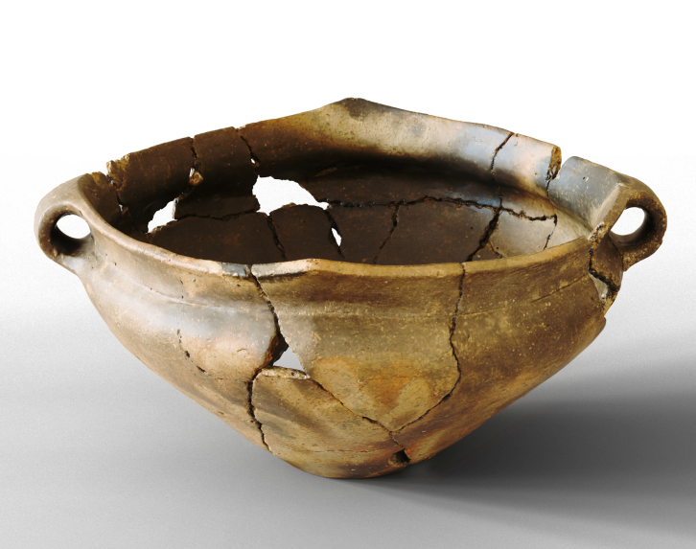
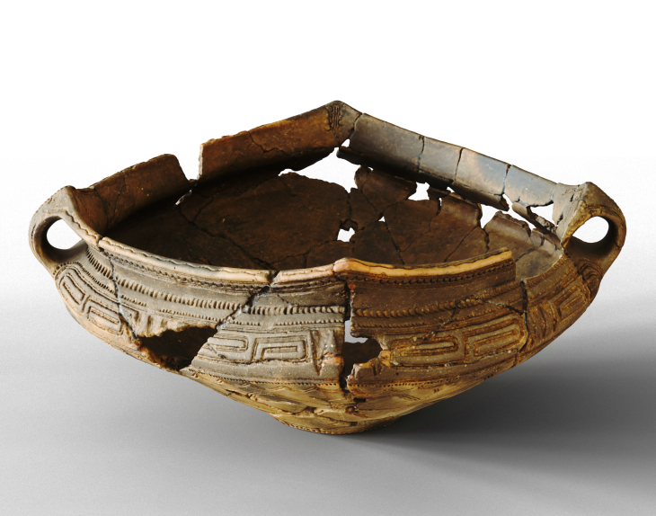

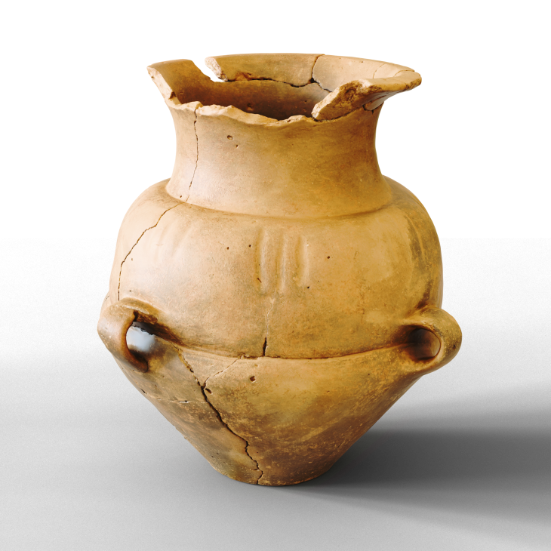
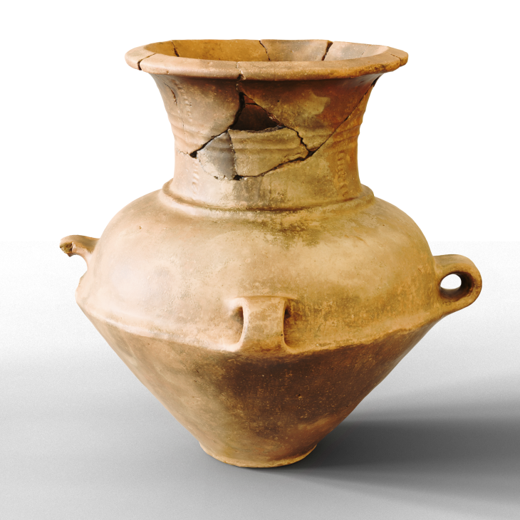
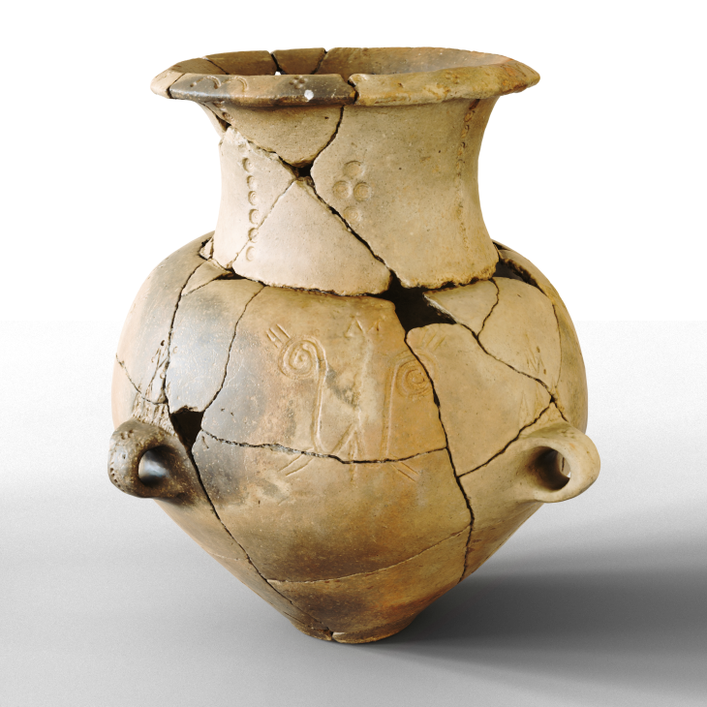

RESULTS
Scan the QR code to see the virtual collection of the vessels
https://3dlab.iict.bas.bg/Projects/Colors_of_prehistory/
снимки на всички съдове отдолу с текст с инвентарните им номера и описание на съда

Slide 14

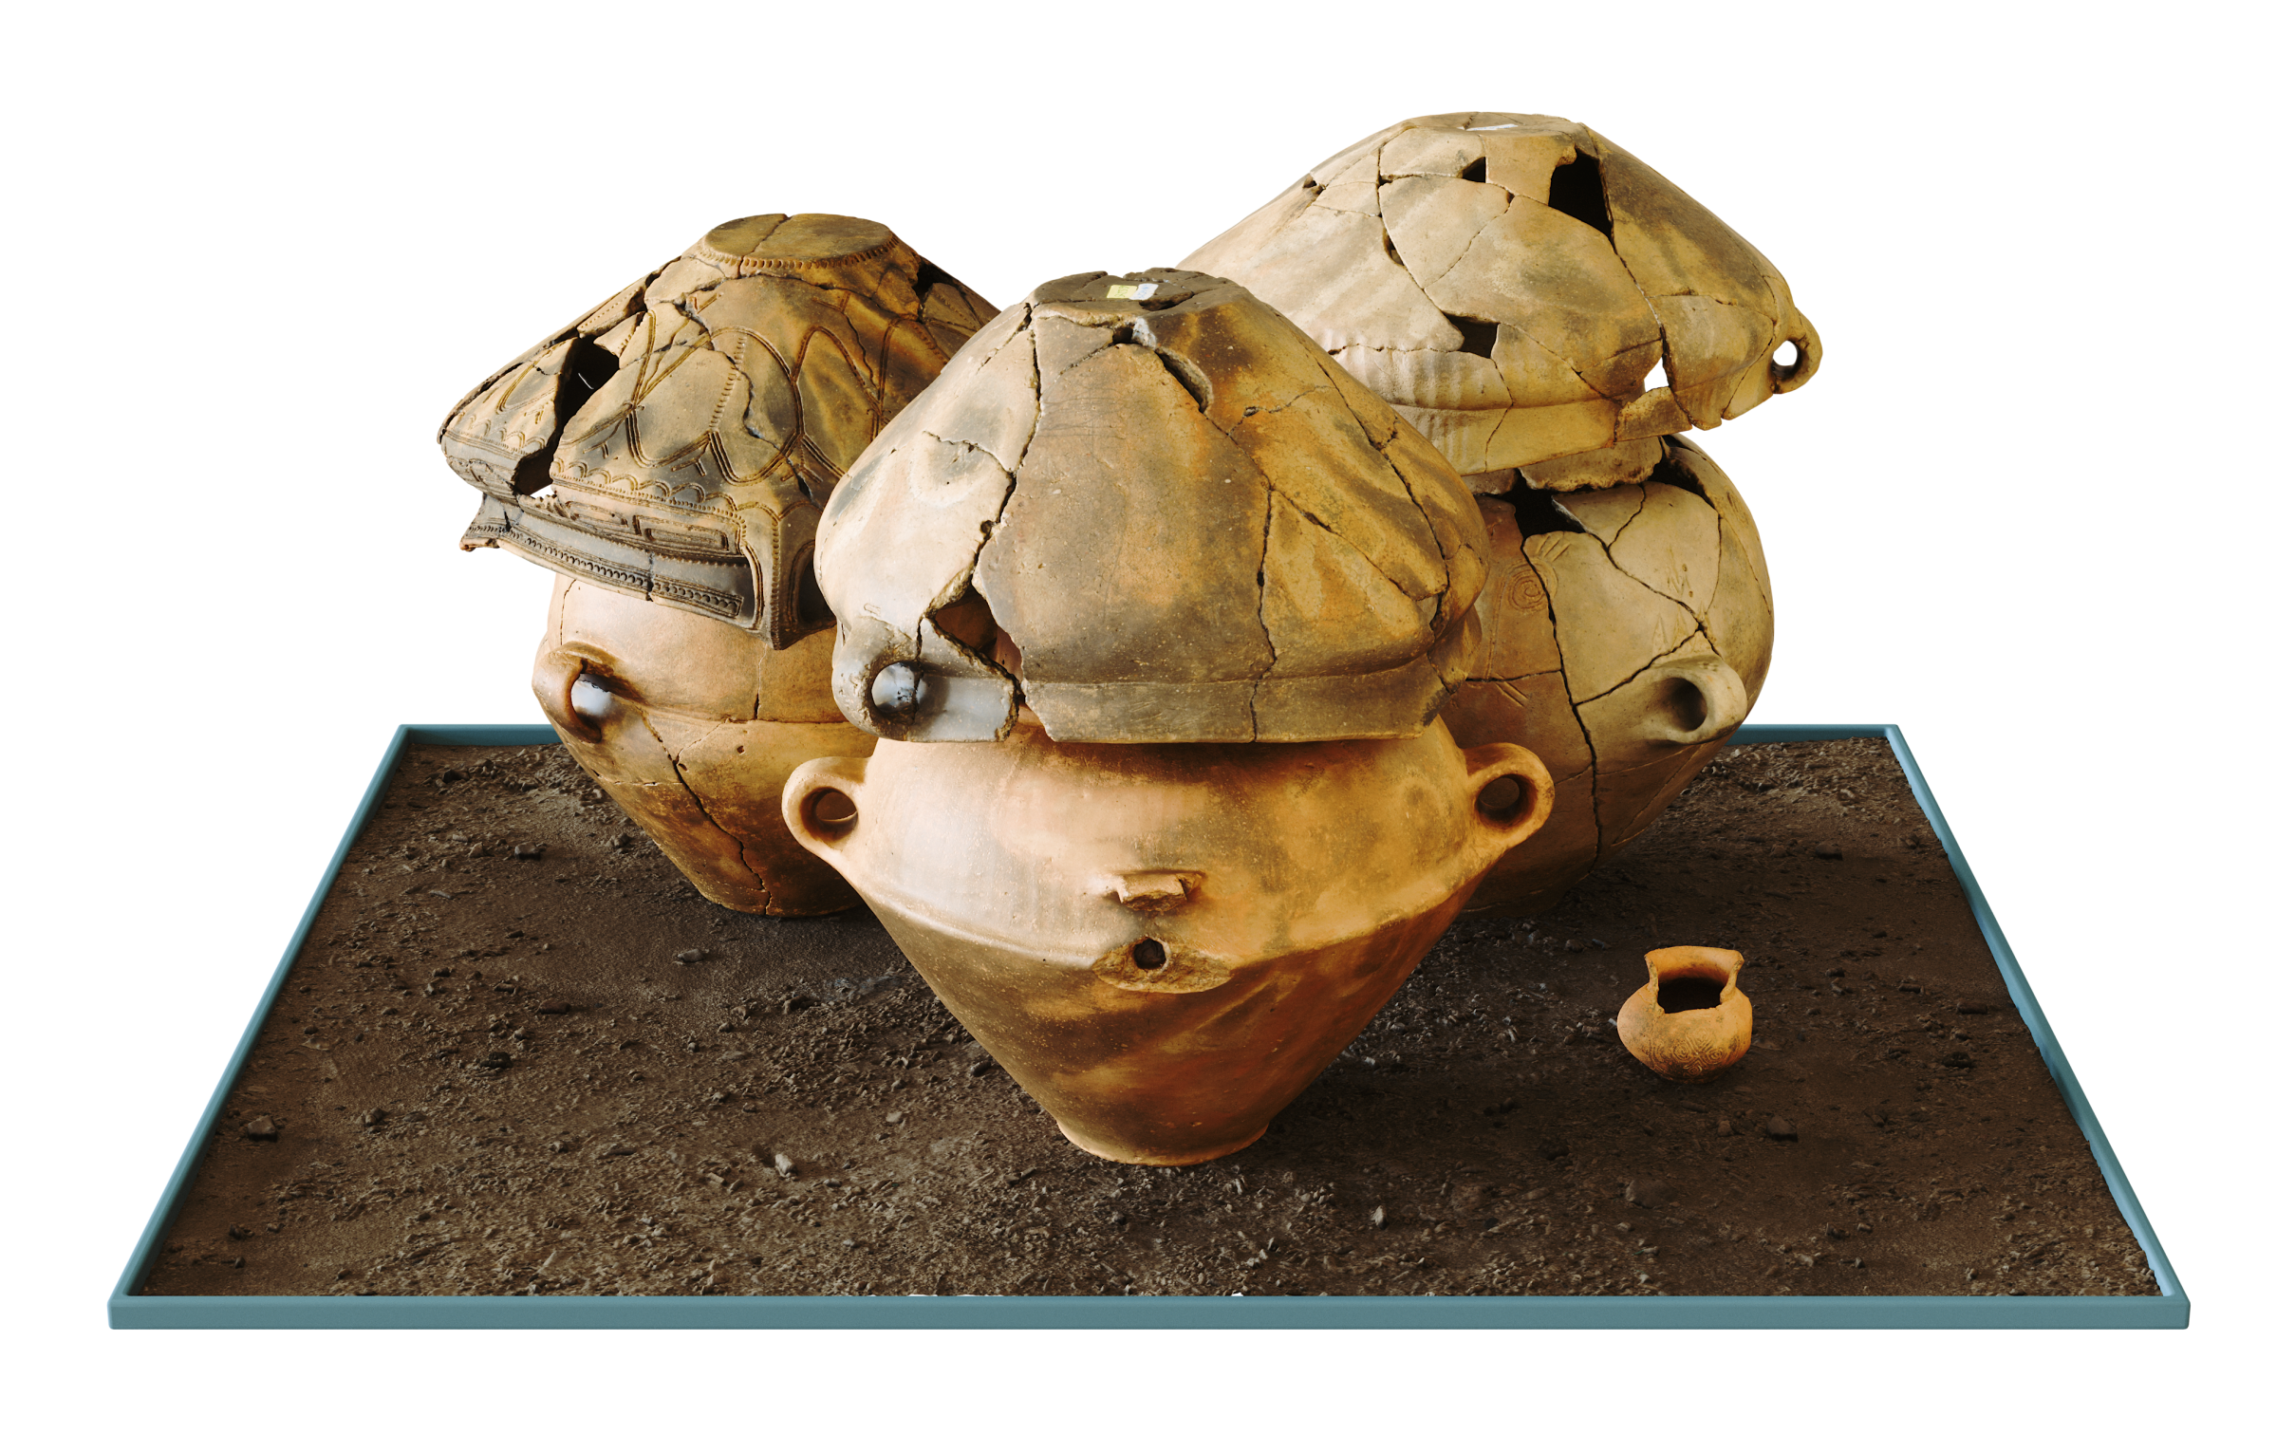


RESULTS
RESULTS
  High-resolution digital models
  Internal vessel documentation of 3 of the vessels
  Accurate burial reconstruction
  Improved archaeological interpretation
  Permanent digital archive
Scan the QR code to see the virtual reconstruction of the burial
https://3dlab.iict.bas.bg/Projects/Colors_of_prehistory/

Slide 15
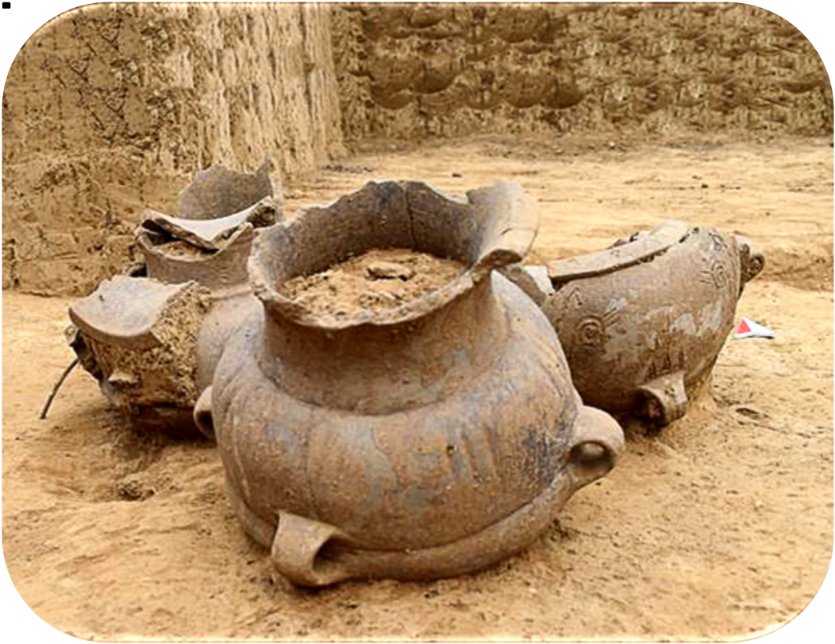

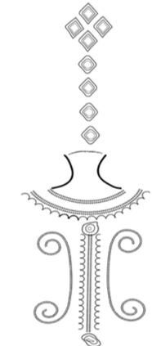
Heritage Visualization
& Public Engagement
The digital reconstruction makes the burial accessible beyond the excavation by enabling virtual exhibitions, educational resources, and immersive heritage experiences. These scientifically accurate 3D models support both archaeological research and public engagement while contributing to the long-term preservation of cultural heritage.
The integration of micro-CT, laser scanning, and photogrammetry enabled the creation of accurate 3D models and the digital reconstruction of the original funerary context. This multidisciplinary approach enhances archaeological research, supports long-term digital preservation, and promotes the wider dissemination of cultural heritage through interactive visualization.

Slide 16


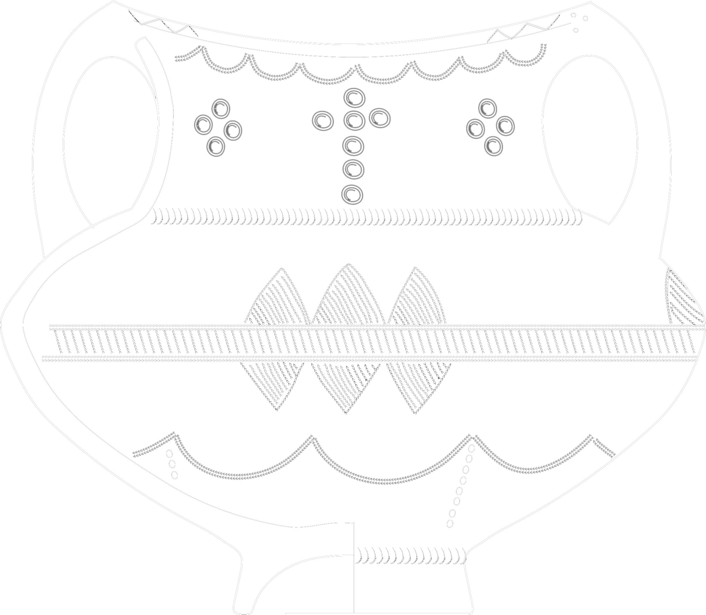
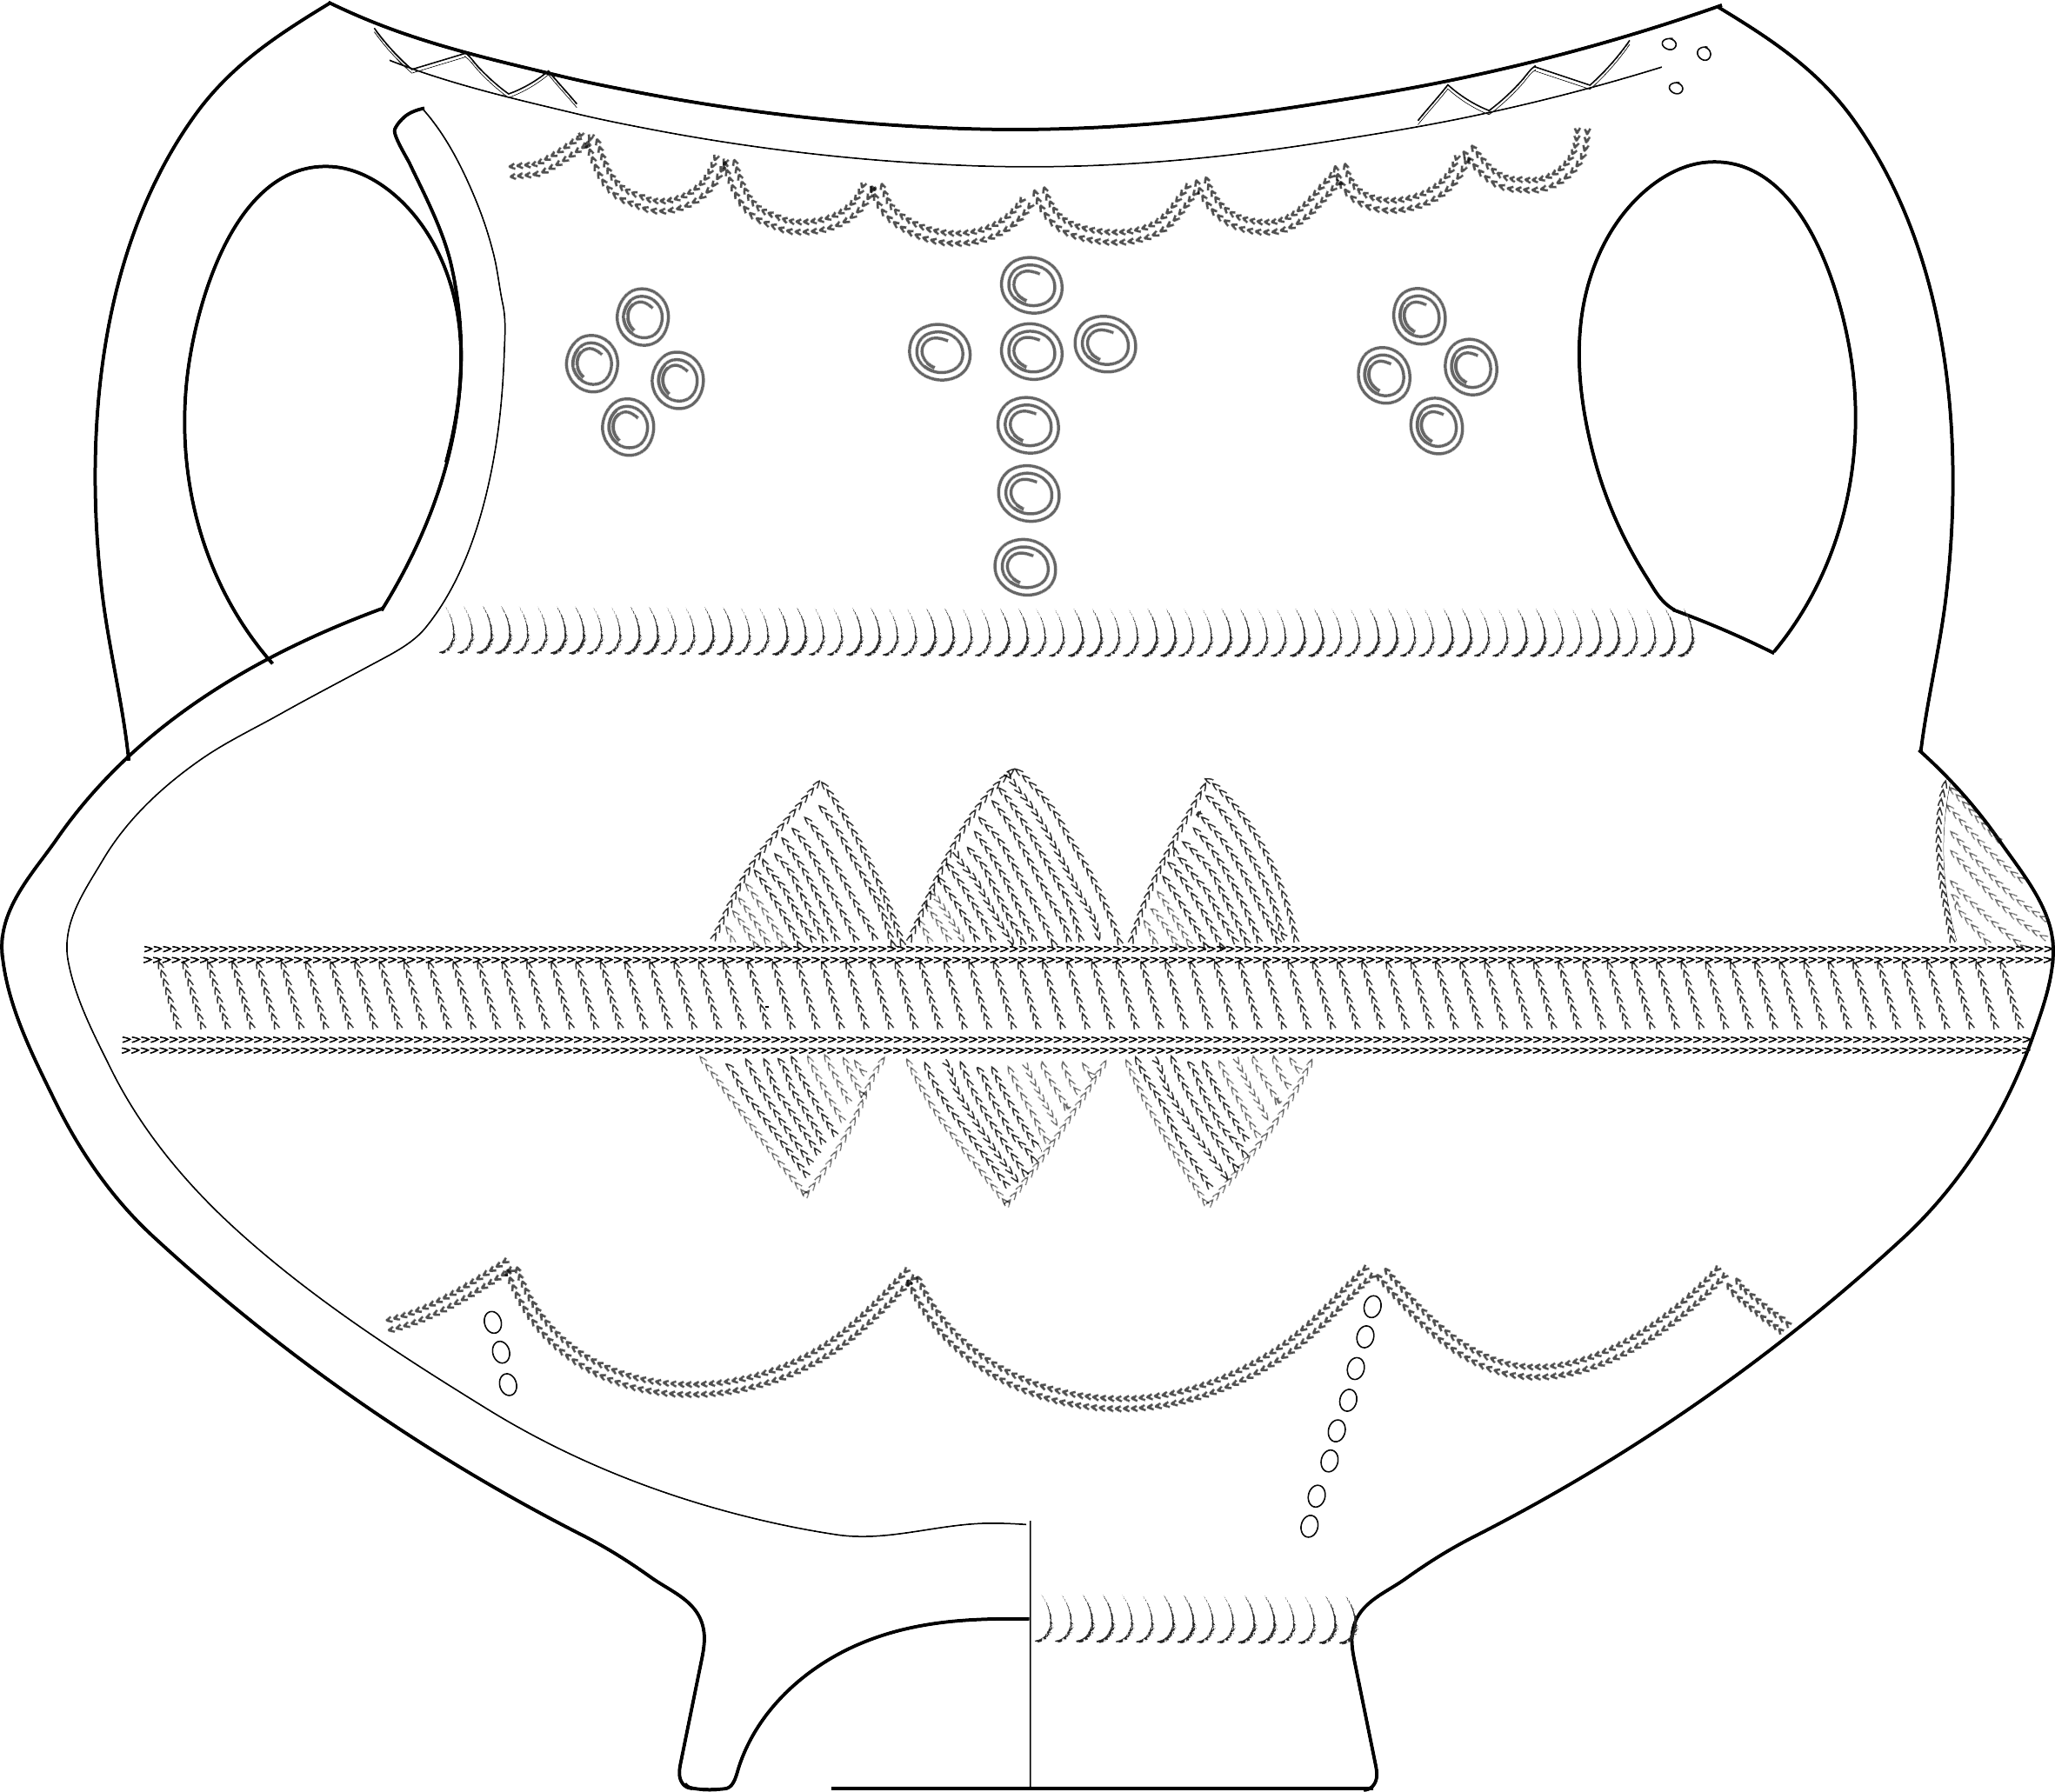





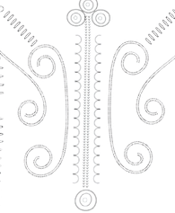
Thank you
office@3dlab.iict.bas.bg
m.tsvetkov@math.bas.bg
https://colorsofprehistory.bas.bg
https://3dlab.iict.bas.bg/Projects/Colors_of_prehistory/

