Slide 1


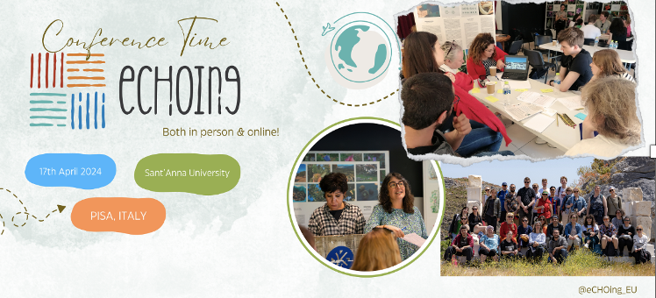

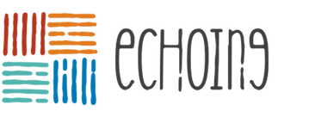






eCHOing Open InnovationMethodology and Lessons on Project Implementation for the Cultural Sector
Alexandra Angeletaki NTNU university
eCHOing CONFERENCE: An experience of collaboration between CHO and HEI for OI
17 April 2024 - Pisa (Italy)
Notes:
The “Recovery of cultural heritage through higher education driven open innovation-eCHOing” project aspires to contribute to the recovery of the higher education sector as a pillar of diversity, social Inclusion, democracy and social responsibility in modern societies, which has been affected by the COVID-19 pandemic. The overall aim of this project in the post-pandemic era is to help HEIs re-consider their academia-society relationship and become more agile in tackling the crisis of important sectors of socio-economic activity severely hit by the pandemic such as the cultural sector. HEIs can start to see the appeal of providing innovative forms of digitally enhanced knowledge building and circulation in the form of Open Innovation (OI).
There are ample opportunities for HEIs to renew and deepen their community engagement in response to the COVID-19 pandemic, including students’ social engagement and volunteering. Open Innovation (OI) is understood as a set of digitally enhanced participatory activities the main forms of which are: a) hacktivism (activism by means of hacking for a social purpose, such as hackathons/datathons, 24H sprints), b) maker movement, c) citizen science and d) crowd initiatives such as crowdfunding and crowdsourcing. The eCHOing project boosts the social dynamics of technology-enhanced participation in the form of OI to improve HE systems and make the cultural sector more agile and resilient.

Slide 2
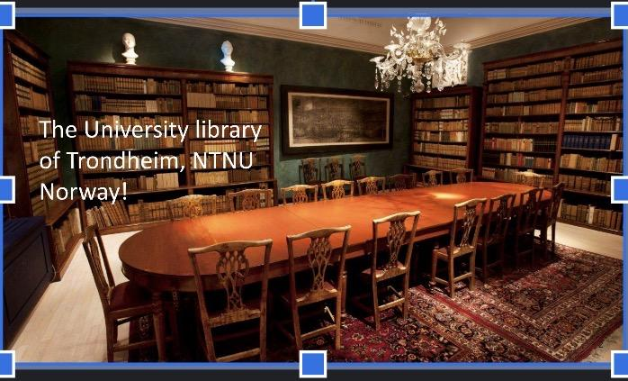
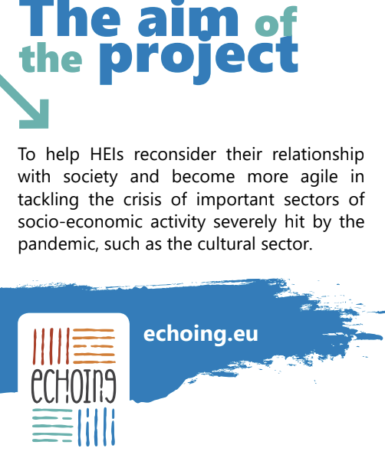
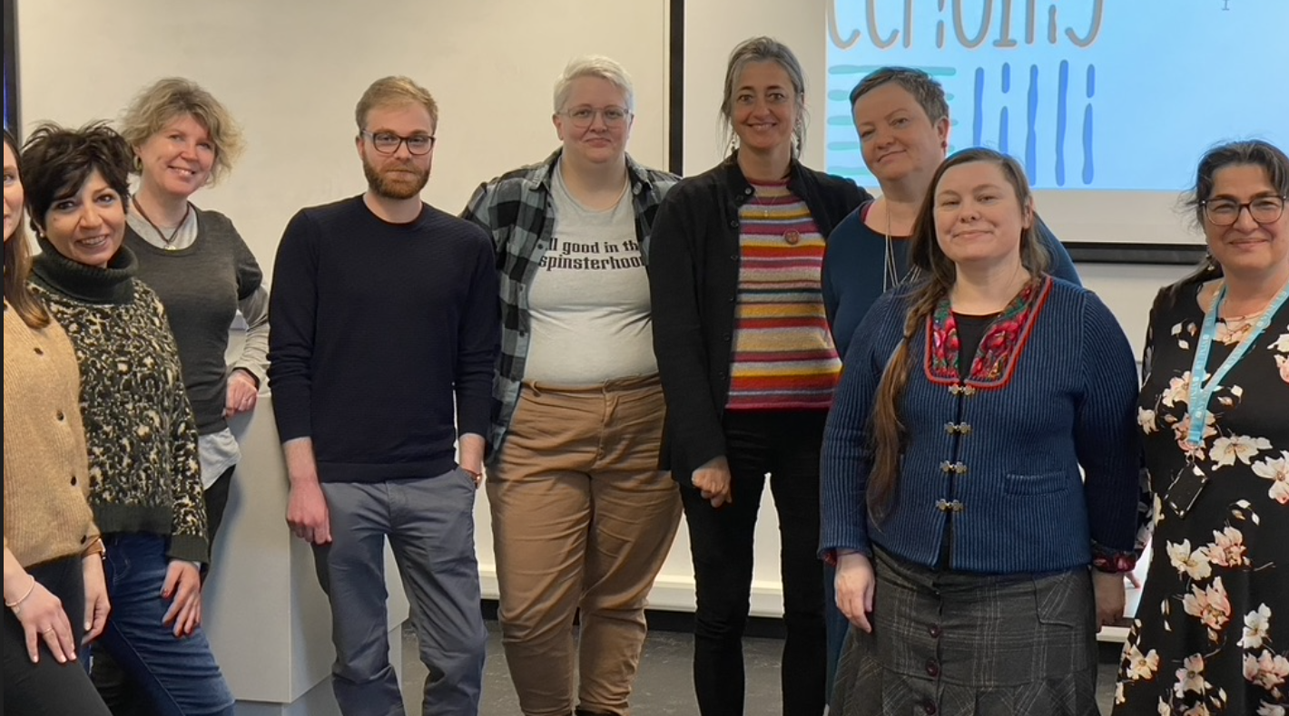
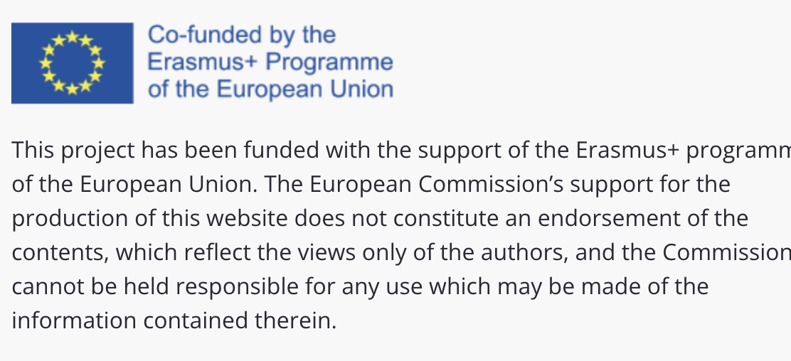
ERASMUS: KA 220 Innovation Partnerships
eCHOing CONFERENCE: An experience of collaboration between CHO and HEI for OI
17 April 2024 - Pisa (Italy
Notes:
the presentation will give an overview of what “eCHOing” is. An Erasmus + project that will try to identify the possibilities of collaborations between HEIs and CHOs through open innovation initiatives and project co-creation and establish a methodology for such collaborations based on real life problems in order to support CHOs through public engagement and OI, thus highlighting the significance of cultural heritage in our modern society.

Slide 3

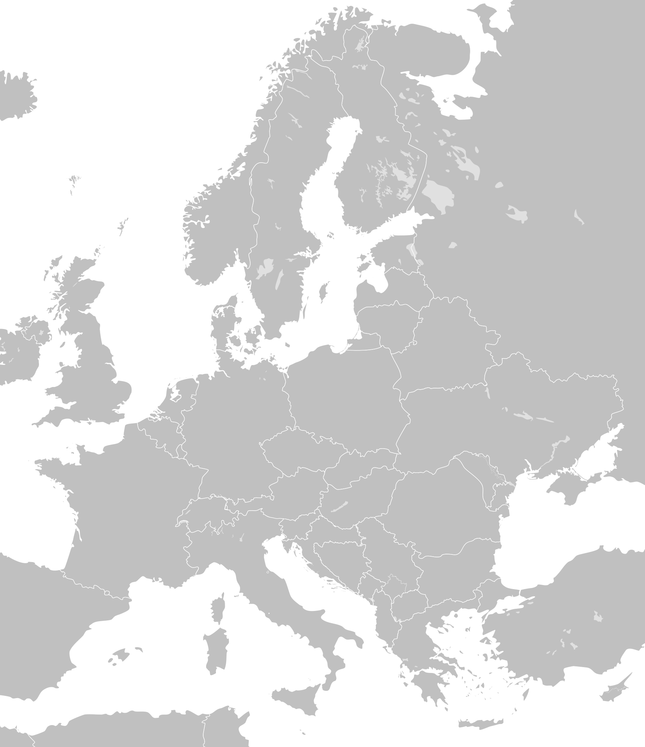

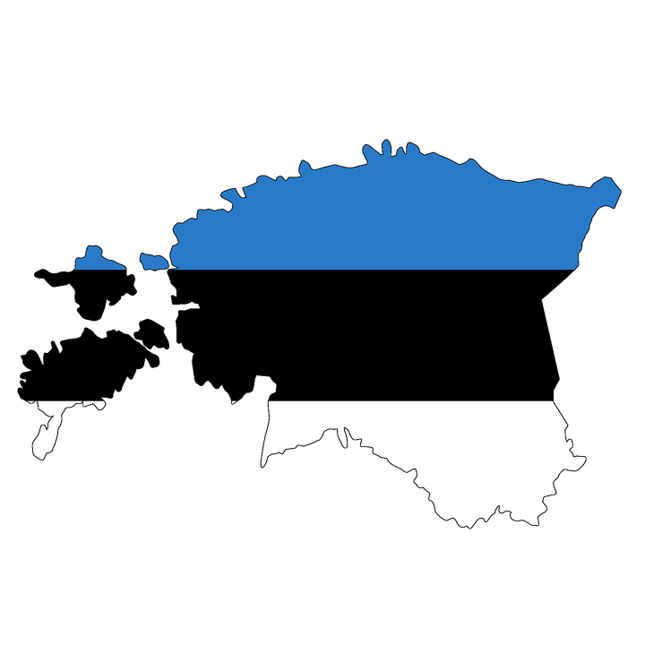
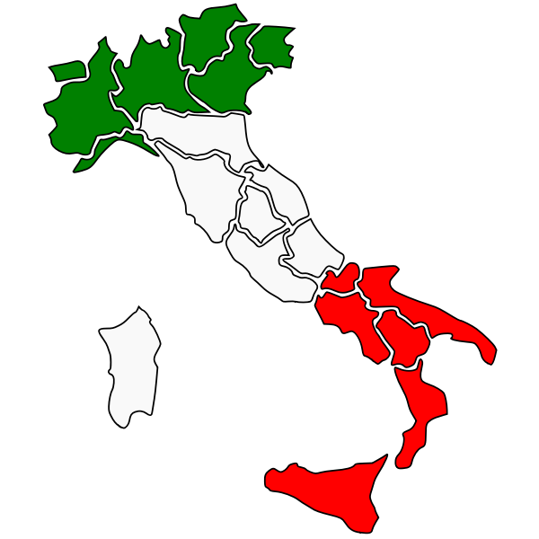

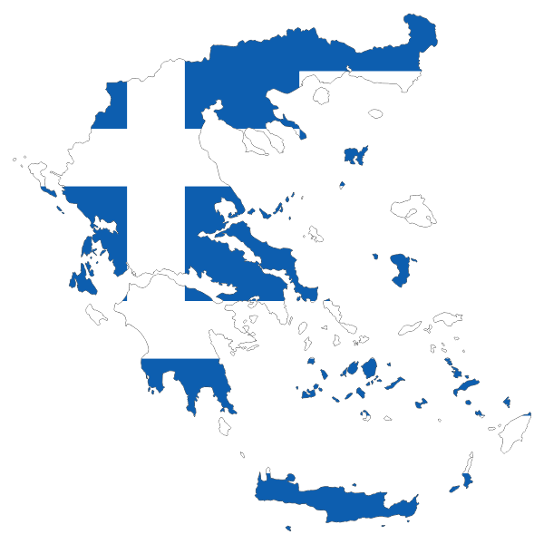
eCHOing-Partners
1
NTNU UB
2
University of Santa Anna Pisa Italy
3
Web2Learn, Thessaloniki Greece
4
Sofia University
5
Tartu University, Viljandi academy
6
Union of Women orgs in Cyclades
OSYGY, Greece
eCHOing CONFERENCE: An experience of collaboration between CHO and HEI for OI
17 April 2024 - Pisa (Italy
Notes:
Project Partners
4 HEIs, 1 business sector, and 1 partner from civil society, across 5 European countries. Those include: NTNU (Norway), Scuola Superiore Sant’Anna (Italy), Sofia University St. Kliment Ohridski (Bulgaria), University of Tartu (Estonia), OSYGY (Greece), and Web2Learn (Greece).

Slide 4
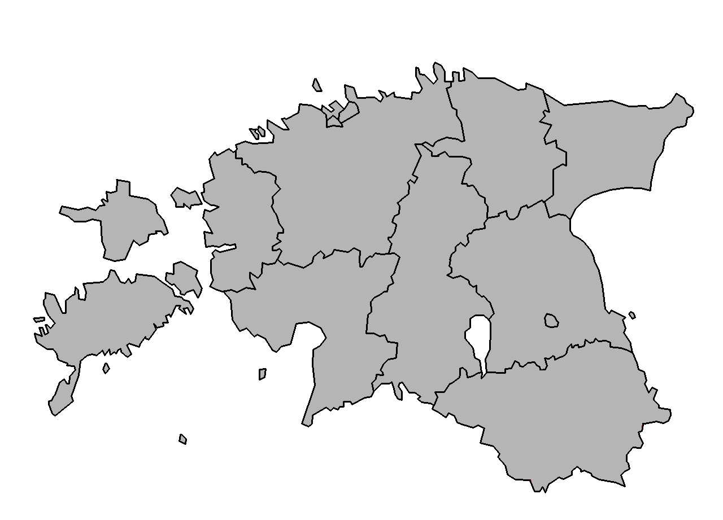
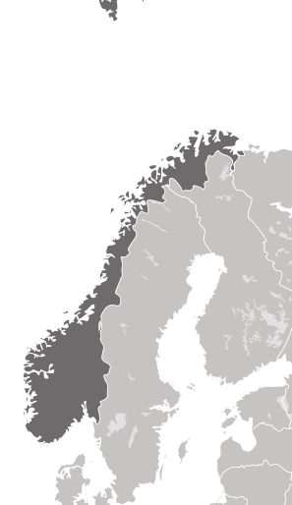


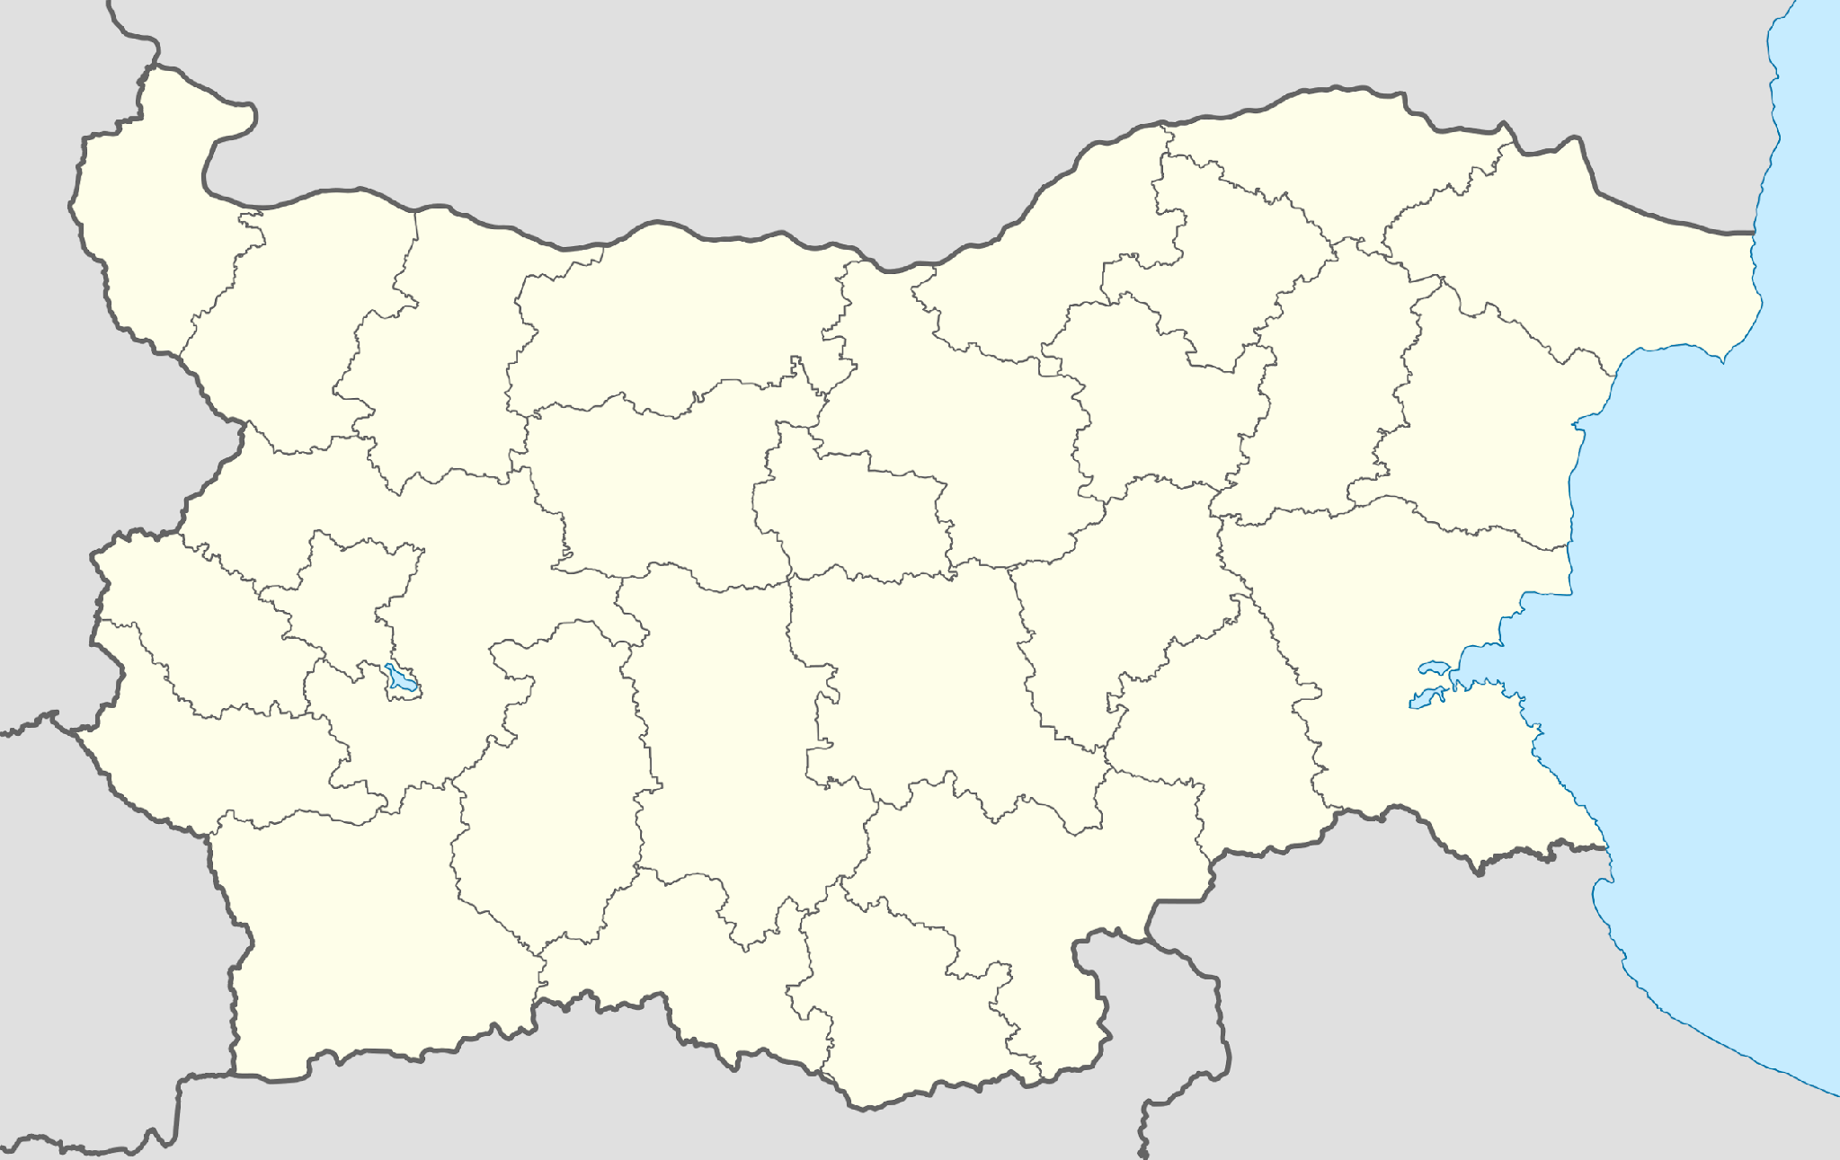
29 Associated partners
Falstad Human rights Center
World Culture United
Kvenna Kunstverk AS
ULLDAGA
Stiklestad National Cultural Center
Estonian Folk Art and Craft Union
The Estonian Open Air
Museum (medium-scale
museum)
MTÜ Loome Sillad
Estonian National Museum (medium-scale museum
Public Library Ivan Vazov, Plovdiv
The Regional Centre for the Safeguarding of Intangible Cultural Heritage in South Eastern Europe under the auspices of UNESCO
CLaDA
Bulgariana
National Museum Vasilii
Levski, Karlovo
National Ethnographic
Museum
Leonardo museum of Vinci
Direzione regionale musei della Toscana
Museo della Grafica
eCHOing CONFERENCE: An experience of collaboration between CHO and HEI for OI
17 April 2024 - Pisa (Italy

Slide 5
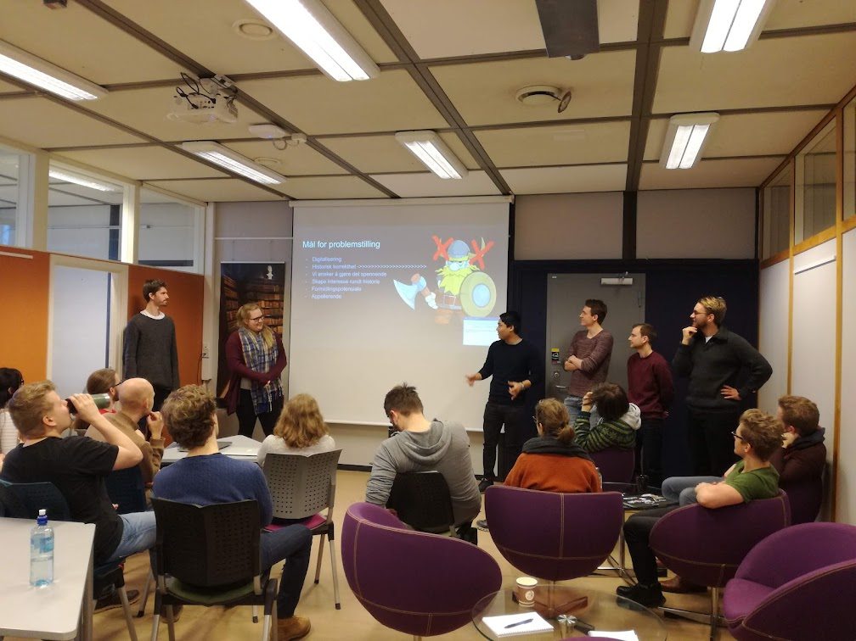
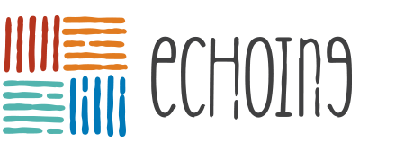
Facilitate a meaningful dialogue between HEIs and CHOs.
Establish Open Innovation collaborations between HEIs and CHOs
Methodology roadmaps for CHos-HEIs OIPs
Goals
eCHOing CONFERENCE: An experience of collaboration between CHO and HEI for OI
17 April 2024 - Pisa (Italy
Notes:
Interdisciplinary work stimulates creativity
Important to establish
-a common terminology ground
-common goals and values
-enriched subject perspectives
-communication strategies with your end-users.

Slide 6




Challenge: Can we create roadmaps for capacity building?
TRANSFERABILITY POTENTIAL
Open innovation is defined here as a transformative approach to academia-society collaborations for more inclusive societies and digital transformation of HEIs and CHOs.
The objective is often twofold:
a) develop capacity building
b) serve to society, as the majority of open innovation initiatives have a social value
HEIs Staff
CHO staff or volunteers
Organisations and other business partners
Students as key contributors!
eCHOing CONFERENCE: An experience of collaboration between CHO and HEI for OI
17 April 2024 - Pisa (Italy
Notes:
The Vision of Echoing is to find ways to support small and medium CHOs that were hit by the pandemic by co-desgning solutions tailored to their real life problems

Slide 7
“Recovery of cultural heritage through higher education driven open innovation” based on Volunteer work!
Address real life challenges in collaboration with small regional Museums, Libraries and NGOs
Investigate different digital tools and apps in the endeavour to integrate technology in archive and museum dissemination
Evaluate aspects of working with interdisciplinary teams and establish collaborations
Develop workflows that allow us to promote collections and reach a wider audience
Include end-users as active participants in the design process and reflect on how we interact, work and learn in the context of a targeted activity
eCHOing CONFERENCE: An experience of collaboration between CHO and HEI for OI
17 April 2024 - Pisa (Italy
Notes:
The eCHOing project aims for the “Recovery of cultural heritage through higher education driven open innovation” due to the Covid-19 pandemic and its effects on our modern society. A way in which diversity, social inclusion, democracy, and social responsibility can be rebuilt is through the overall improvement of the relationship between Higher Education Institutions (HEIs), Cultural Heritage Organizations (CHOs), and society’s everchanging needs, by means of open-innovation (OI) and other digitally enhanced tools.
Open innovation (OI) is a process in which a new idea, device, or method addresses a certain problem in a way that gives importance to an individual or group, with the help of modern technology. Openness, thus, offers an opportunity for citizens to get involved and serve a social purpose, by participating in digitally enhanced activities. Such activities include hacktivism (activism by means of hacking for a social purpose), maker movement (DIY technology-based inventions), citizen science (participation of citizens in a scientific research), and crowd initiatives (such as crowdfunding and crowdsourcing).
After finding and analyzing practices in which cultural heritage and CHOs are benefited through innovative projects, we can then provide the correct methods, tools, and teaching practices to HEIs and their staff. In that way, HEIs will actively support CHOs through public engagement and OI, thus highlighting the significance of cultural heritage in our modern society at such a difficult time.

Slide 8
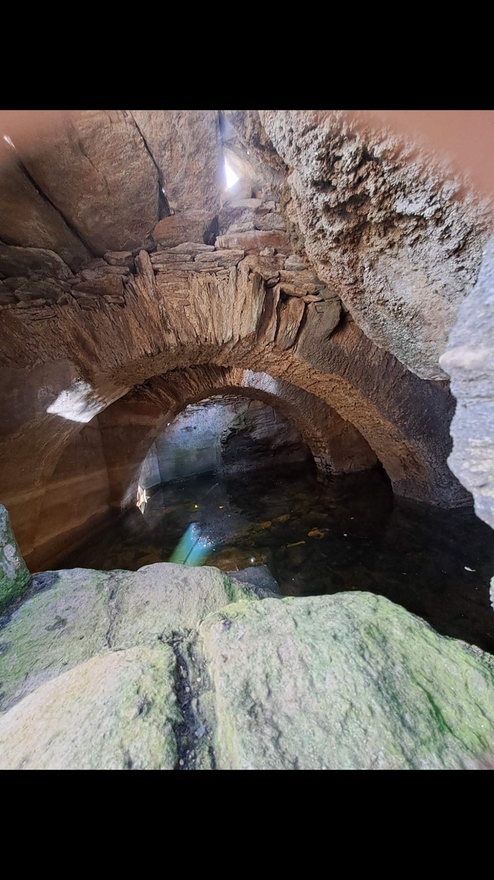
The outcomes as called in Erasmus+ terminology
eCHOing CONFERENCE: An experience of collaboration between CHO and HEI for OI
17 April 2024 - Pisa (Italy
Notes:
studentshandbooks, based on Surveys and interviews of Museum practices of staff of the 25 cultural organisations that have signed letters of Intend with the project and HEI students and staff.

Slide 9
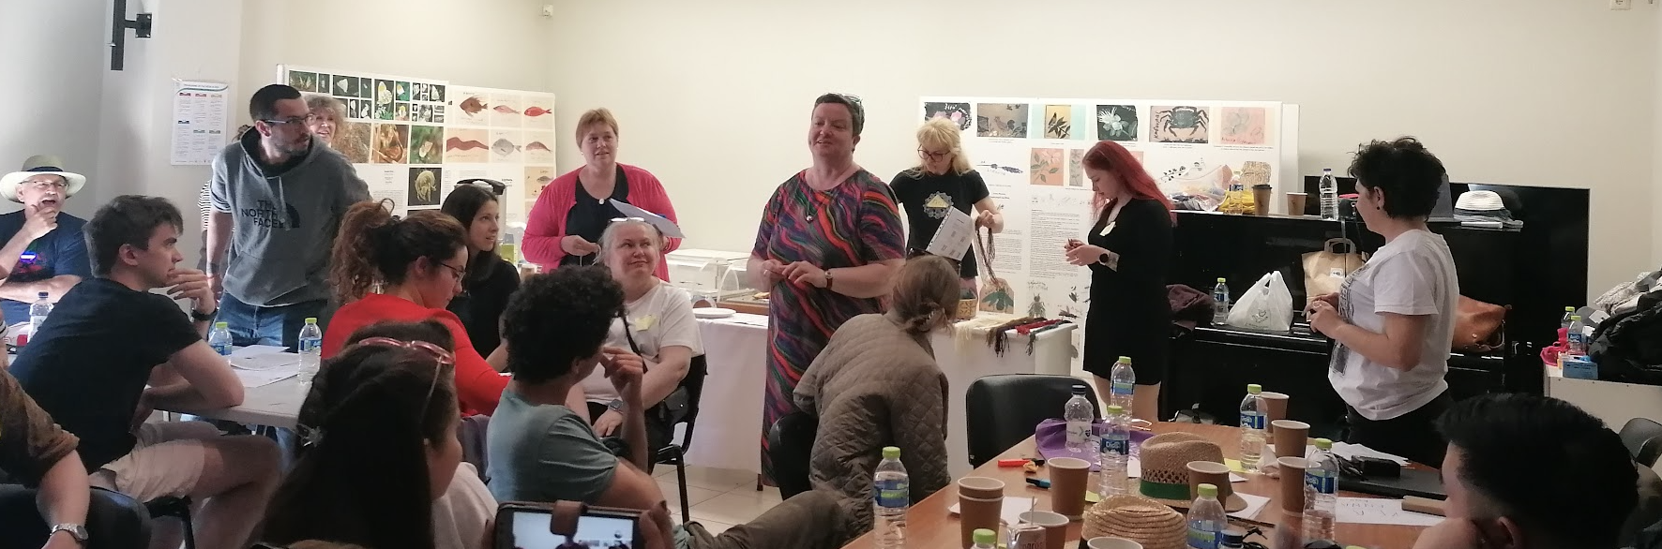
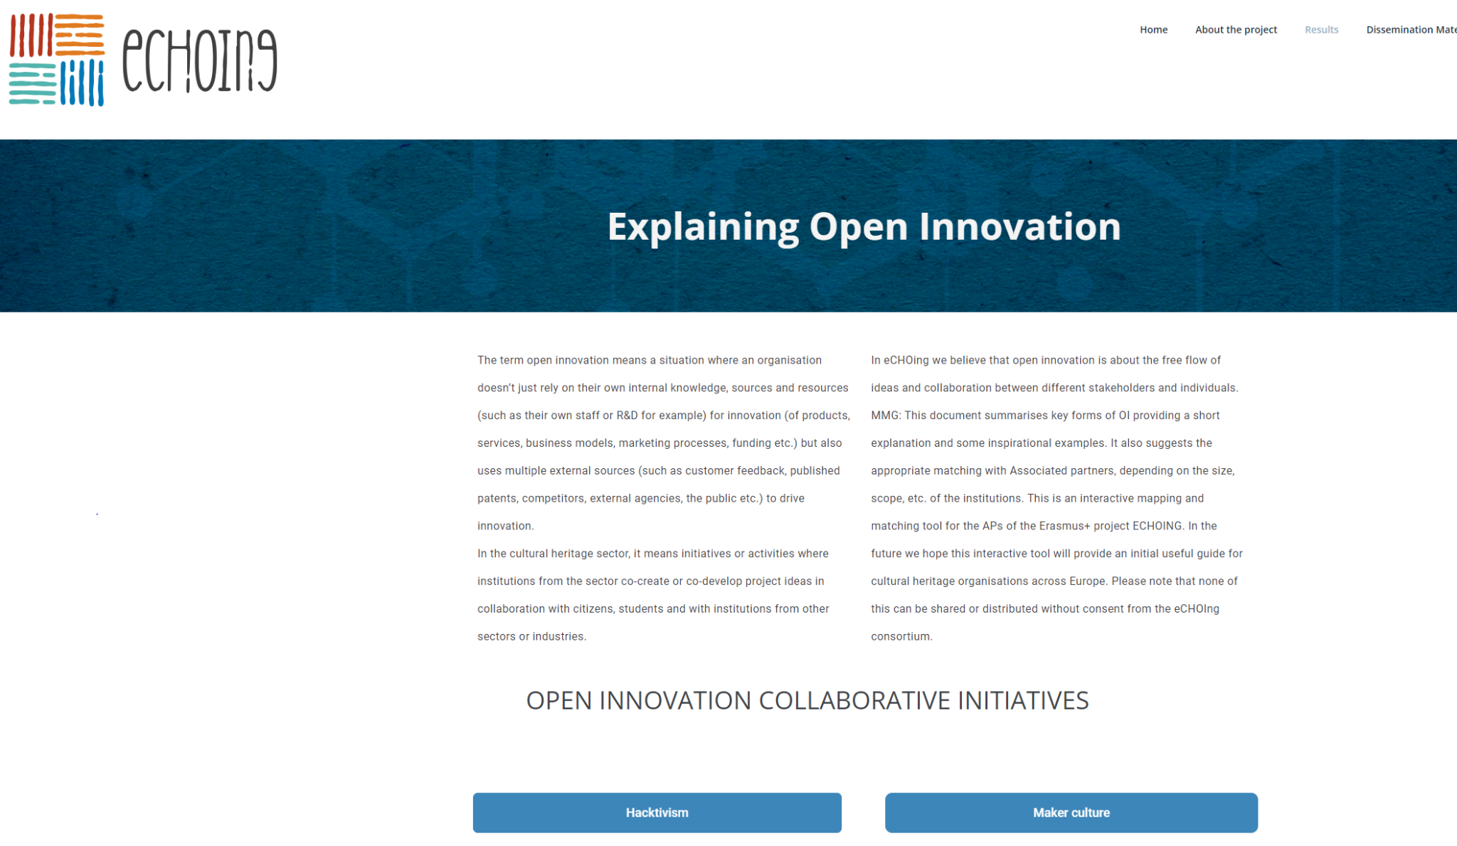
Best practices: 1.Open innovation guide
eCHOing CONFERENCE: An experience of collaboration between CHO and HEI for OI
17 April 2024 - Pisa (Italy

Slide 10
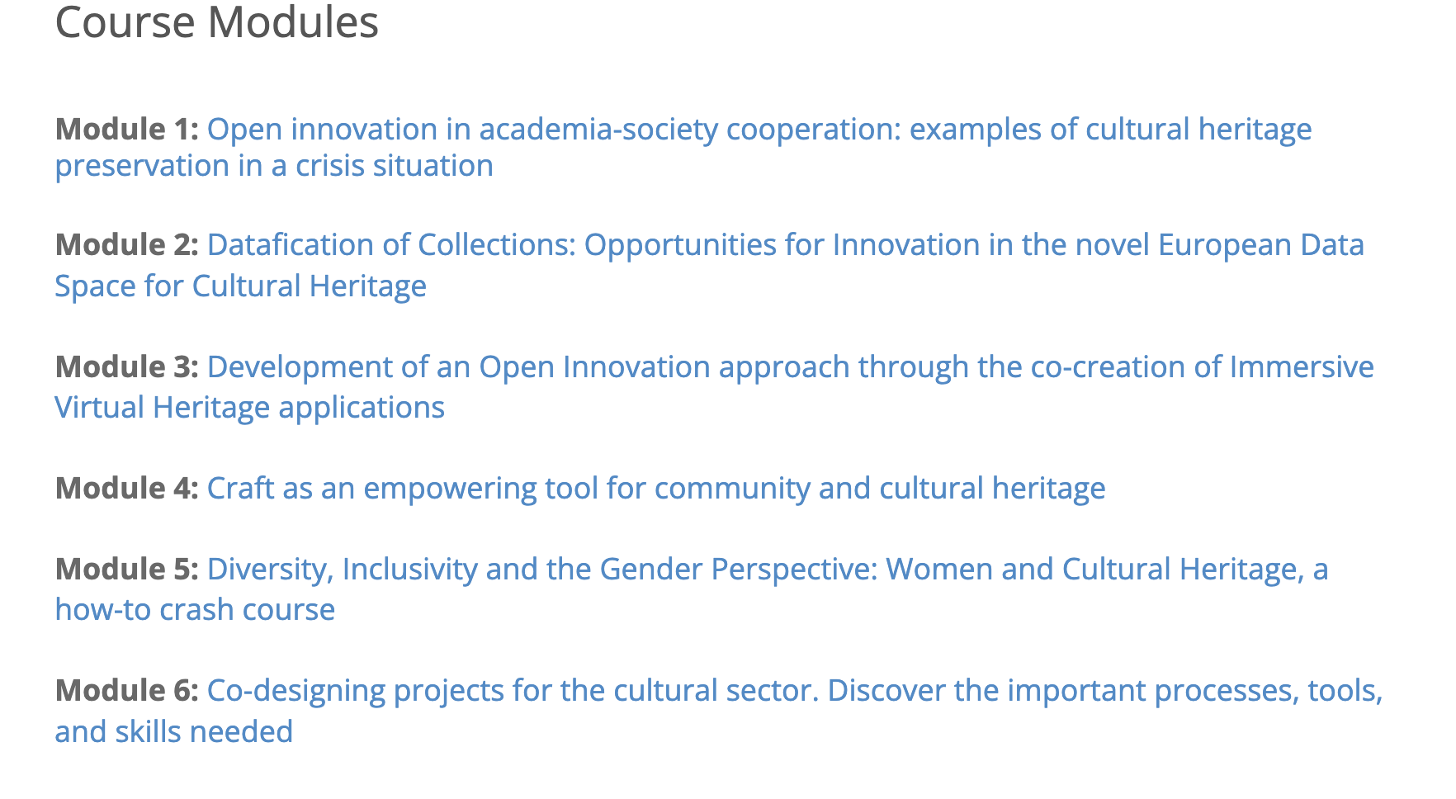
OPEN TO ALL
eCHOing CONFERENCE: An experience of collaboration between CHO and HEI for OI
17 April 2024 - Pisa (Italy

Slide 11
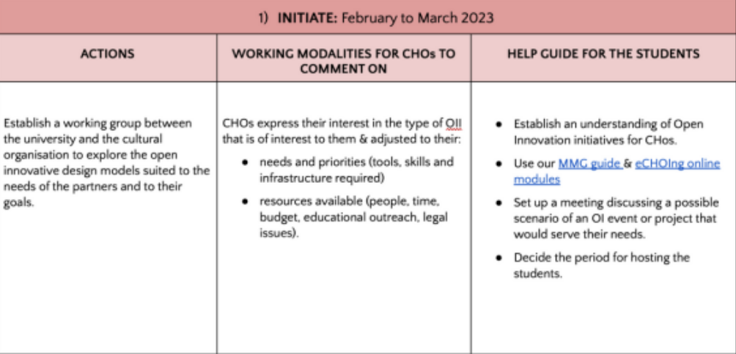

eCHOing: a methodology frame!
eCHOing CONFERENCE: An experience of collaboration between CHO and HEI for OI
17 April 2024 - Pisa (Italy

Slide 12
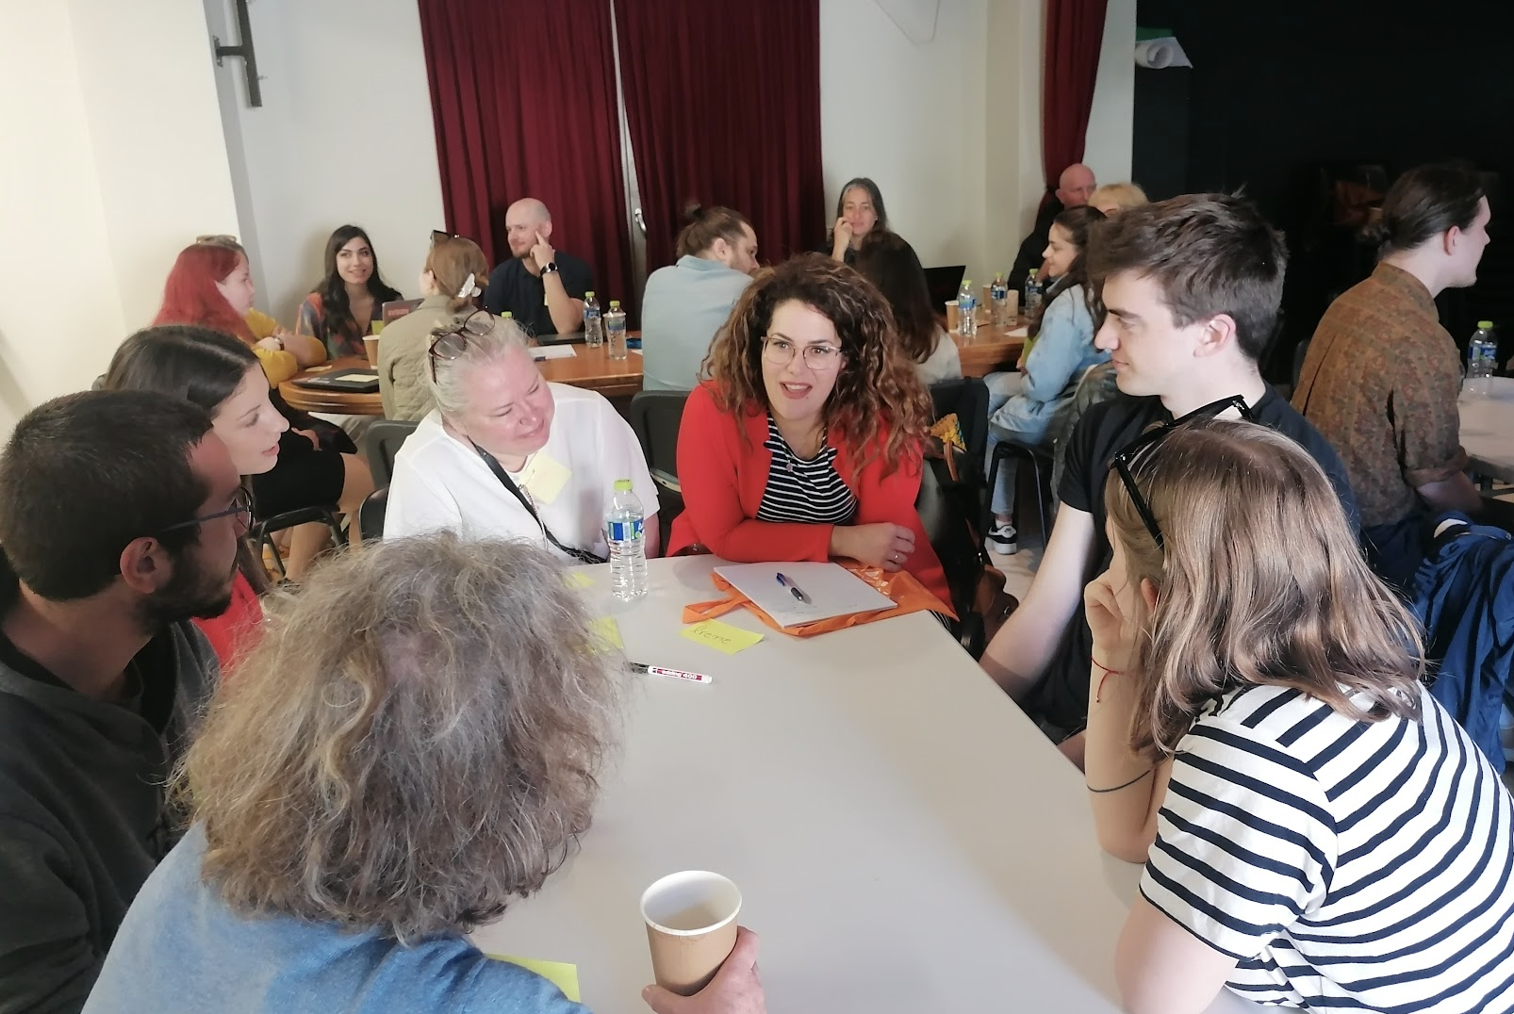
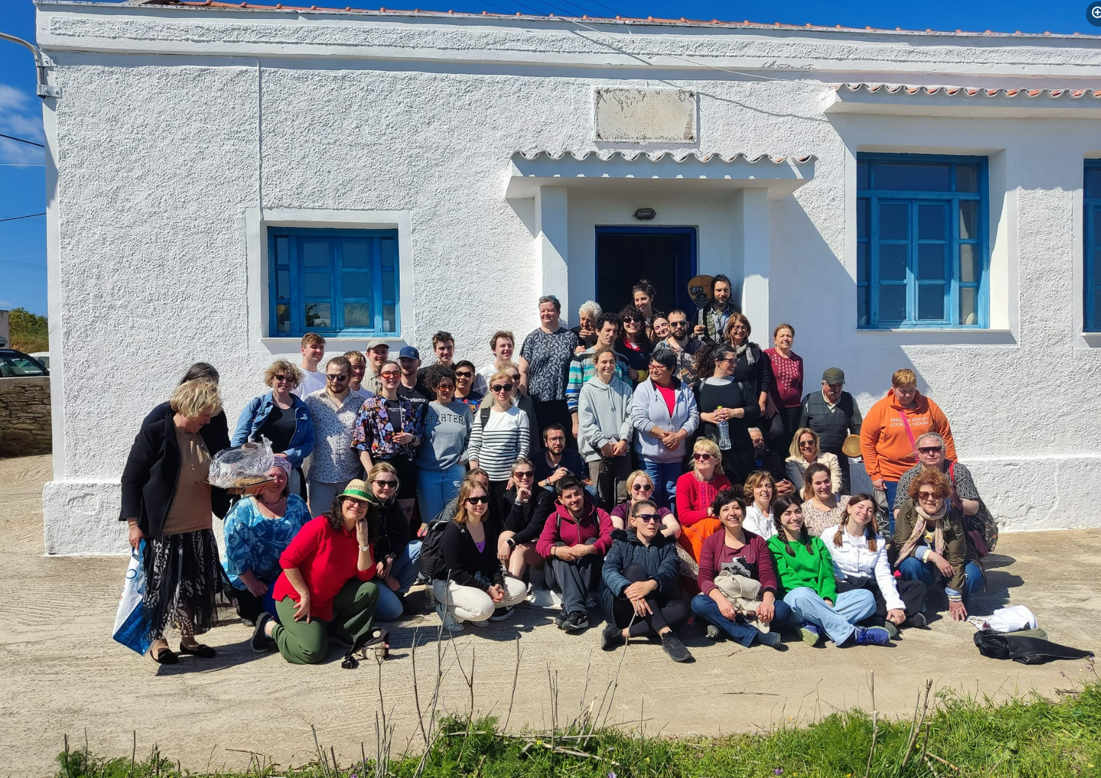
KEA WORKSHOP APRIL 2023
eCHOing CONFERENCE: An experience of collaboration between CHO and HEI for OI
17 April 2024 - Pisa (Italy
Notes:
The eCHOing project aims for the “Recovery of cultural heritage through higher education driven open innovation” due to the Covid-19 pandemic and its effects on our modern society. A way in which diversity, social inclusion, democracy, and social responsibility can be rebuilt is through the overall improvement of the relationship between Higher Education Institutions (HEIs), Cultural Heritage Organizations (CHOs), and society’s everchanging needs, by means of open-innovation (OI) and other digitally enhanced tools.
Open innovation (OI) is a process in which a new idea, device, or method addresses a certain problem in a way that gives importance to an individual or group, with the help of modern technology. Openness, thus, offers an opportunity for citizens to get involved and serve a social purpose, by participating in digitally enhanced activities. Such activities include hacktivism (activism by means of hacking for a social purpose), maker movement (DIY technology-based inventions), citizen science (participation of citizens in a scientific research), and crowd initiatives (such as crowdfunding and crowdsourcing).
After finding and analyzing practices in which cultural heritage and CHOs are benefited through innovative projects, we can then provide the correct methods, tools, and teaching practices to HEIs and their staff. In that way, HEIs will actively support CHOs through public engagement and OI, thus highlighting the significance of cultural heritage in our modern society at such a difficult time.

Slide 13
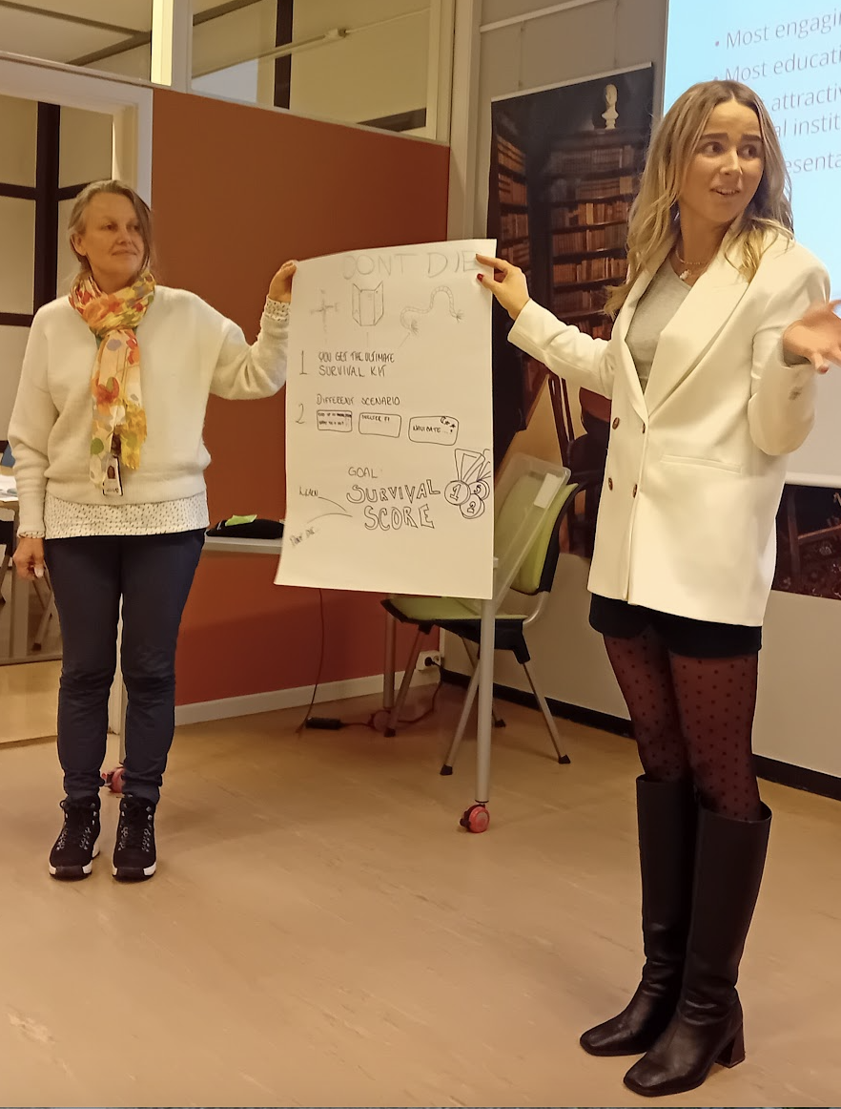
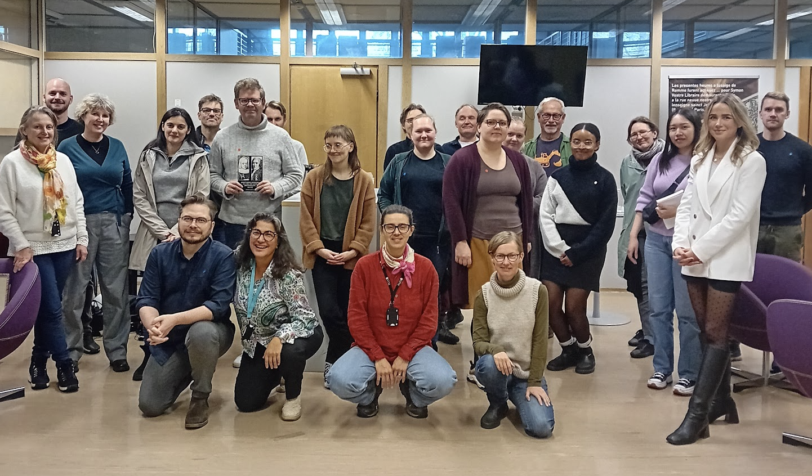
The eCHOing students: Interest and dedication
eCHOing CONFERENCE: An experience of collaboration between CHO and HEI for OI
17 April 2024 - Pisa (Italy

Slide 14
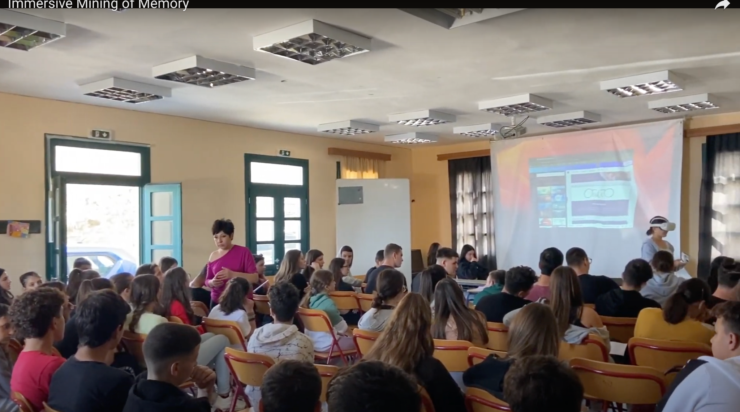
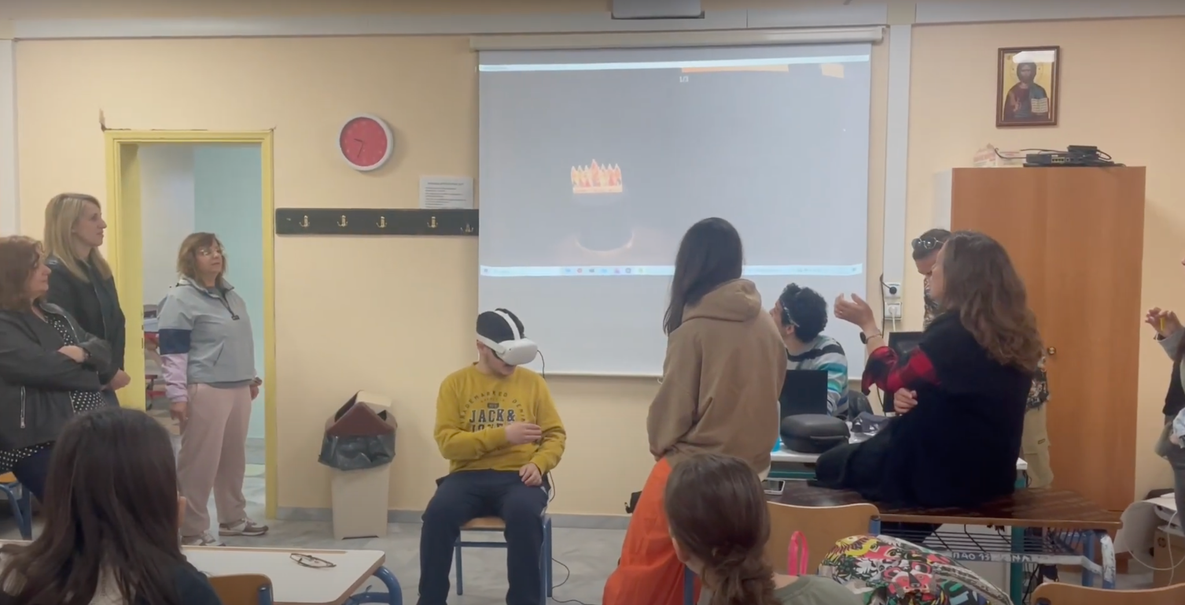
Schools as key collaborators.
.
eCHOing CONFERENCE: An experience of collaboration between CHO and HEI for OI
17 April 2024 - Pisa (Italy

Slide 15

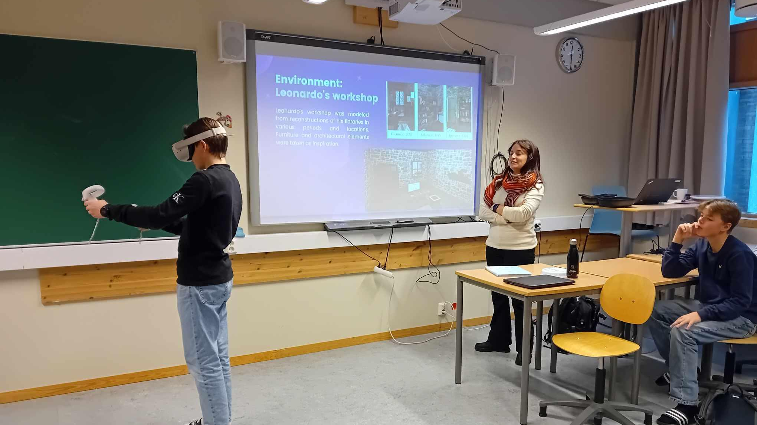
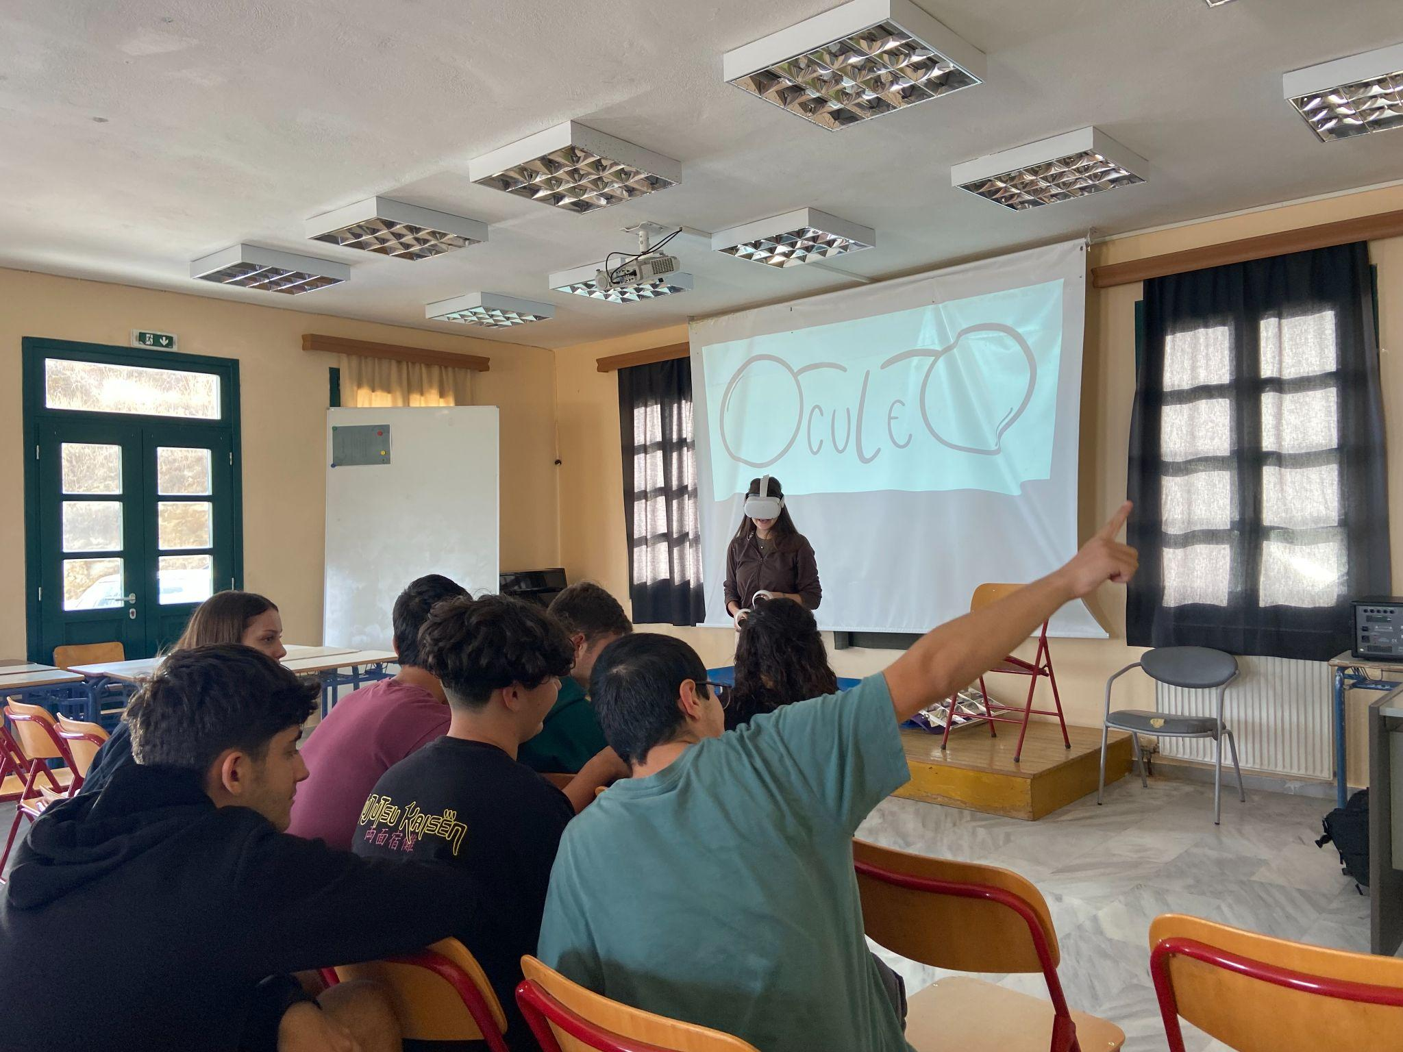
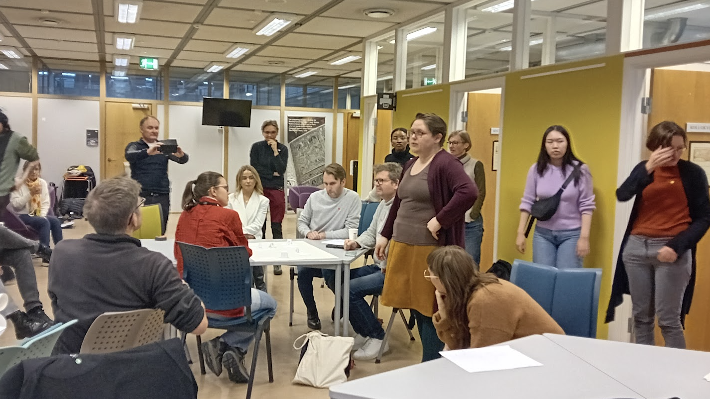
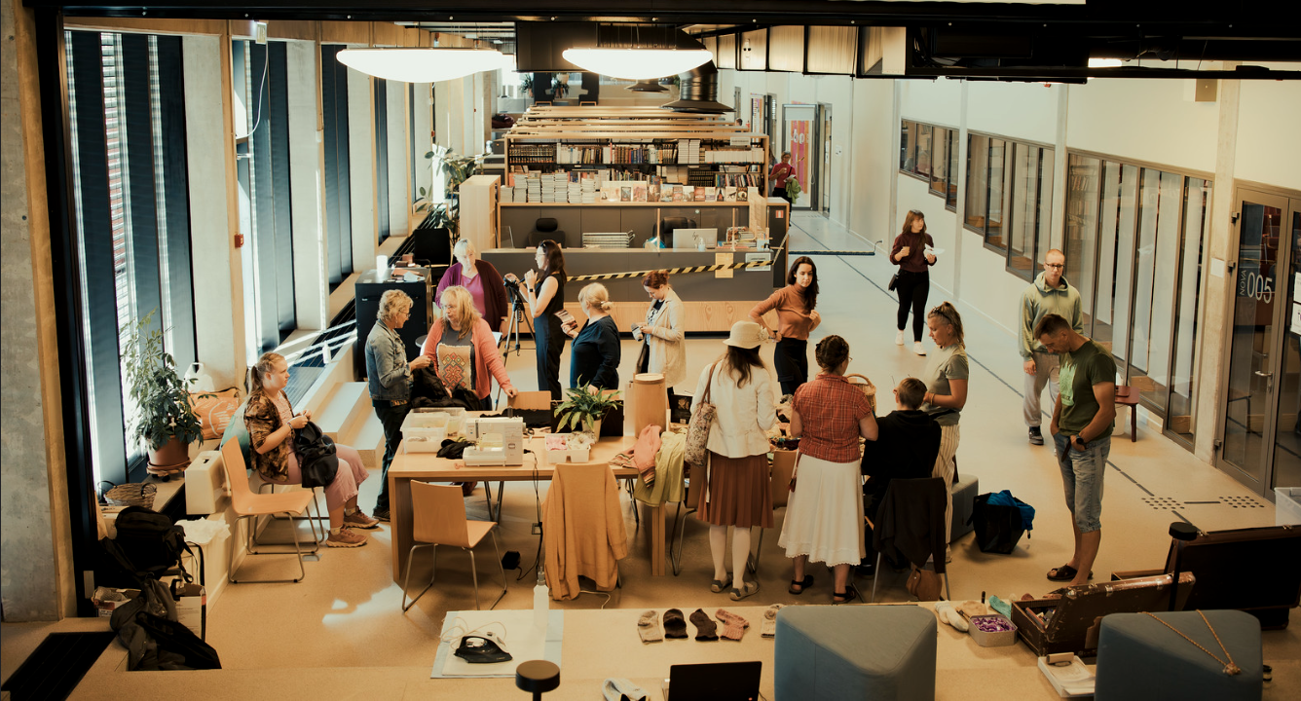
28 projects in 5 countries!
eCHOing CONFERENCE: An experience of collaboration between CHO and HEI for OI
17 April 2024 - Pisa (Italy

Slide 16
Immersive Mining of Memory in Kea: Experiental learning
The objective of the Immersive Mining of Memory project is to breathe new life into Kea's disused mines, preserving their historical significance. By harnessing the power of Citizen Science, the project seeks to collect valuable information, documents, and photographs from the mines' operational era to ensure that their memory is not lost. A key aspect of the project involves the developmentof a self-guided tour featuring QR codes and downloadable content for visitors.
Interviews of relatives-Storytelling workshop-VR workshops

Slide 17
Innovative partnerships in Bulgaria
https://www.youtube.com/watch?v=3xl_5CEIHuA
The Museum of Traditional Crafts and Applied Arts in Troyan coined valuable partnerships:
with ICCT-BAS - 3D digitisation - currently over 100 objects digitised
with IMI-BAS - digitisation of historical newspapers (collated the most complete set of digital newspapers identifying missing issues in libraries and museums across the country)

Slide 18
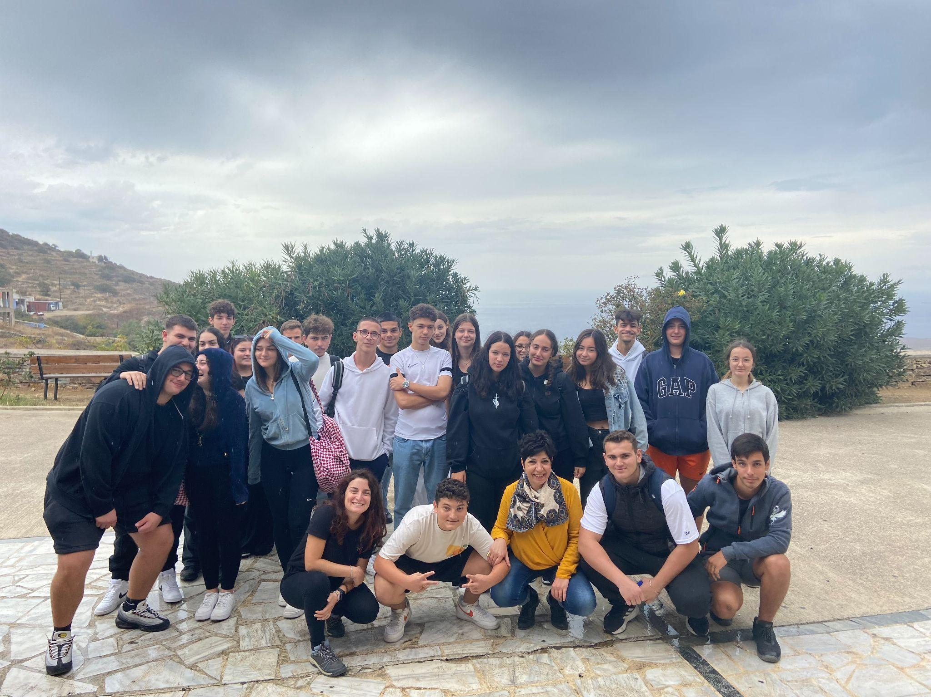
Creating bridges between cultures-equal participation for all! Volunteer work
Learn about
Discuss
Brainstorm
Solve
Co-create
Evaluate
Reflect
eCHOing CONFERENCE: An experience of collaboration between CHO and HEI for OI
17 April 2024 - Pisa (Italy

Slide 19

Methodology as a challenge!
Cultural Institutions bring their challenges to the table.
Cross-disciplinary teams to find solutions
Students carry out and test the eCHOing methodology to facilitate the process
School students: the change-agents
For the facilitators
Reports of project implementation
Survey answers
Work in focus groups
Master thesis!
eCHOing consortium monitors the process the implementation-the results-the impact
17 April 2024 - Pisa (Italy

Slide 20
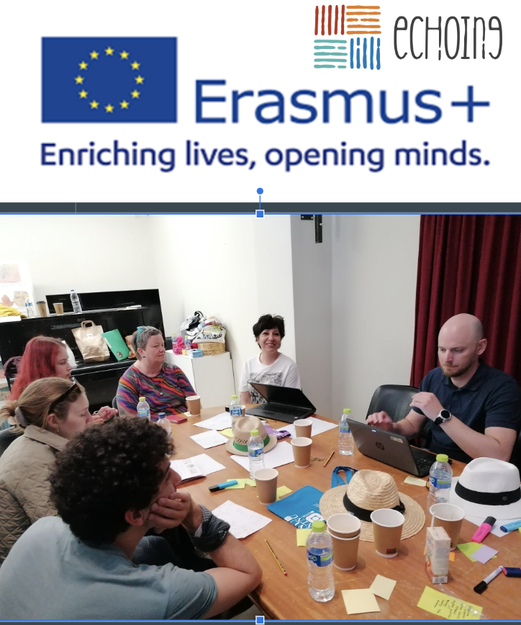
Further impact
28 Projects that continue through the CHOs
Surveys from staff and students (300) respondents-Analysis
Dissemination outcomes workshops, conferences, events
Future experts: Students key-collaborators
A blueprint for inter-cultural and inter-disciplinary collaborations
All reports at https://www.ntnu.edu/echoing/results
eCHOing CONFERENCE: An experience of collaboration between CHO and HEI for OI
17 April 2024 - Pisa (Italy

Slide 21
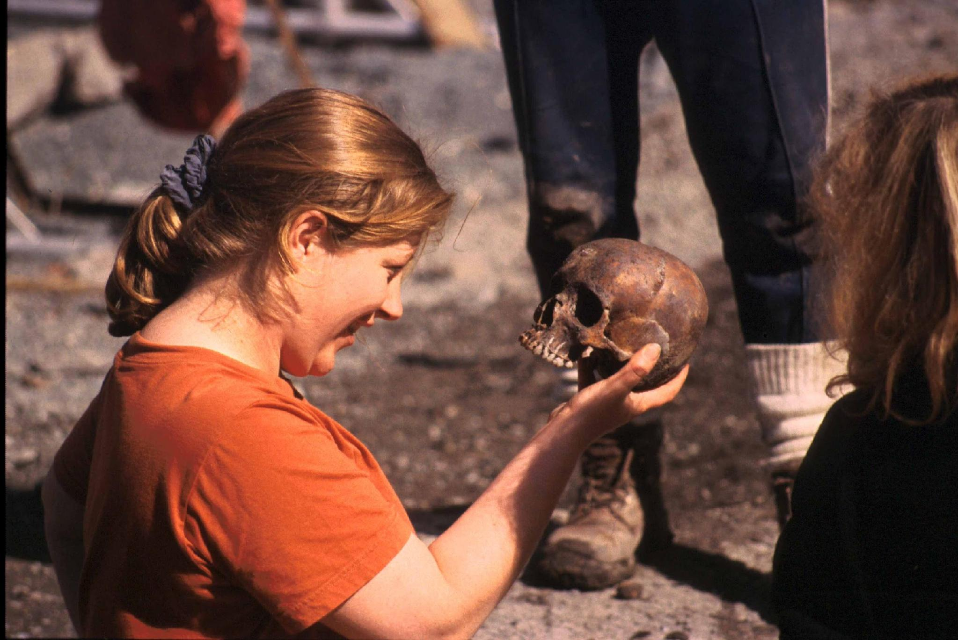
Questions?
Contact: aalekas@gmail.com
eCHOIng
You tube channel
Linkedin:linkedin.com/in/angeletaki
eCHOing CONFERENCE: An experience of collaboration between CHO and HEI for OI
17 April 2024 - Pisa (Italy

Slide 22
Thanks!
eCHOing CONFERENCE: An experience of collaboration between CHO and HEI for OI
17 April 2024 - Pisa (Italy)

