Slide 1






Data collaborations with cultural heritage institutions: opportunities and challenges
Gustavo Candela
Building Data Collaborations for Digital Cultural Heritage
6th July 2026

Slide 2
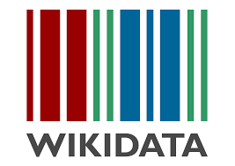




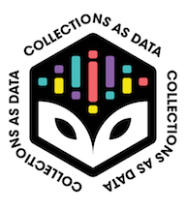
Content
Reuse
About me
Introduction
Working partnerships & use cases
Future work
AI
Knowledge Base
Documentation

Slide 3








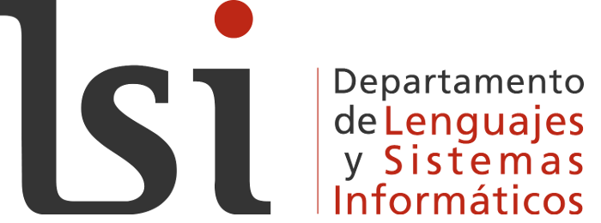





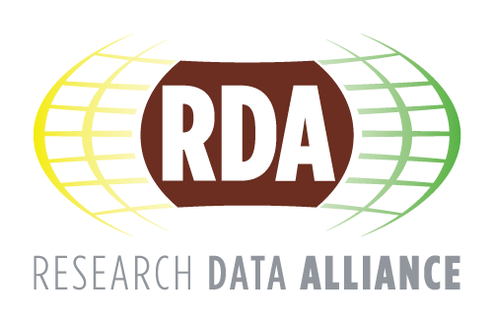

About me
Gustavo Candela
PhD
Developer at Biblioteca Virtual Miguel de Cervantes 2010-2023
Lecturer in CS
  Joint Research committee DARIAH
  Technical Assessment Committee Echoes
  Wikimedia Spain
  DHwiki DARIAH WG
gcandela@ua.es
https://www.ua.es/

Slide 4
Introduction
GLAM Datasets
Collections as data
Wikidata

Slide 5


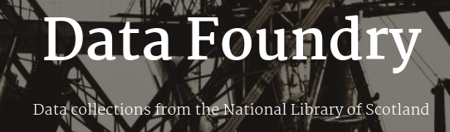












Dataset examples
https://americanart.si.edu/about/lod
https://labs.kb.dk/
https://doi.org/10.5281/zenodo.8051036
https://id.loc.gov
https://data.bibliotheken.nl
https://data.nationallibrary.fi
https://bnelab.bne.es
https://data.bnf.fr/
https://api.moma.org/
British Library Labs projects
https://labs.onb.ac.at
https://data.cervantesvirtual.com/
https://data.bnl.lu/
https://www.dnb.de/EN/lds
Getty Provenance Index

Slide 6
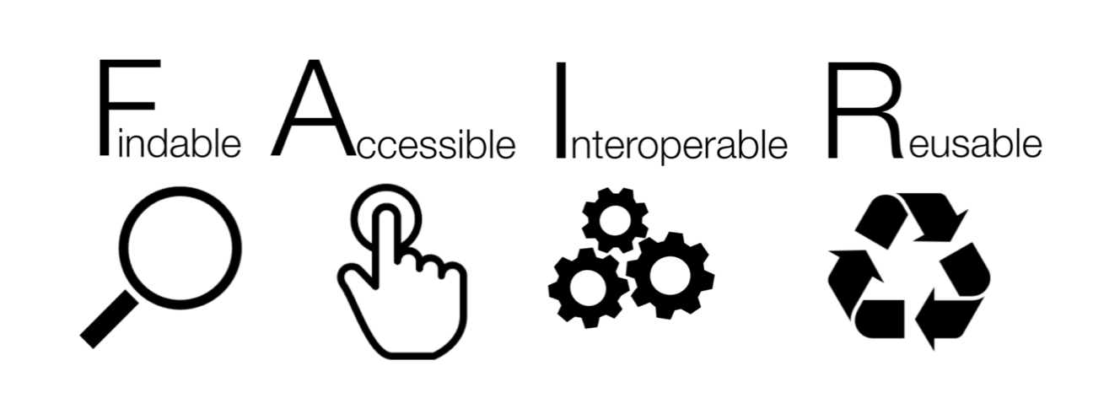
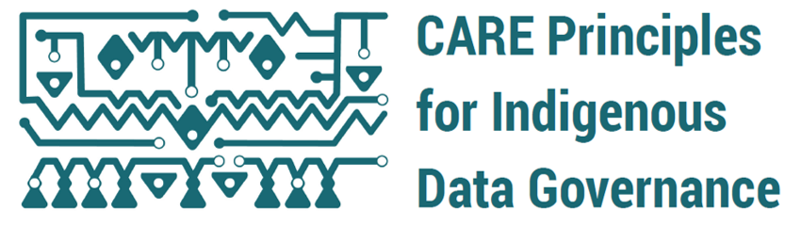
Collections as data
With many thanks to Thomas Padilla
Findable
Accessible
Rich metadata and permanent identifiers
Machine-readable metadata
Interoperable
Reusable
Focused on data
Metadata described with vocabularies
Licence and documentation
Collective benefit
Authority to control
Inclusive and equitable outcomes
Recognizing rights and interests
Complement FAIR
Responsibility
Ethics
For indigenous languages and worldviews
Minimizing harm, and for justice and future use
https://collectionsasdata.github.io/
https://www.gida-global.org/care

Slide 7
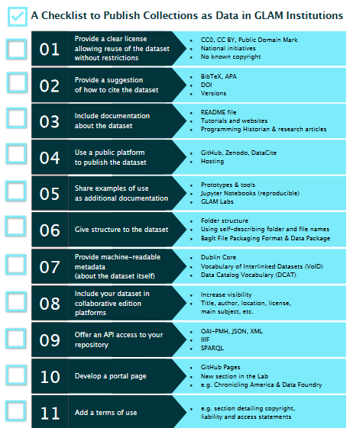
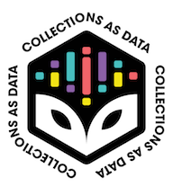
Publishing Collections as Data
Publication
A checklist to make available digital collections suitable for computational use
https://doi.org/10.48550/arXiv.2304.02603
Global Knowledge, Memory and Communication

Slide 8

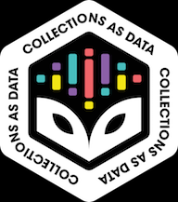




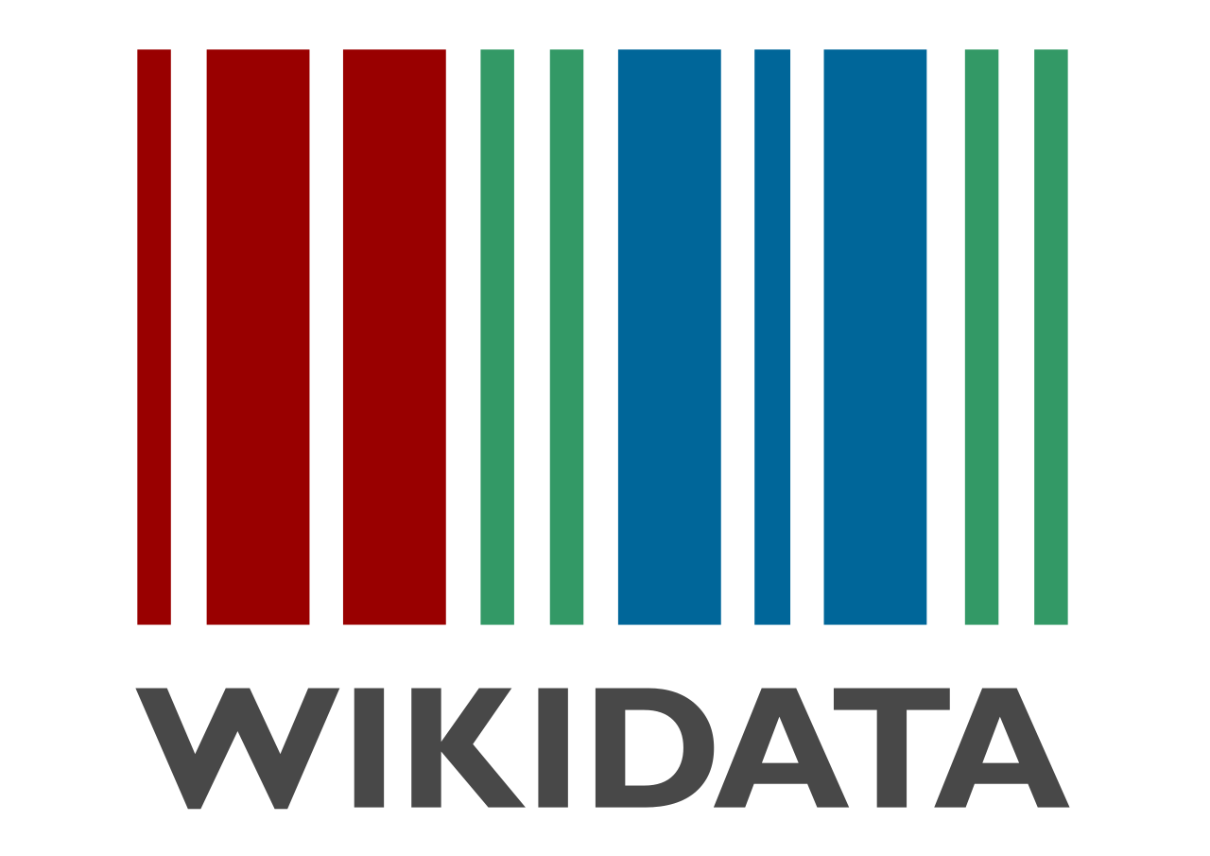


Reproducible data access and reuse: Jupyter Notebooks
What kind of tasks can we apply with Jupyter Notebooks?
Data visualisation
Named-Entity Recognition
Reproducible workflows
Data quality
Federated queries
LLM & RAG
Computer Vision & LLM
Gustavo Candela, Sally Chambers, Tim Sherratt: An approach to assess the quality of Jupyter projects published by GLAM institutions. J. Assoc. Inf. Sci. Technol. 74(13): 1550-1564 (2023). https://doi.org/10.1002/asi.24835
YOLO

Slide 9


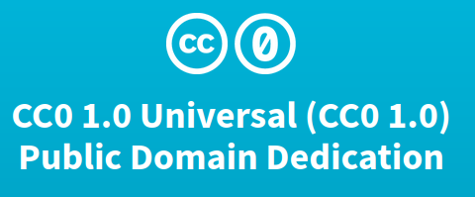



Wikidata
Multilingual
Structured data
Public domain
Based on standards
Edited by the community

Slide 10
Wikidata in GLAM - Benefits
Discoverability
Public Engagement
Quality
Multilingual
Linked Open Data

Slide 11


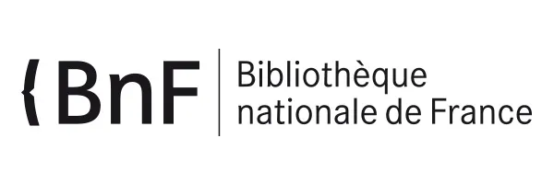
GLAM in Wikidata
Properties
Property | Description
P5361 | BNB person ID
P268 | Bibliothèque nationale de France ID
P950 | Biblioteca Nacional de España ID
P227 | German National Library
P244 | Library of Congress authority ID
Wikidata as identity hub
Gustavo Candela, Mirjam Cuper, Olga Holownia, Nele Gabriëls, Milena Dobreva, Mahendra Mahey: A Systematic Review of Wikidata in GLAM Institutions: a Labs Approach. TPDL (2) 2024: 34-50. https://doi.org/10.1007/978-3-031-72440-4_4

Slide 12
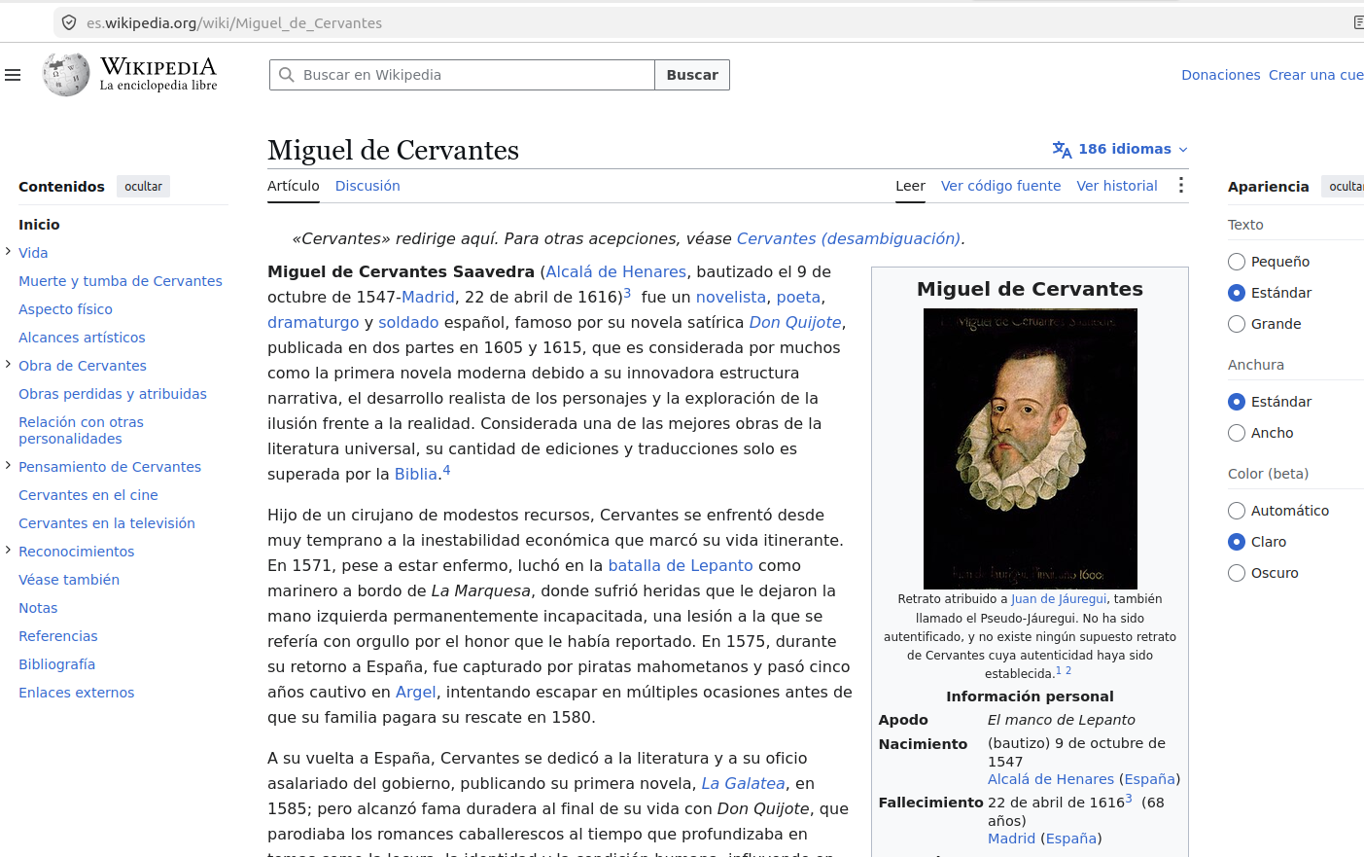
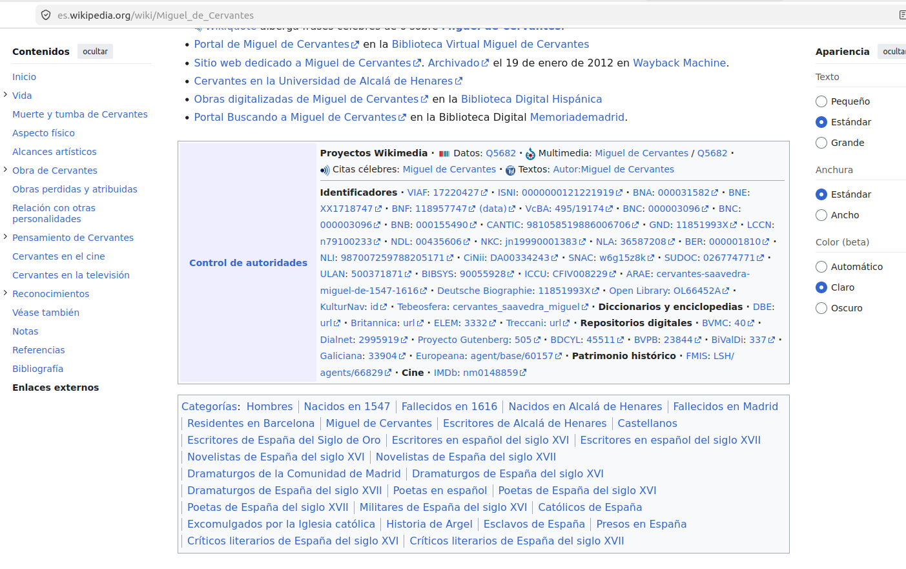
https://es.wikipedia.org/wiki/Miguel_de_Cervantes

Slide 13
Working partnerships & case studies
Publishing and reusing collections as data
Events & partnerships
Use cases
Challenges

Slide 14
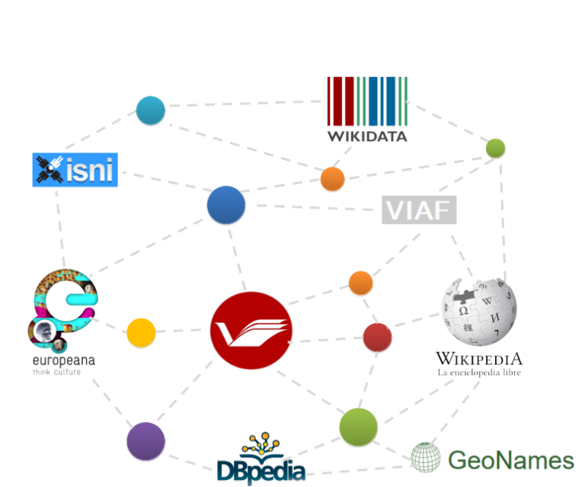

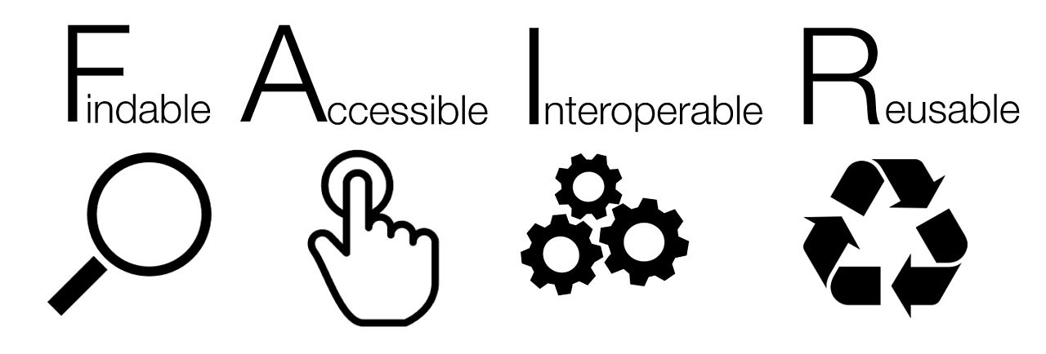



Biblioteca Virtual Miguel de Cervantes & RDA
In 2015 the BVMC transformed the catalog into RDA to facilitate its reuse
Based on Web Semantic and Linked Open Data
Data modelling using the vocabulary RDA Registry
Enriched with external repositories such as Wikidata, GeoNames and VIAF
Available by means of a SPARQL API and a Lab (https://data.cervantesvirtual.com/)
Aiming at providing new services and uses of the catalogue
Adopting the FAIR principles

Slide 15
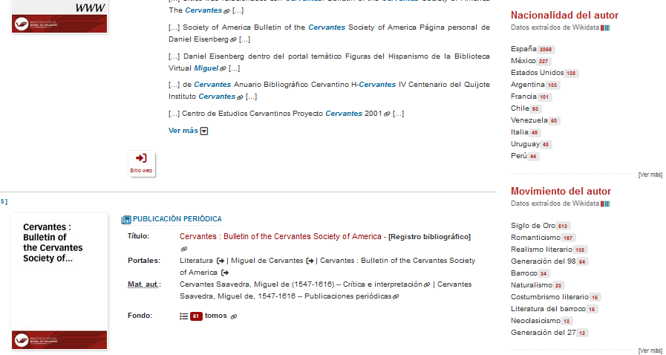
Biblioteca Virtual Miguel de Cervantes
How can the traditional website benefit from the enrichment?
The BVMC and Wikidata are connected
New ways to explore the data
https://www.cervantesvirtual.com/buscador/?q=miguel+de+cervantes

Slide 16
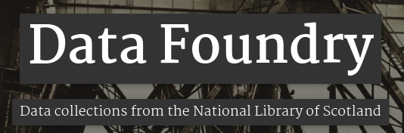
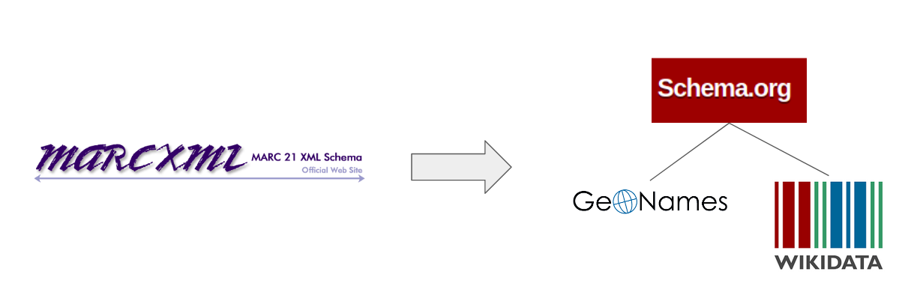


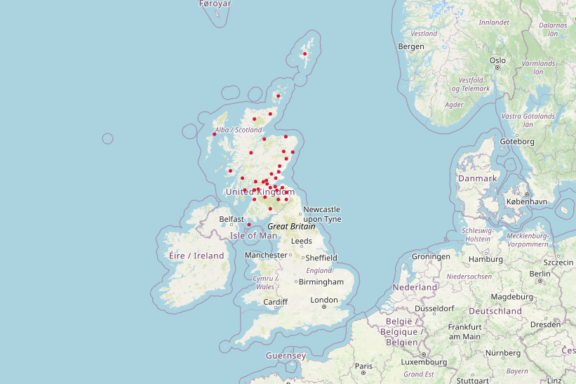
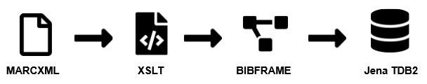
With thanks to Sarah Ames
National Librarian’s Research Fellowship in Digital Scholarship 2022-23
Candela, G. (2026). Towards a semantic approach in GLAM Labs: The case of the Data Foundry at the National Library of Scotland. Journal of Information Science, 52(1), 3-21. https://doi.org/10.1177/01655515231174386
https://github.com/NLS-Digital-Scholarship/nls-fellowship-2022-23

Slide 17
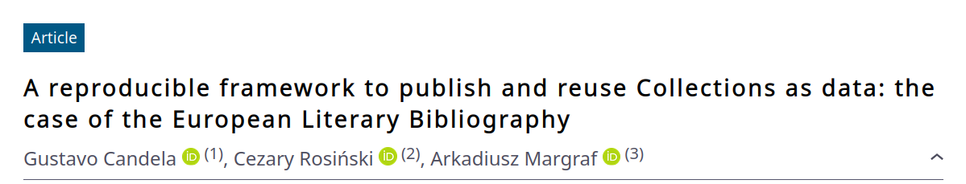
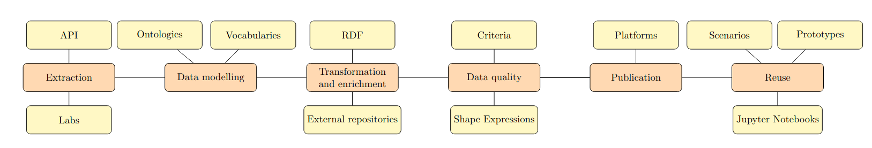
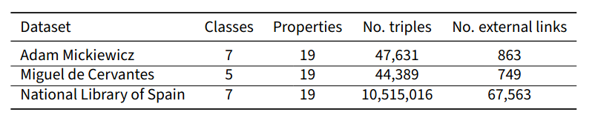
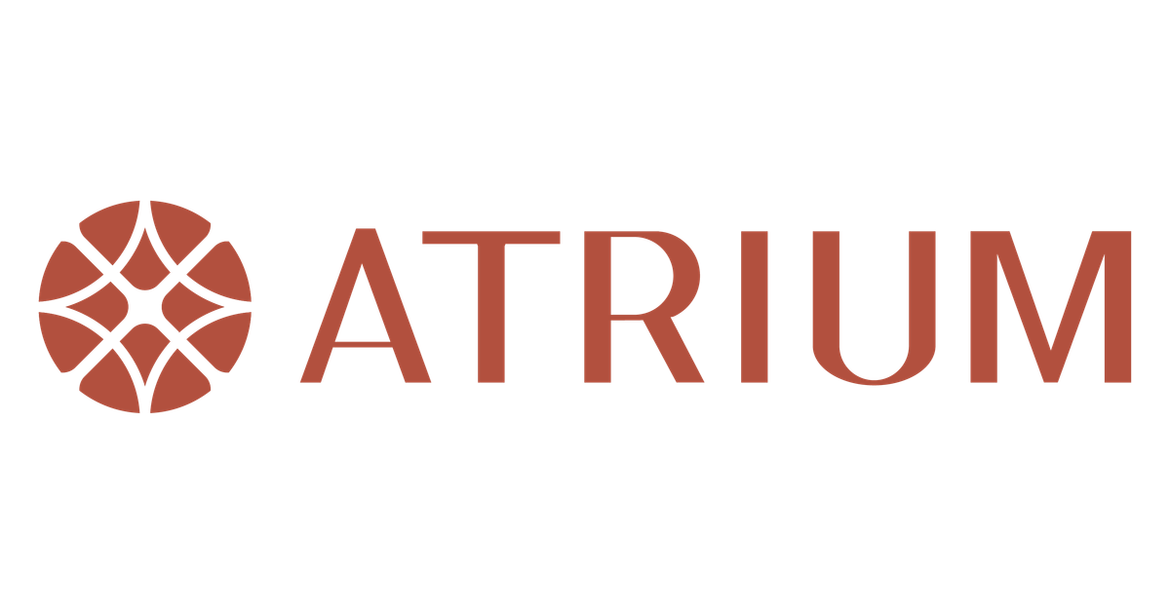
European Literary Bibliography & knowledge graphs
https://doi.org/10.46298/transformations.14729
Scenario 1: Comparative analysis of provincial Spanish novels featuring vampires
Scenario 2: Republican writers who migrated during the Spanish Civil War
Scenario 3: Geographical distribution of publications dedicated to particular Spanish writers
https://atrium-research.eu/blog/Reusing%20bibliographic%20content/

Slide 18
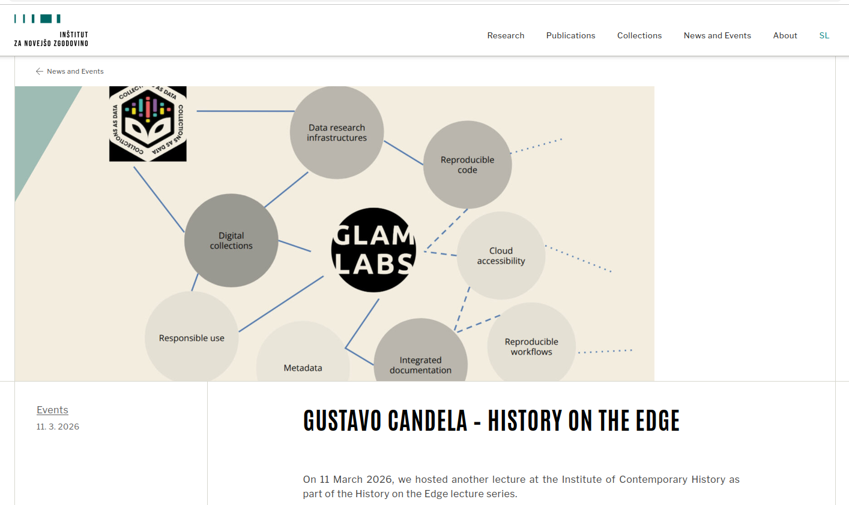
https://inz.si/en/2026/03/27/gustavo-candela-zgodovina-na-spici/

Slide 19
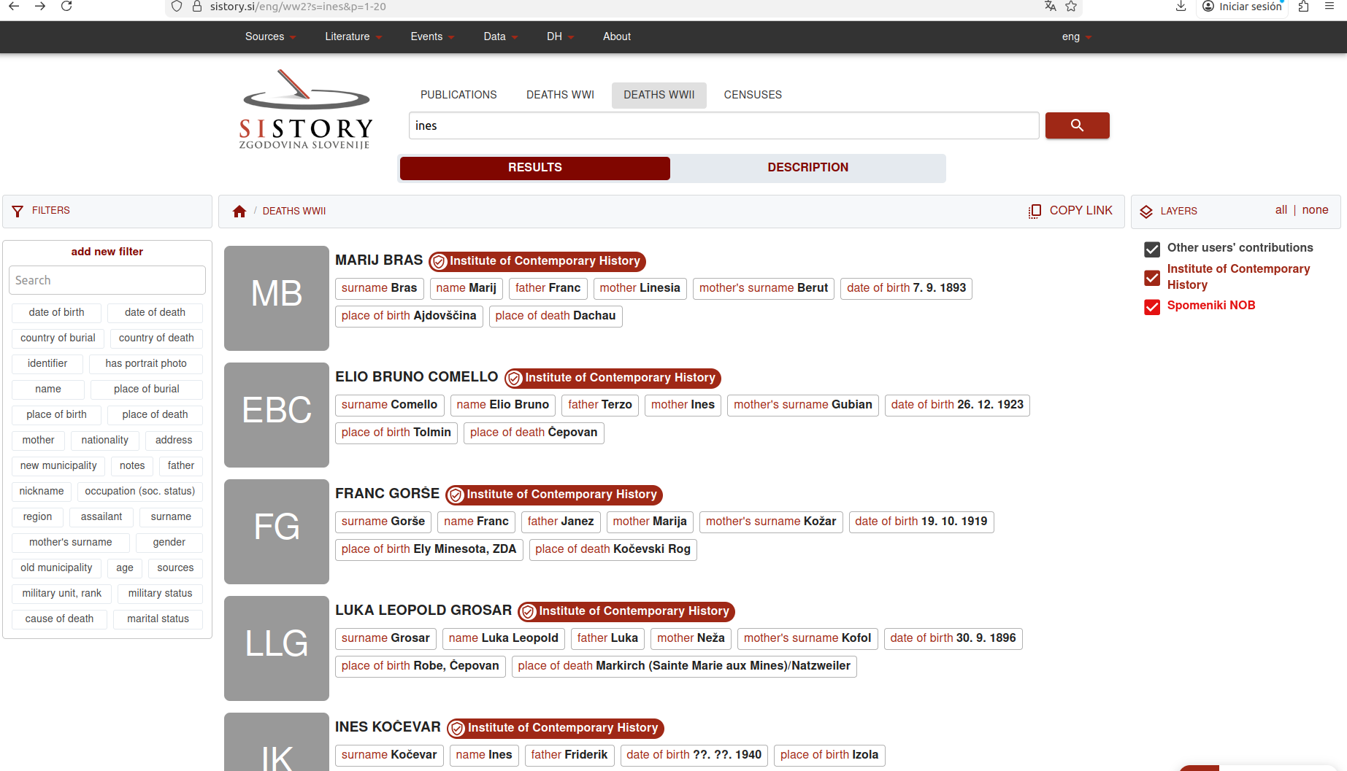
API available?
Extraction of data?
Documentation?
Examples of use?
Enrichment with external repositories?

Slide 20
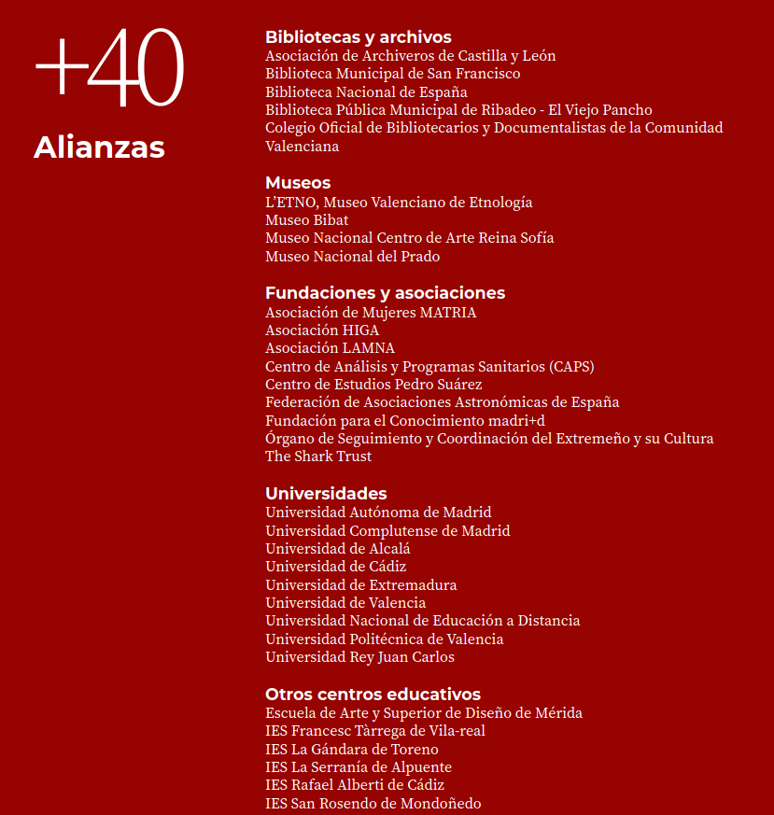
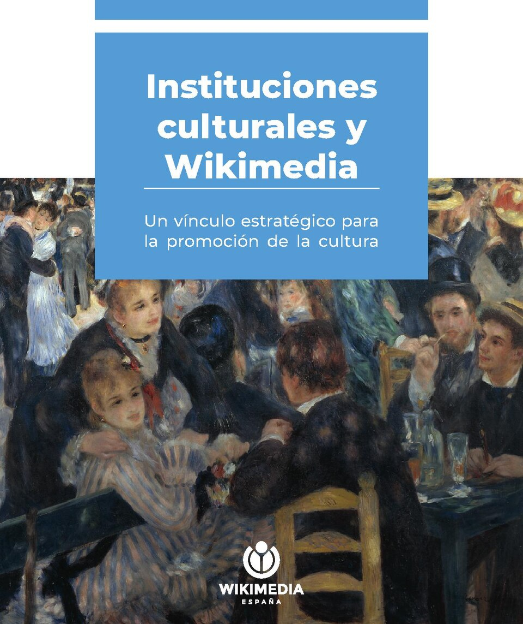
Partnerships in WMES
https://commons.wikimedia.org/wiki/File:Instituciones_culturales_y_Wikimedia.pdf

Slide 21
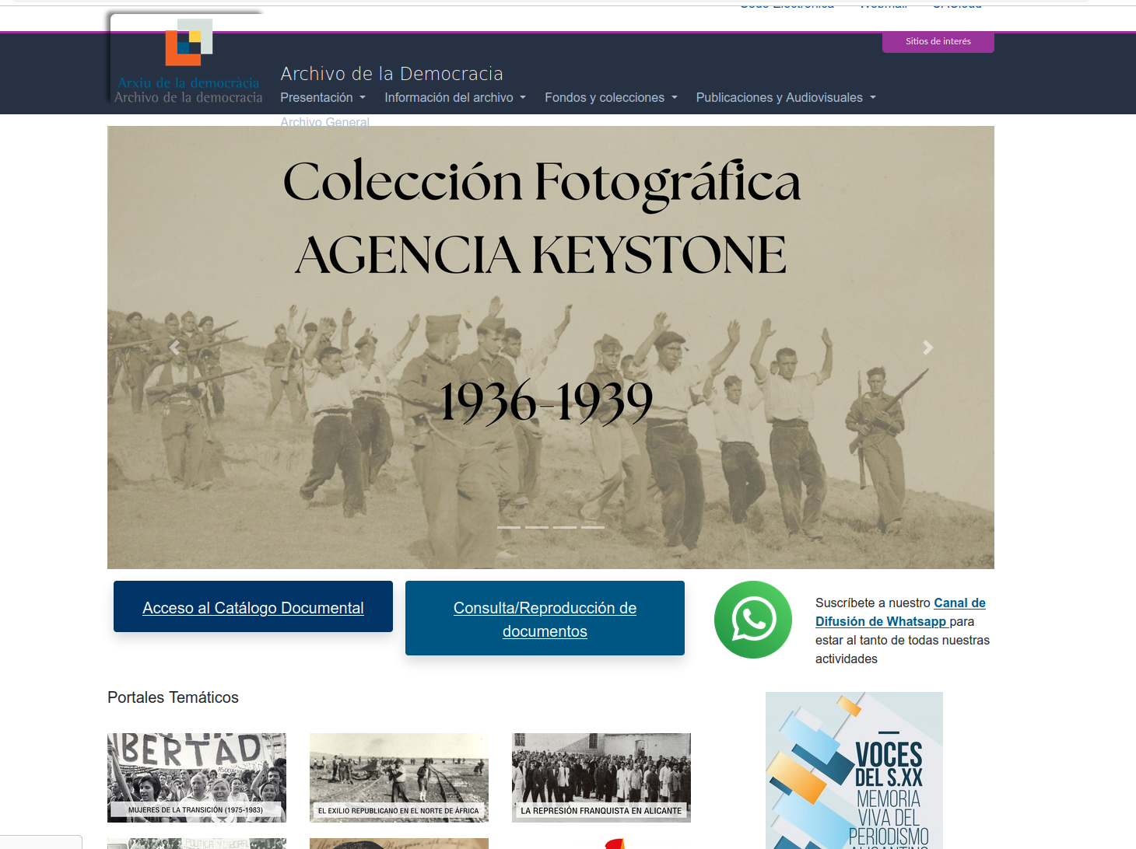
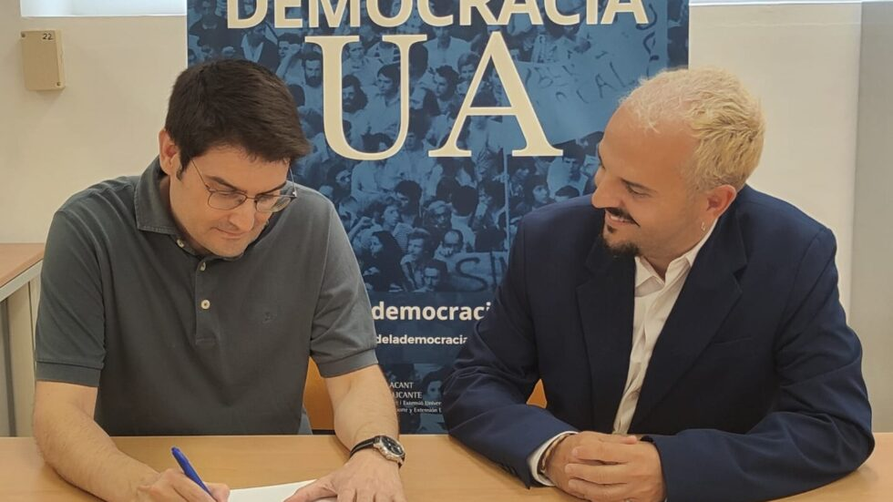
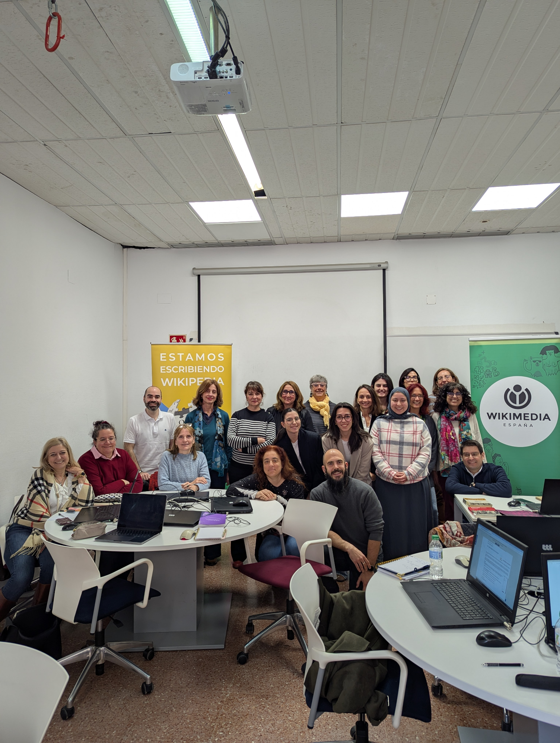

Wikimedia España & University of Alicante
https://archivodemocracia.ua.es/
https://wikimedia.es/marzo-en-wikimedia-espana-actividades-por-el-8m-para-visibilizar-a-las-mujeres-en-wikipedia/

Slide 22
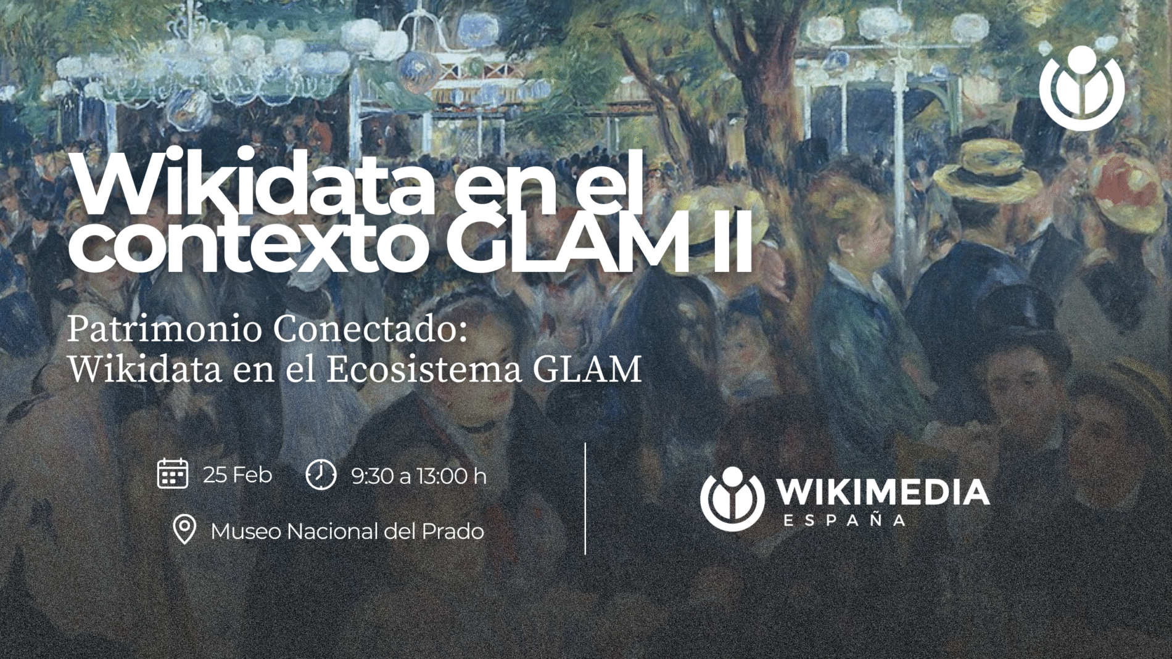
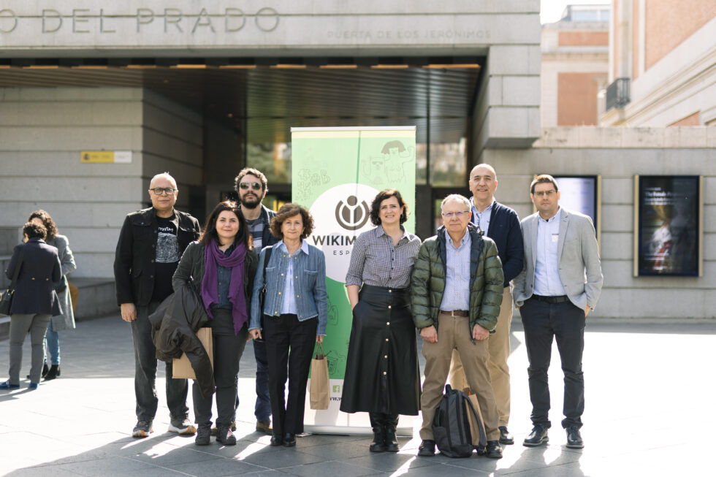
Wikidata in GLAM
Sgarciacine, CC BY-SA 4.0,
https://wikimedia.es/abiertas-las-inscripciones-para-wikidata-en-el-contexto-glam-ii-patrimonio-conectado-en-el-museo-del-prado/
https://wikimedia.es/patrimonio-conectado-wikidata-impulsa-el-ecosistema-glam-desde-el-museo-del-prado/

Slide 23
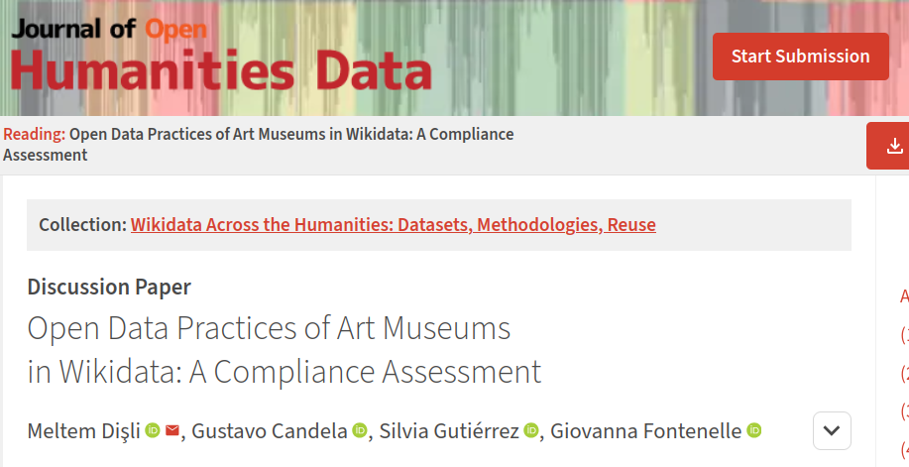
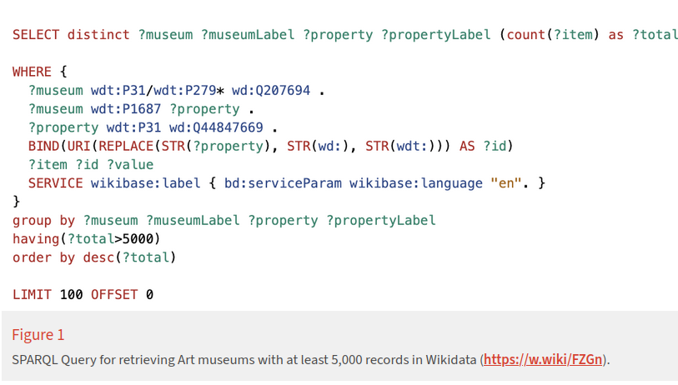
Data quality in museums
Data quality criteria
Understandability
Availability
Federated
Reusability
Timeliness
Enrichment
File repository (Wikimedia Commons)
https://w.wiki/FZGn
https://doi.org/10.5334/johd.438

Slide 24
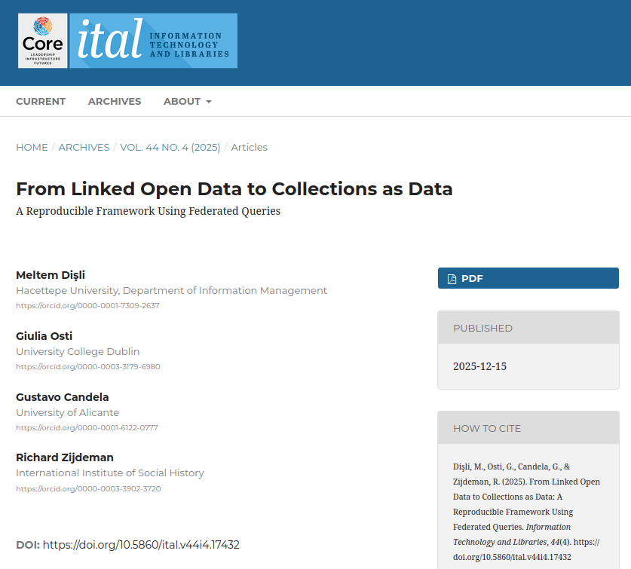

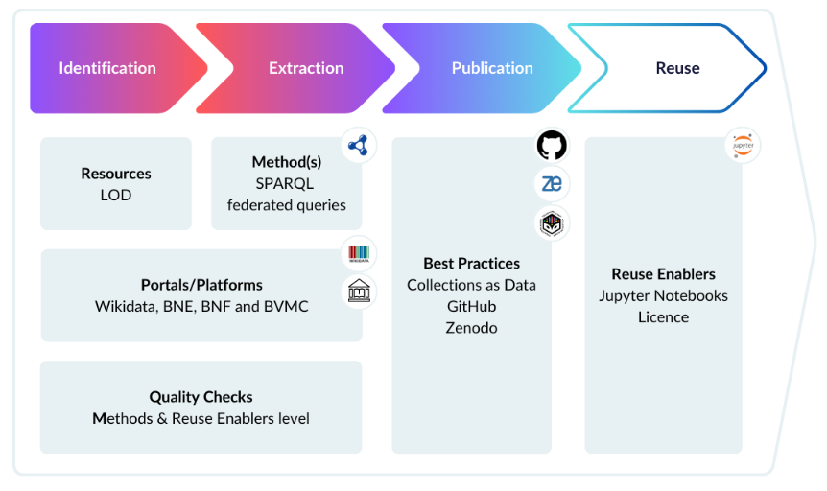
Exploring the use of SPARQL federated queries
4 Use cases
Spanish Golden Age Literary movement
Jorge Juan y Santacilia
María de Zayas y Sotomayor
Bibliographic records
https://doi.org/10.5860/ital.v44i4.17432
Avoiding data silos….

Slide 25

Challenges
Data quality and consistency
  Metadata in Wikidata is community-edited, so records may vary in completeness or consistency
Technical expertise
  Technical skills are often needed for batch uploads, data reconciliation, and automated workflows
Staff capacity and resources
  Smaller GLAM institutions may have limited staff, funding, or technical infrastructure.
Licensing and copyright
  Wikidata requires data to be released under the Creative Commons CC0 1.0 Universal public domain dedication.
  Copyright restrictions can limit the sharing of images or descriptive content.
Sustainability and continuous updating
  Long-term sustainability requires clear workflows and responsibilities
Modeling complex collections
  Some cultural heritage objects have complex provenance, ownership histories, or relationships that can be difficult to model.

Slide 26
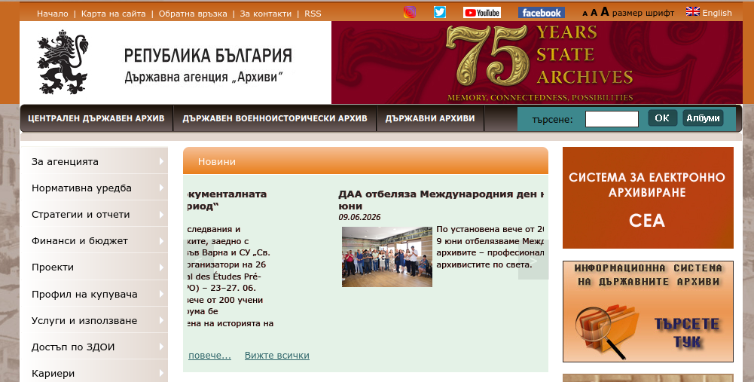
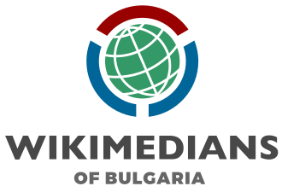


What about Bulgaria?
Which institutions do you think would be interested in these types of activities?
What types of activities do you think would be most suitable for Bulgarian institutions? Datathons, hackathons, …
How can we promote this work within Bulgarian Cultural Heritage institutions? Which challenges can impede moving forward?

Slide 27
Future work
Wikibase in GLAM
Additional use cases based on the Spanish Civil War
Exploring archives in Chile
Additional collaborations…

Slide 28
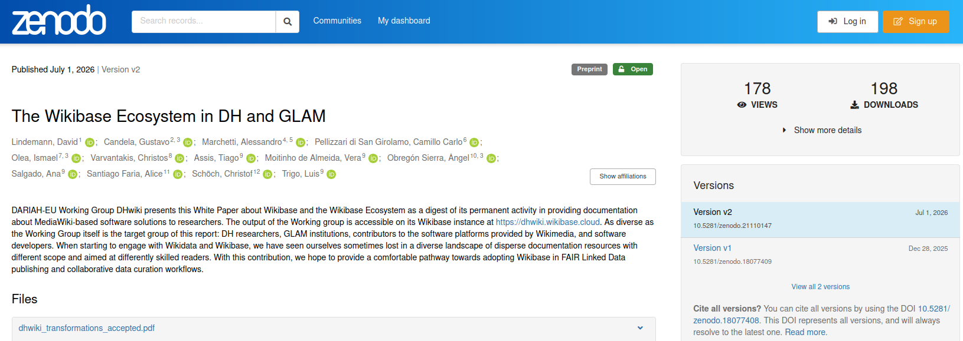
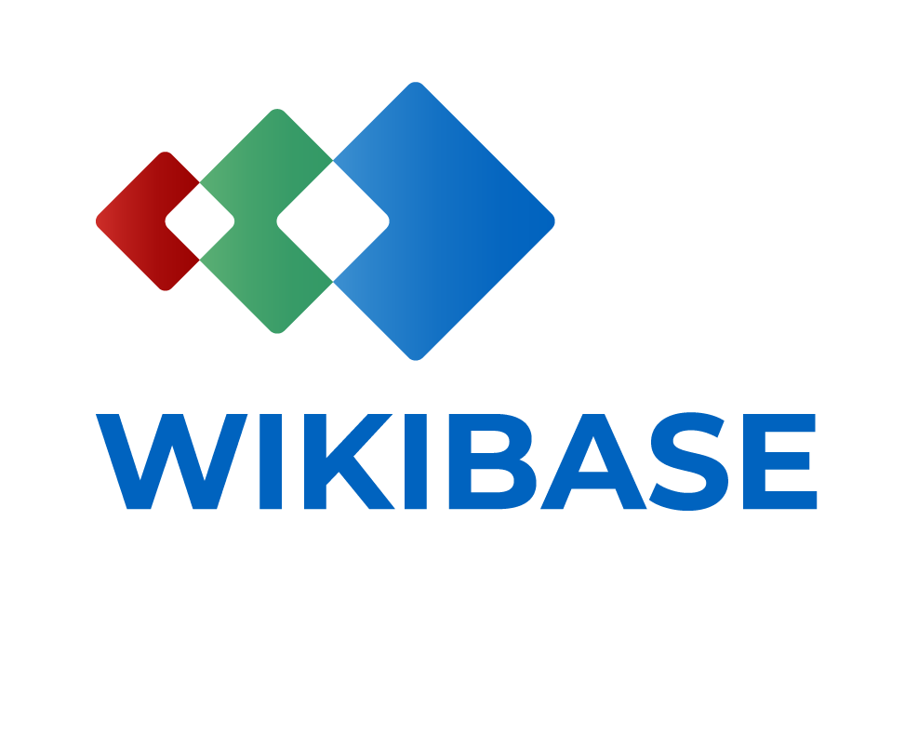


https://doi.org/10.5281/zenodo.18077408
https://www.wikibase.cloud/

Slide 29




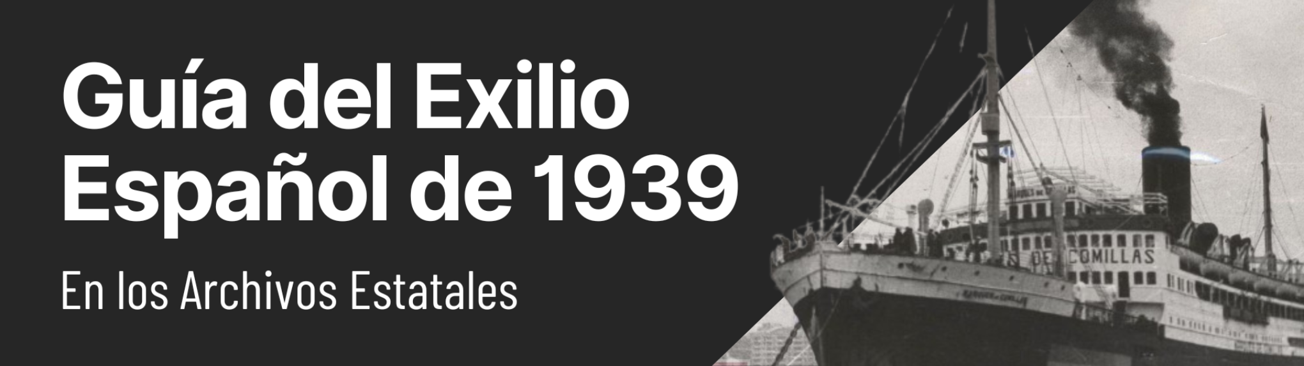


Extracting collections as data & Spanish Civil War
Uses cases
Refugee ships on which Spanish exiles embarked during the Spanish Exile and the Spanish Civil War
Artists from the period of the Spanish Republic and Spanish Civil War
French refugee camps, which concentrated the Spanish Republican exiles of 1939
Bibliographic records related to the Spanish Civil War
Edit
Data research infrastructures
GLAM institutions
Vocabularies and ontologies
Dissemination
Identification of sources
Data extraction and modelling
Publishing and reuse
Open science and reproducibility
https://github.com/hibernator11/Spanish-Civil-War-KGs
Guide to the Spanish Exile of 1939 in the State Archives
Many thanks to Meltem Dişli, Paul Spence, Cezary Rosiński and Arkadiusz Margraf
Article published soon! Journal on Computing and Cultural Heritage

Slide 30


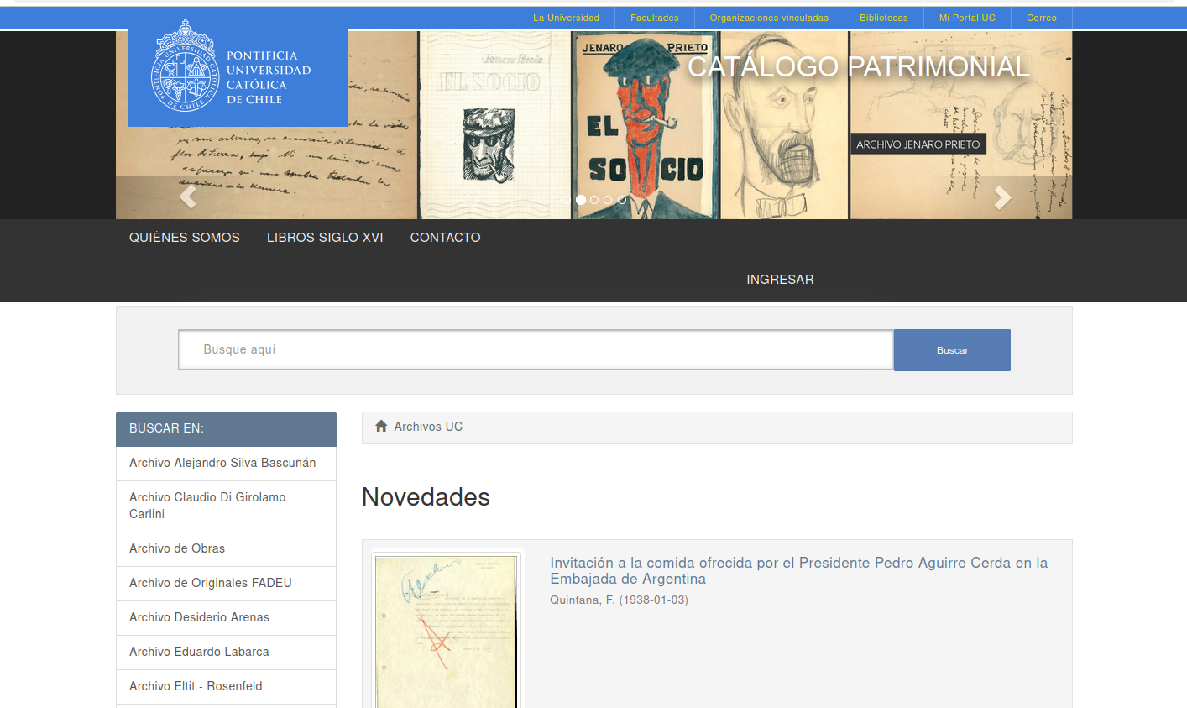





Exploring archives in Chile: A Collections as data approach
Fellowship in Chile - August 2026
Knowledge sources
Word embeddings
2
Search Retrieval Information
Query
Prompt + query
Relevant information enhance the context
https://archivospatrimoniales.uc.cl/
3
1
Generated text response
5
Prompt + query + enhanced context
4
LLM

Slide 31
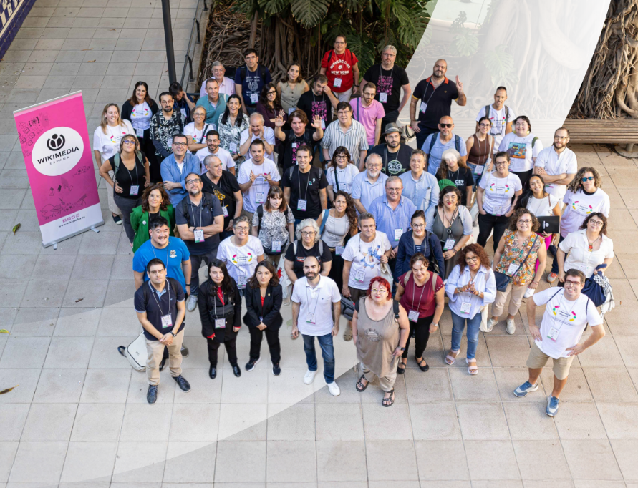
Additional collaborations
More partnerships with GLAM institutions and research institutions
New Data Science staff member?
Events, datathons and hackathons

Slide 32
Data collaborations with cultural heritage institutions: opportunities and challenges
Thank you!
gcandela@ua.es
“Inspiration exists, but it has to find you working.” Pablo Picasso

