Slide 1






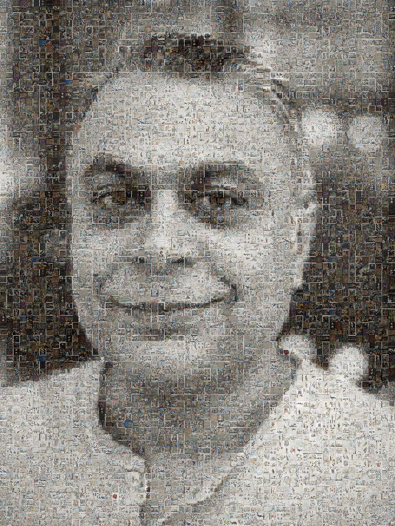
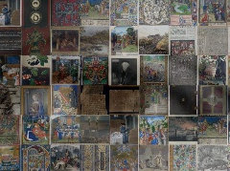
Mr Mahendra Mahey
From GLAM Labs to open innovation: enabling reuse and experimentation
13:10-13:40, Monday 6 July 2026,
Ivan Evstatiev Geshev Hall, Bulgarian Academy of Sciences, 15 Noemvri St., Sofia
Research Data Analyst in Humanities - Tallinn University
PhD Candidate (2024-2027) - Information Science Research Group – University of Strathclyde
Researcher - Estonian Research and Cultural Data Infrastructure Project
Researcher - Estonian National Museum, Tartu, Estonia
https://orcid.org/0000-0001-7608-6152
We are our history!
Image made up of
500 digital heritage images
First FOCUS Internal Training Building Data Collaborations for Digital Cultural Heritage Stakeholders, Reuse and Open Innovation
My work at the Estonian National Museum is supported by the Estonian Ministry of Culture's research and development program “Estonian Culture Research and Development Programme 2023-2026” under grant KUM-TA 43 “Digital Cultural Heritage as a Societal Resource”
mahendra.mahey@tlu.ee

Slide 2
http://tiny.cc/GLAM-Labs-Sofia-6-7-26

Slide 3
Structure
Introduction
Creative research and experimentation
RODEO
Reuse of Digital Collections
Lessons learned
GLAM Labs

Slide 4
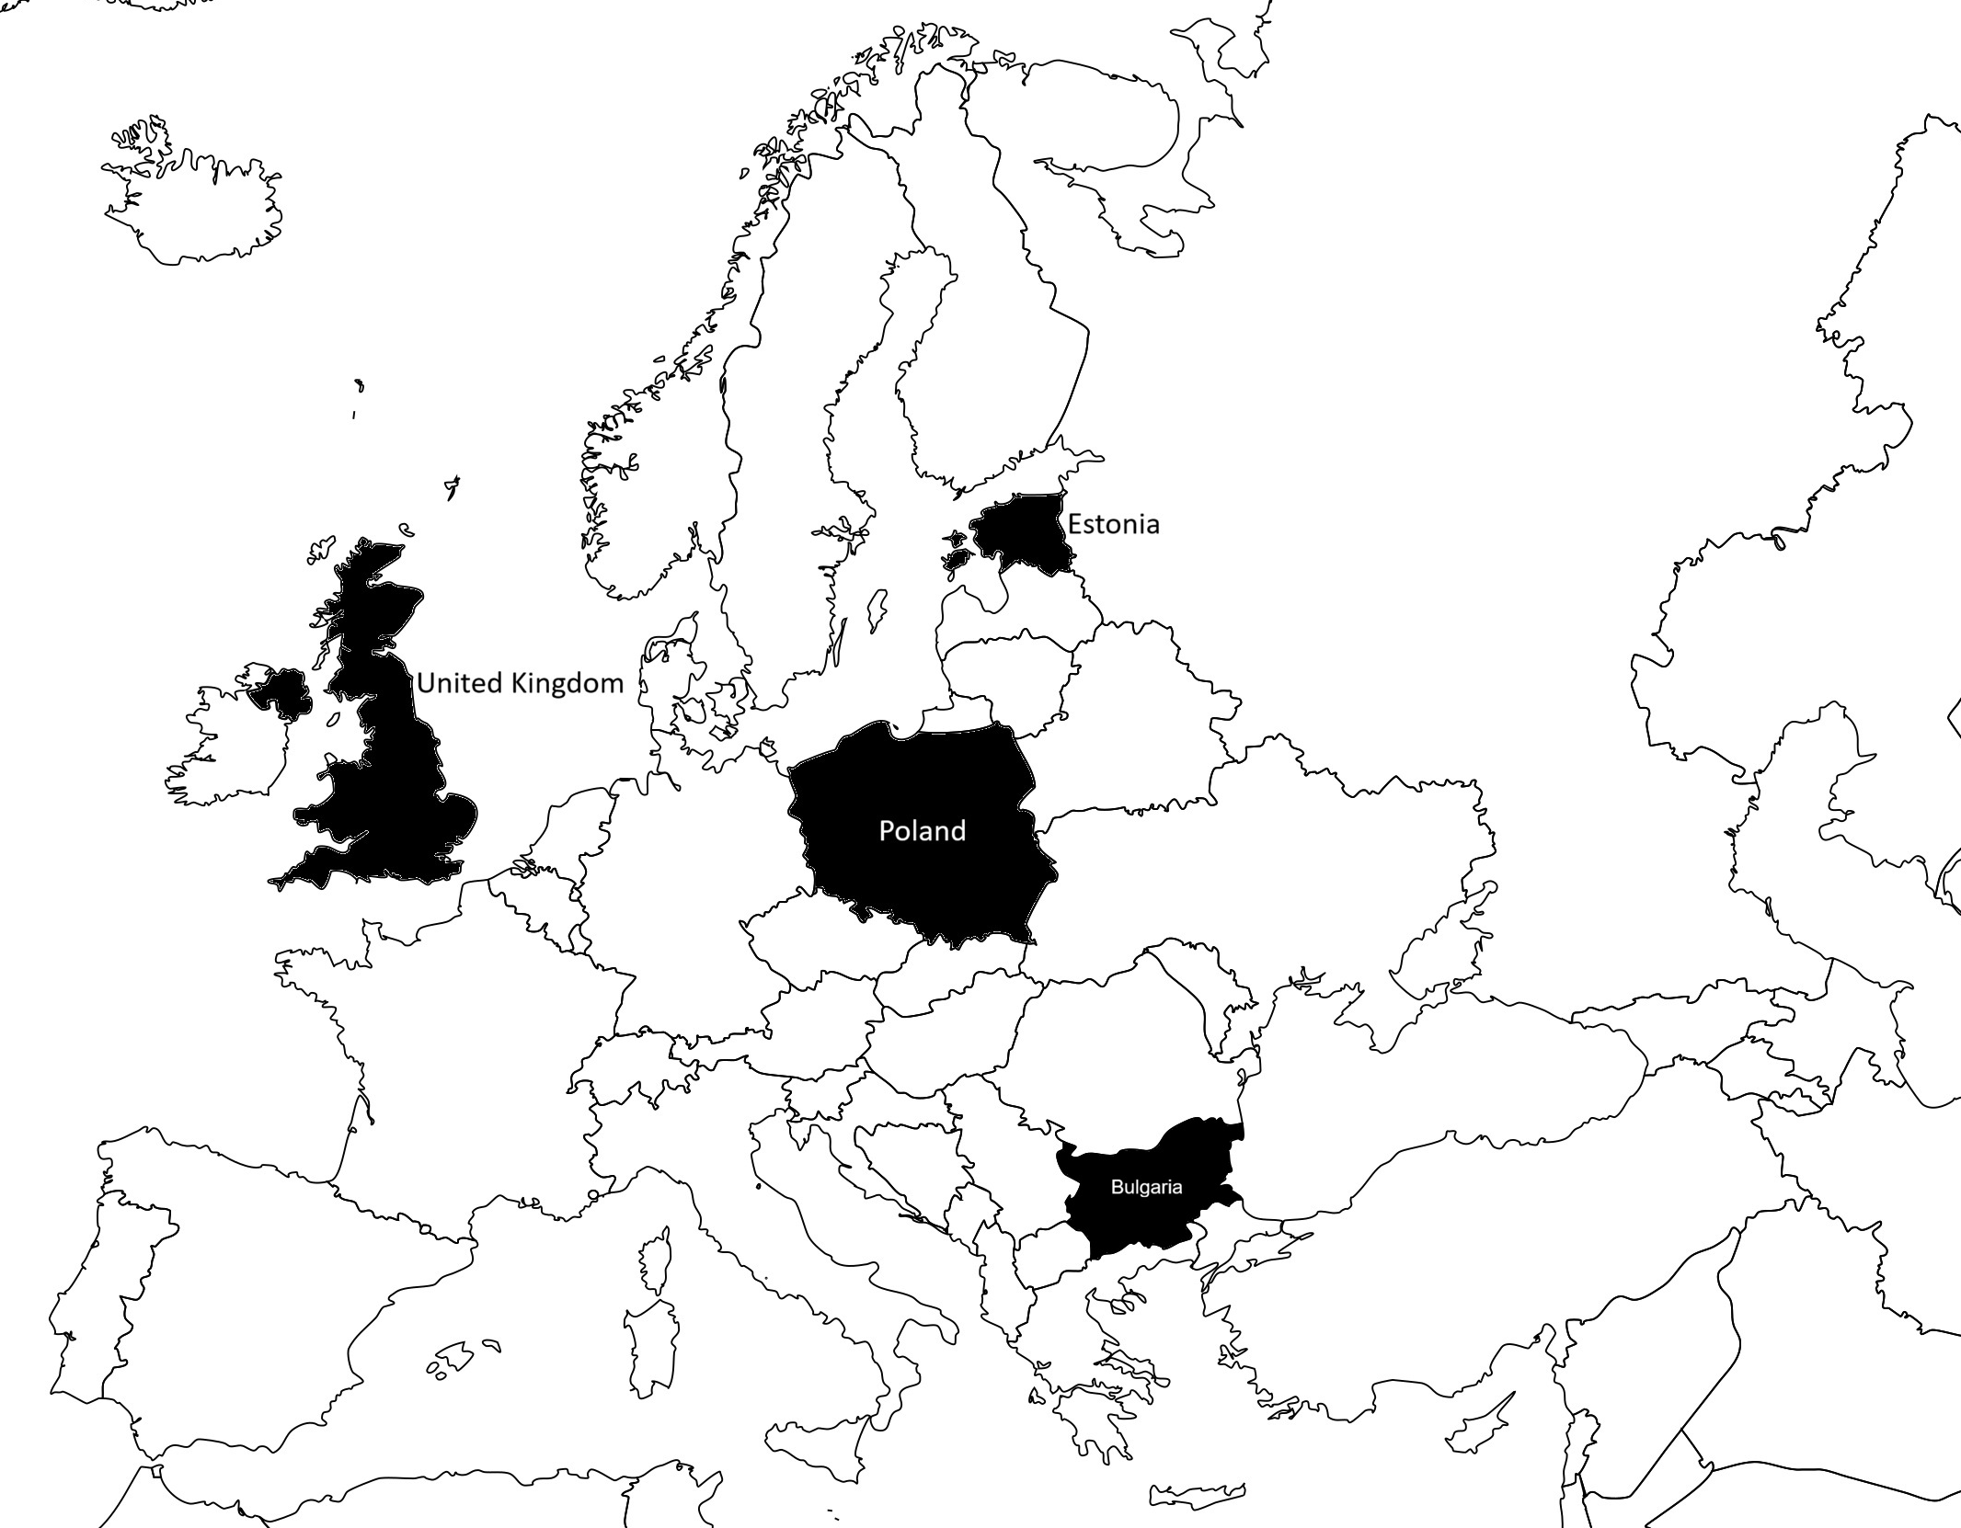















Over 35 years of professional experience in
Research, Education and Cultural Heritage
Researcher (Datafication)
Schools | Colleges | Universities | Libraries | Museums

Slide 5
GLAM Labs
GLAM Labs are online and/or physical spaces that facilitate experimentation with digital and born digital cultural heritage

Slide 6
Gallery, Library, Archive and Museum Labs address the following challenges
Return on investment on digitising / capturing digital
– how are they being used, what value and impact they are having, especially when opening collections for all,
the choices made in digitisation (what and why) to help influence future decisions about what gets digitised
What digital collections can be used openly & onsite?
- how to tell people, go to them, they won’t necessarily come to you, is there anything of interest to anyone?
How we are & should be supporting our users when they want access & experiment with digital collections manually & computationally?
  - right access, discovery to digital collections / data? Advice, guidance, technical support, training. Are we providing the right services, tools and processes?
Explore the ‘feel’, ‘shape’, ‘patterns’ ‘needles in haystacks’ of collections at scale
- especially using computational methods, GLAM Labs often found in digital scholarship (e.g. digital humanities) departments
Circular value - find, explore, augment discovery in often ‘messy’ cultural heritage data & put that data back (help improve the GLAM)
- often without public computational access
Discover, celebrate old culture, research & remix to create new culture for inspiration & joy to make relevant

Slide 7
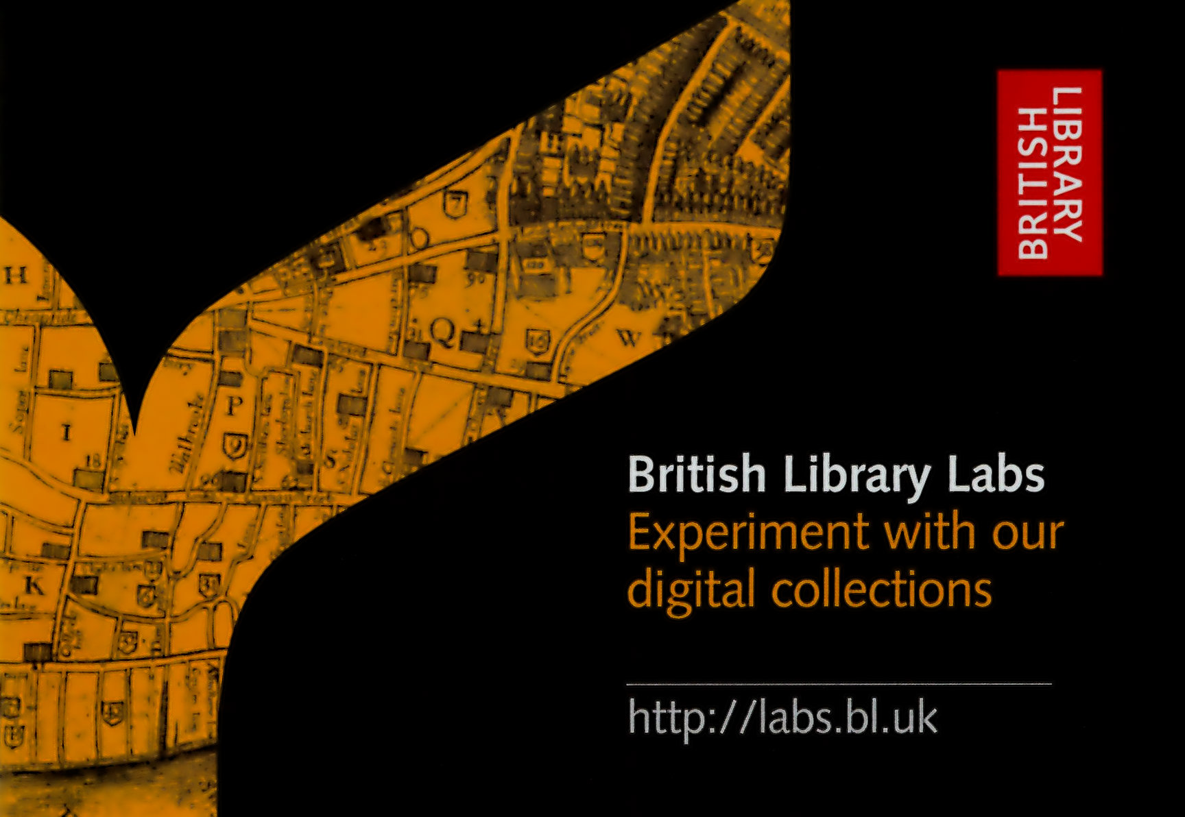
Ran BL Labs from 2012 - 2021
Supported and showcased over 300 projects with researchers, artists, entrepreneurs, educators and British Library staff
Competitions, Awards, Projects and hundreds of conversations
Positioning around using cultural heritage data in data science and Higher Education
Building global community of Galleries, Libraries, Archives and Museums (GLAM) Labs
Funded by the British Library and previously by the Andrew W. Mellon Foundation

Slide 8
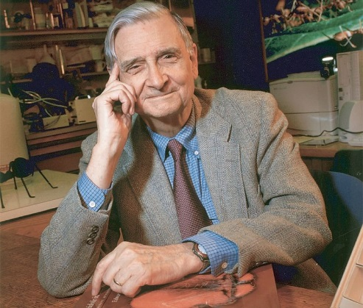
Understanding a person and humanity is hard …
We have Palaeolithic emotions;
Some of us work in medieval institutions;
Yet we have been given god-like technology
e.g. computing and internet
Adapted from interview with Sociobiologist
Edward Osborne Wilson - 2009

Slide 9
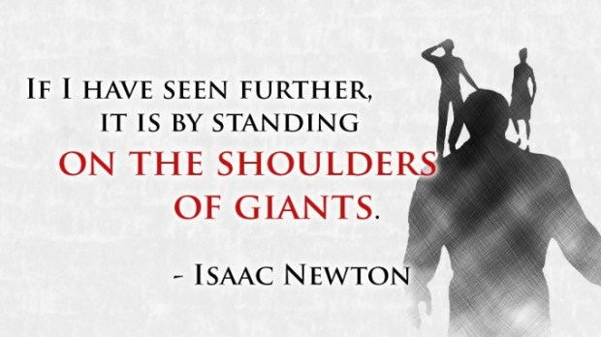
Standing on the Shoulders of Giants / Pioneers

Slide 10
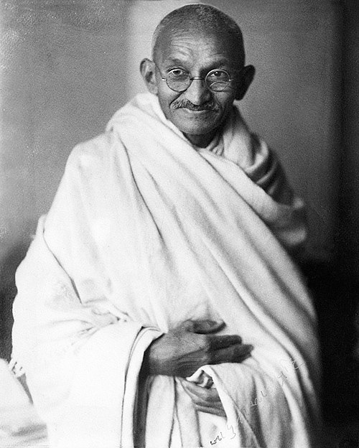
‘Be the change you want to see in the world’
Ask yourself…do you really care?

Slide 11
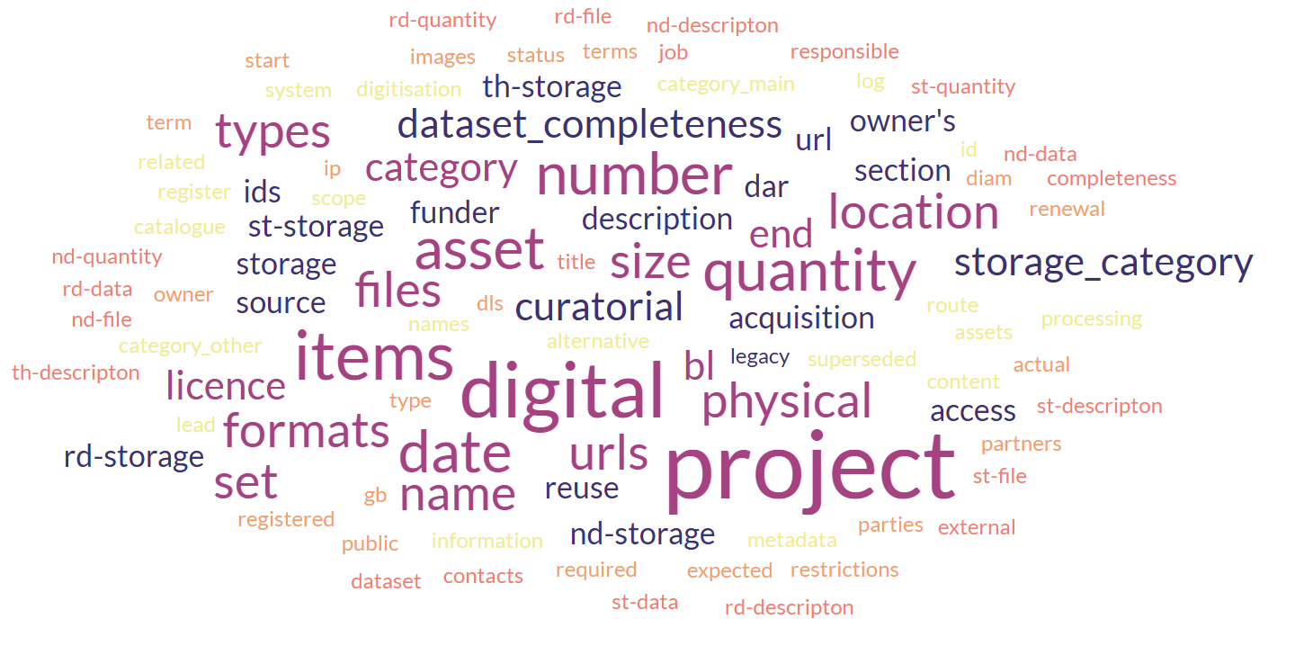
What digital collections do you have?
Does the institution know what is has?
Does it have a list?
At the British Library, there was
a Digital Asset Register?
Essential for doing this work

Slide 12
The biased mysterious story of the digital collection… and ALL collections, get to know the story of the collection
Still there?
Curator
Is there any background documentation?
Old format not supported
Who paid for the digitisation?
Published
What media was the
digitisation done from?
Unpublished
Digital
Collection
Who did the digitisation?
Technology used
Where is it?
Access / API?
Born digital?
Can it still be accessed?
Politics when digitised, e.g. Brexit?
Generates income
No Descriptive information
Reputational risk in using?
Descriptive information
Personalities involved
Inconsistent descriptive information
Legalities /
Ethics / Morality
Surprises (e.g. gaps)
Paradata
Good to know the background ‘story’ and biases of a digital collection
if you want to use it for projects …

Slide 13
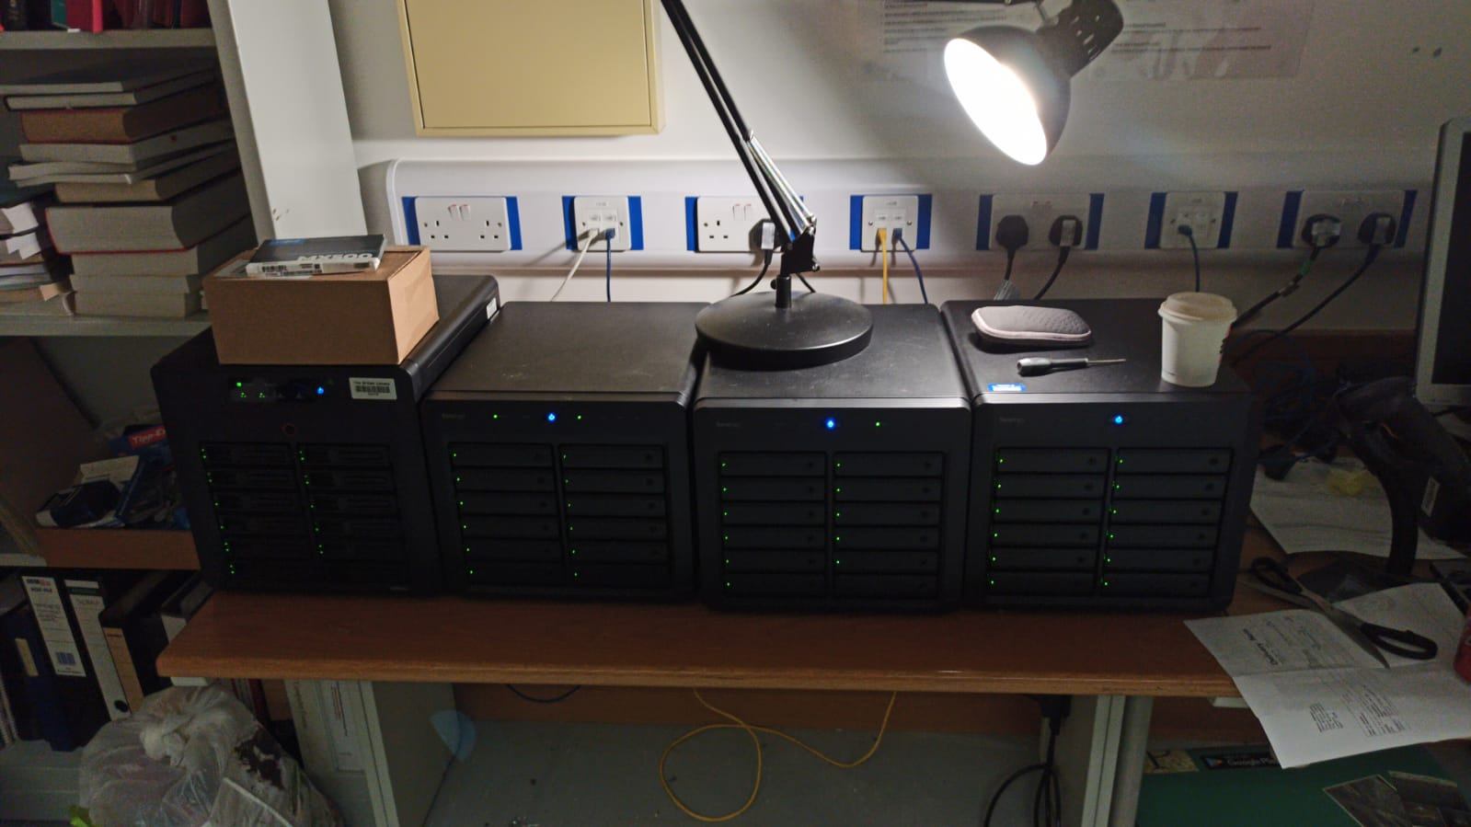
Getting the digital collections out of digital preservation systems
DP systems are often engineered for long term preservation not easy access
Lab’s solution is to take the materials from silos and make a copy of raw files available to researchers

Slide 14
audience and digital collections
audience interests
digital collections
Have a ‘date’
with the ‘data’
Often small in proportion
to physical collections
4%* at the British Library!
180* million physical items
Only 9% books
‘Sweet spot’
Hard intellectual engagement sometimes required given
the smaller size & sometimes ‘random nature’ of digital collections
when compared to the physical collections
*estimate

Slide 15
Awards
How @ GLAM Labs?
Competition
Tell us your ideas of what to do with our digital content
Engagement, energy,
excitement & ideas around
digital collections!
Road-shows
Events – Data sprints / Hack Events…
Social Media
Meetings
Conversations
Show us what you have already done with our digital content in research, artistic, commercial, learning and teaching, staff categories
Projects
Talk to us about working on collaborative projects
Digital Research Support Service

Slide 16
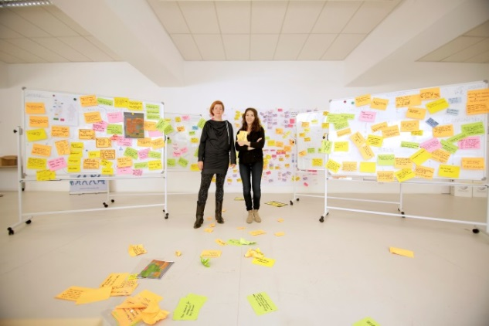
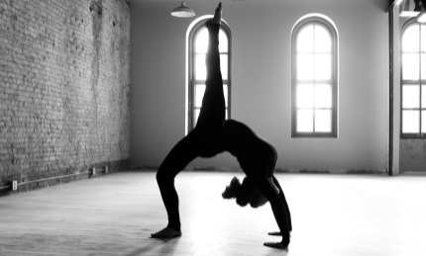
What engagement with people wanting use digital content?
Dialogue typically:
  we have exactly the digital content
  / data relevant to your project
  we don’t have exactly what you're looking for,
  let’s talk…
  engagement hard intellectual work
  constantly required to maintain interest in BL digital collections!
We also tend to attract projects with ‘fuzzier’ boundaries and possibly open to more interdisciplinary / collaborative research
Artists / Creatives find this dialogue easier…
https://goo.gl/qpCLlk
https://goo.gl/wMTS3Z

Slide 17
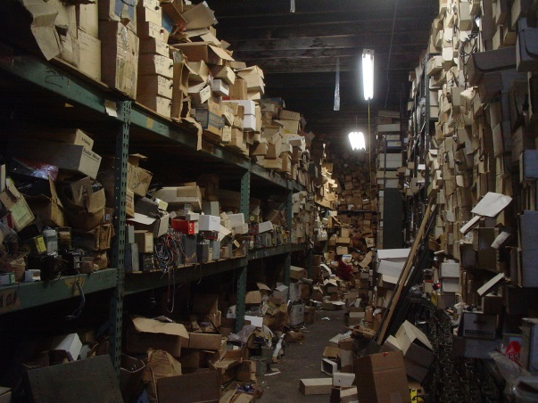
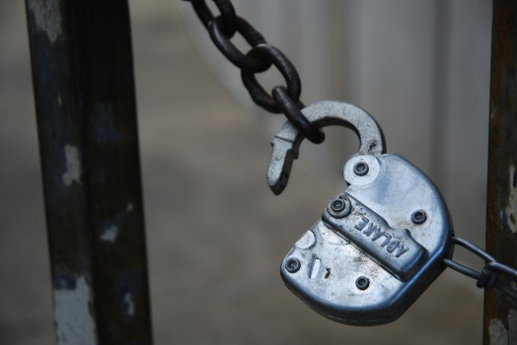
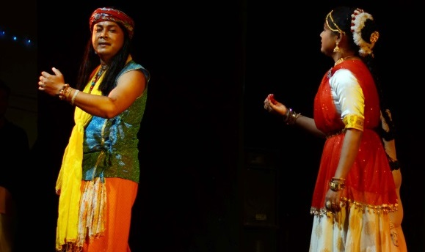

Example of pattern of research at GLAM Labs (1, 2, 3)
Finding invisible / well hidden things in ‘messy’ historical data, patterns, giving data back (circular)
Unearthing / unlocking hidden histories & data to stimulate new research
Celebrating hidden histories / data creatively through events, art & performance
Not the British Library!
https://goo.gl/mcpa8B
https://goo.gl/vJ291F
https://goo.gl/Ql0Bwz

Slide 18
Example phases of interaction / engagement with digital heritage in the GLAM Lab
Have a ‘date’
with the ‘data’
Next steps
Publish reuse
Rethink
Iterate
Phase 1
Data Journey
Phase 2
Query-Focussed
Phase 3
Hard deadline
Constrained resources
Ideas change, once people explore the data and perhaps the culture of the institution!
Use computational methods only where appropriate
Well informed question
once you have seen the collection
Incubation idea
to get support

Slide 19

Challenges of access to Digital Collections
Onsite @
British Library
Labs Residency Model
Competition / Digital Research Support Application
Hot Desks and Digital Research Spaces in Reading Room
NOT ONLINE
READING ROOM
OPEN
£
Over 700 Digitisation / Capturing Born Digital Projects
20 %* Openly Licensed – most online
80 %* Available onsite only at the moment

Slide 20
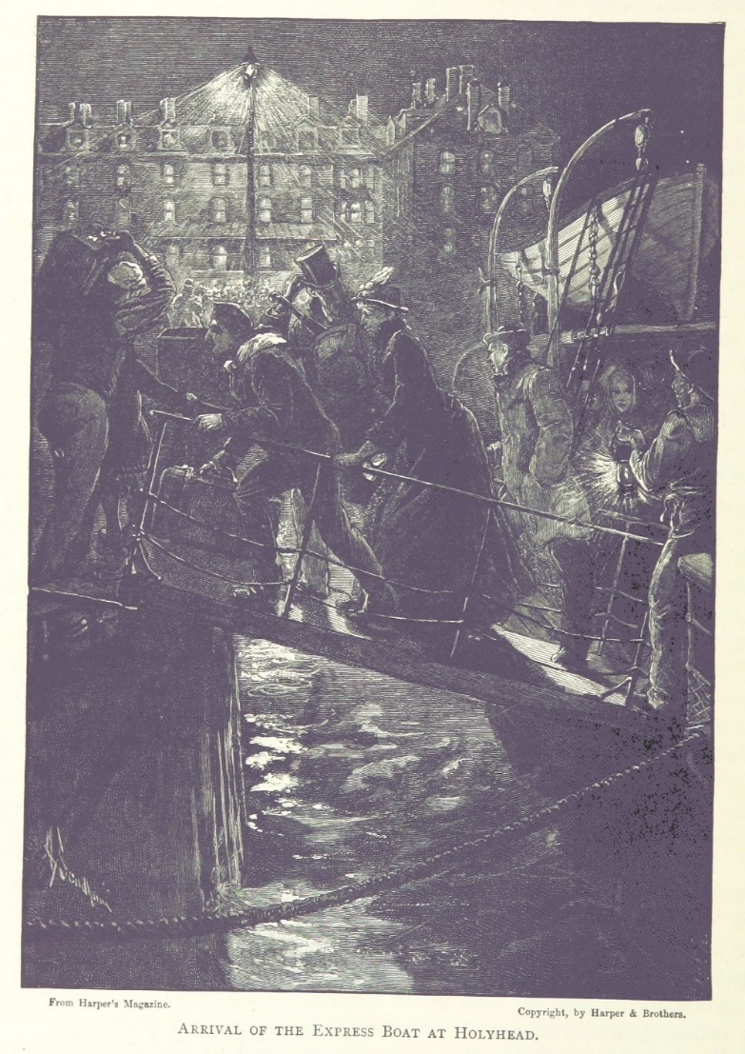

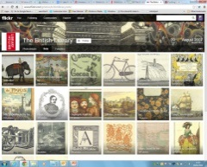
Putting your digital collections (and all collections) where the light is
Don’t assume people will come to you!
If you build it, they may not necessarily come!
Labs often provide the ‘retail’ of the often-invisible GLAM warehouse / treasure chest
Institutions need to put their collections where people look, where the light is, search engine optimisation, social media etc.
Engage your users
put collections
where they look
E.g. BL Labs has used Flickr &
Wikimedia Commons
https://www.flickr.com/photos/britishlibrary/11214863534/
https://goo.gl/LZRmaZ

Slide 21
Publish openly – users are NOT obliged to capture reuse…
You could provide form to complete before or after access
  Text to encourage to tell the organisation
  Good ideas but also barriers to use
  Rarely done and questionable rationale
  Poor use
But let’s tap into other human motivations

Slide 22
Through a GLAM Lab
Publication is a motivation
If you tell me story (and are willing to share) you might get an award of actual reuse
Motivation – are researchers more likely to do this?
Does it work?

Slide 23
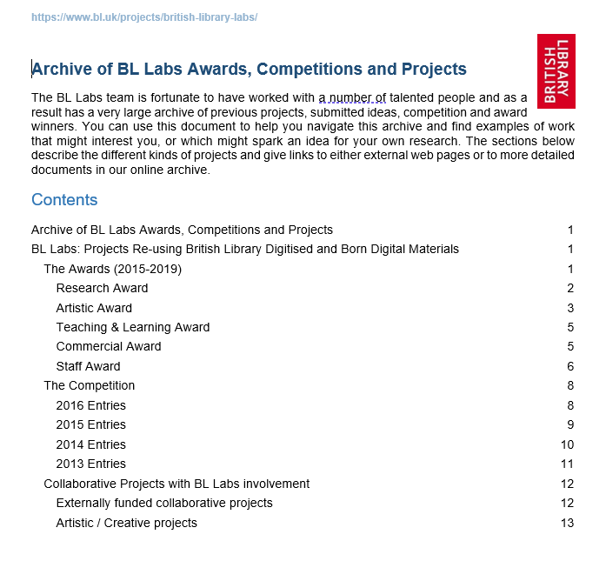
BL Labs Digital Project Archive
Over 300 projects
Examples of reuse
Captured through asking and reward system
Probably drop in ocean
Also used to demonstrate impact
Get more funding
Generate new ideas for reuse at workshops

Slide 24
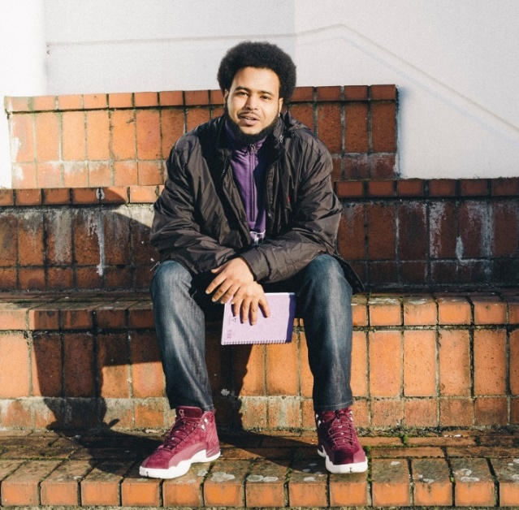
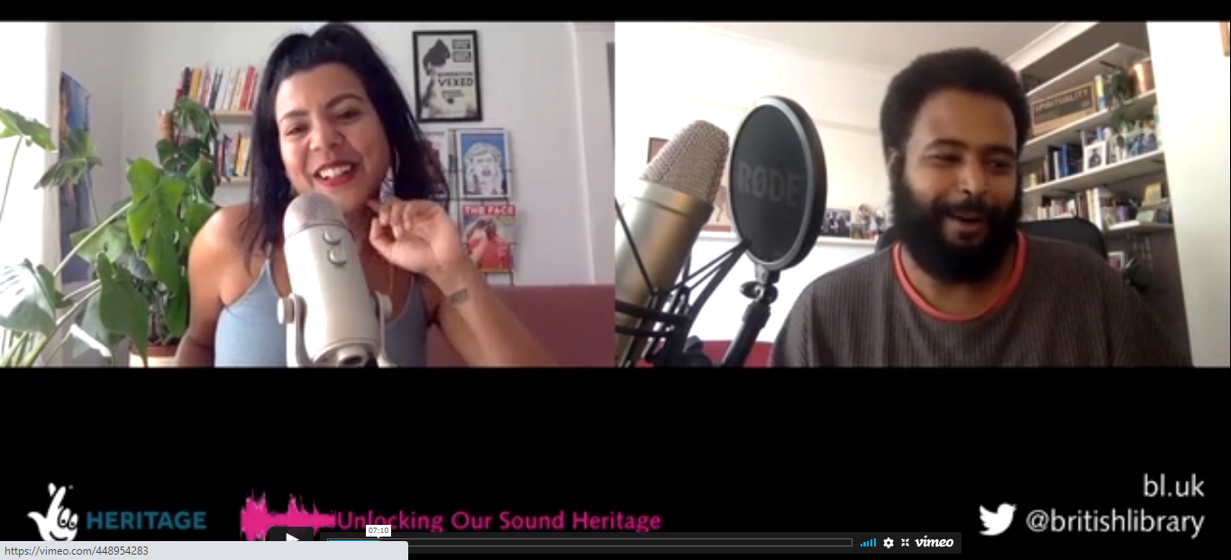
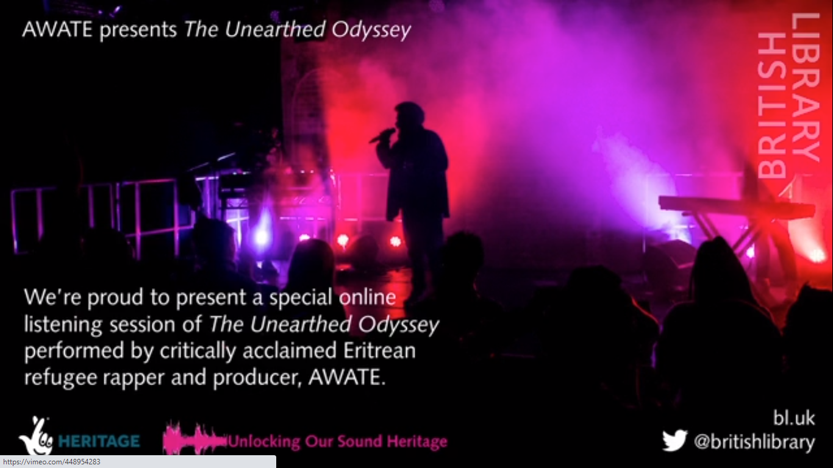

Unlocking our Sound Heritage
Artist in Residence: The Unearthed Odyssey
http://tiny.cc/shortlist-2020
Awate Suleiman
rapper &
multimedia artist
@awatemusic
https://www.happinessisopenforbusiness.com/
https://www.bl.uk/case-studies/awate-the-unearthed-odyssey

Slide 25
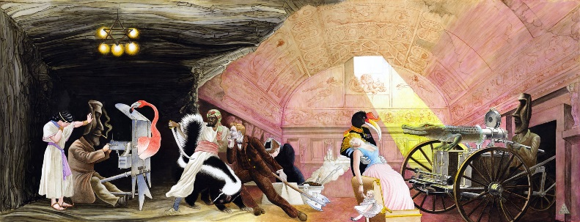
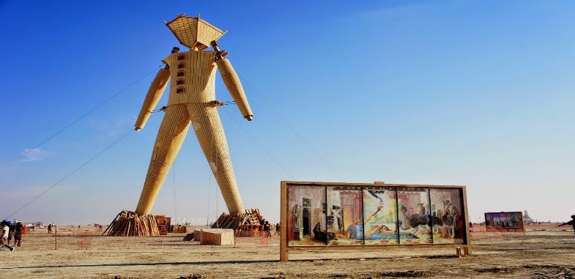
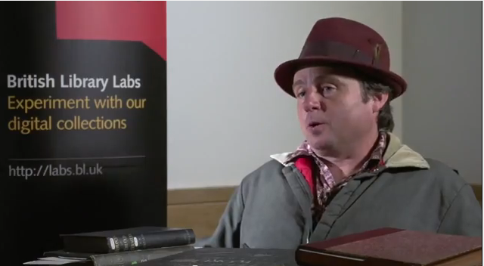
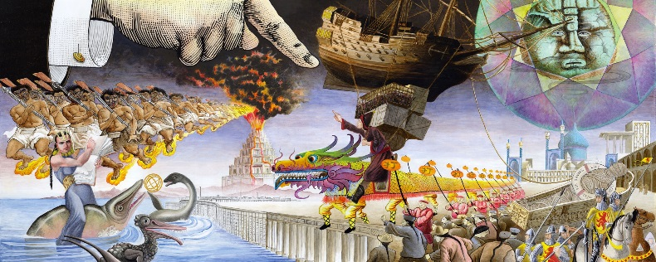
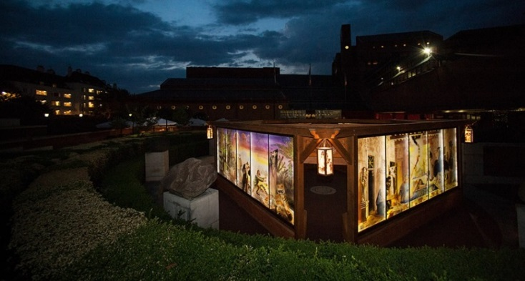
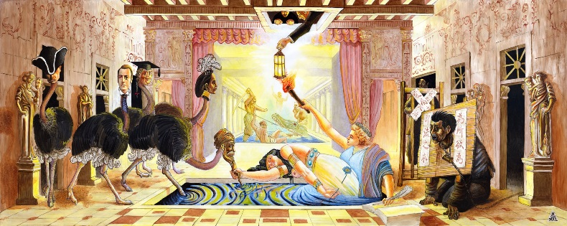
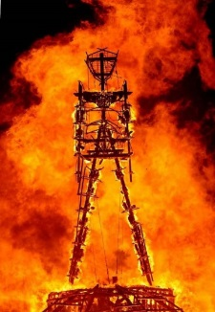
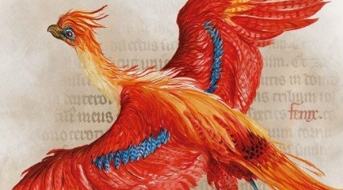
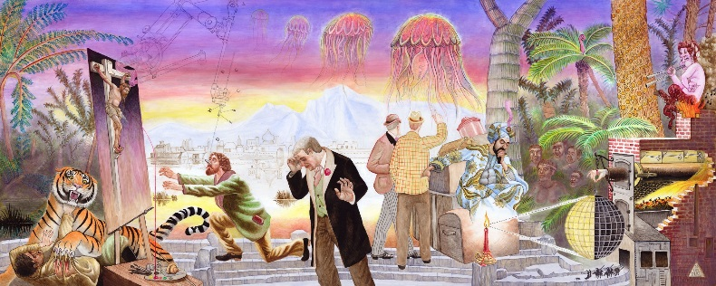
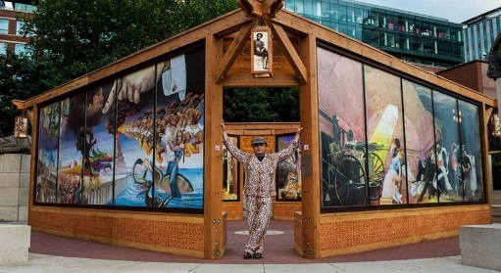

David Normal – Artist
Crossroads of Curiosity –
Collage Paintings
Crossroads of Curiosity @ Burning Man 2014
https://youtu.be/Q3SBxO34Zlc
‘It was beyond my wildest dreams’
Crossroads of Curiosity @ British Library 2015
https://www.crossroadsofcuriosity.org/
1 million images from scanned books

Slide 26
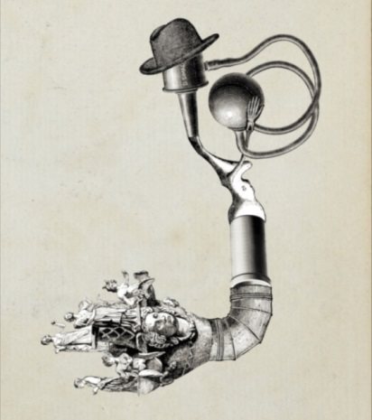
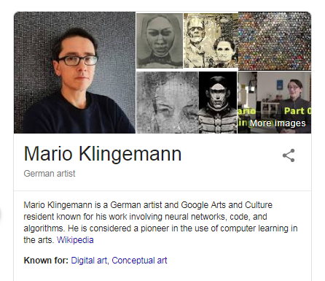
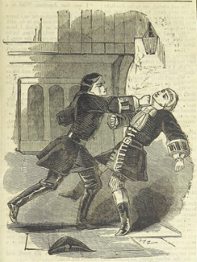
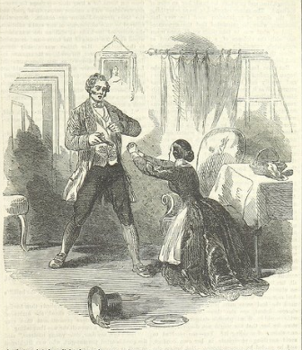
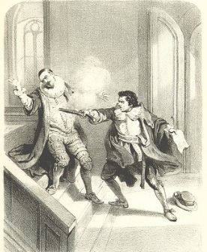
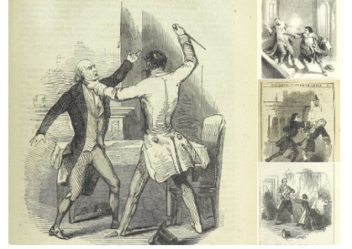
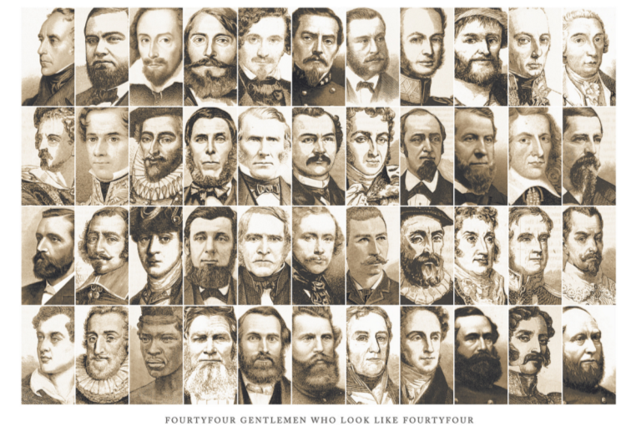
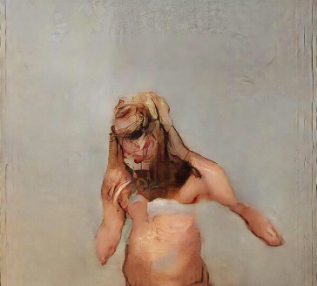
Mario Klingemann – Code Artist
First Artistic Award winner!
http://quasimondo.com/
http://goo.gl/dM8ieA
The Butcher’s Son
2018 LUMEN Prize winner
https://lumenprize.com/a-i-portrait-scoops-gold/
44 Men who Look 44
(Notice the direction faces)
A Hat on the ground
spells trouble

Slide 27
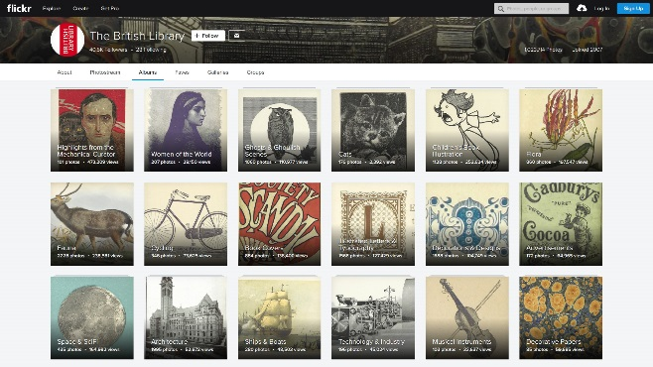
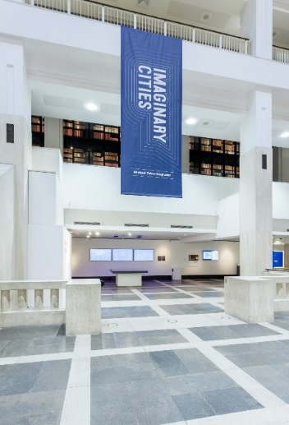
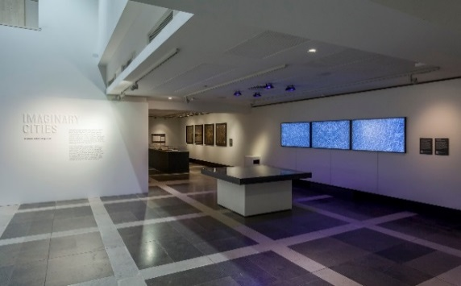
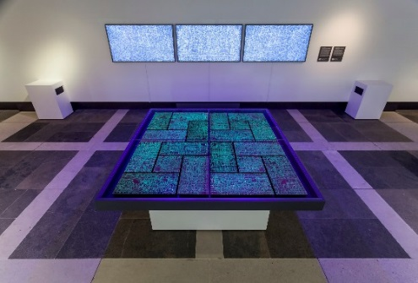
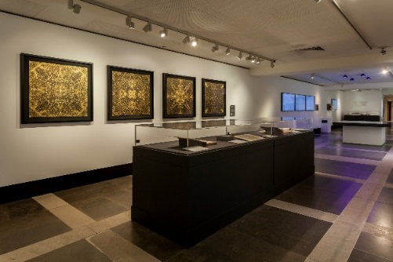
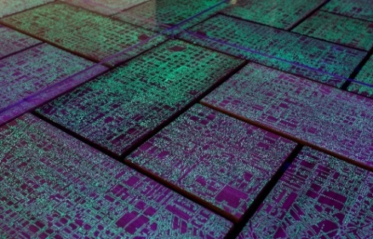
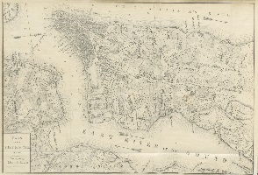
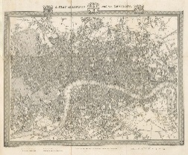
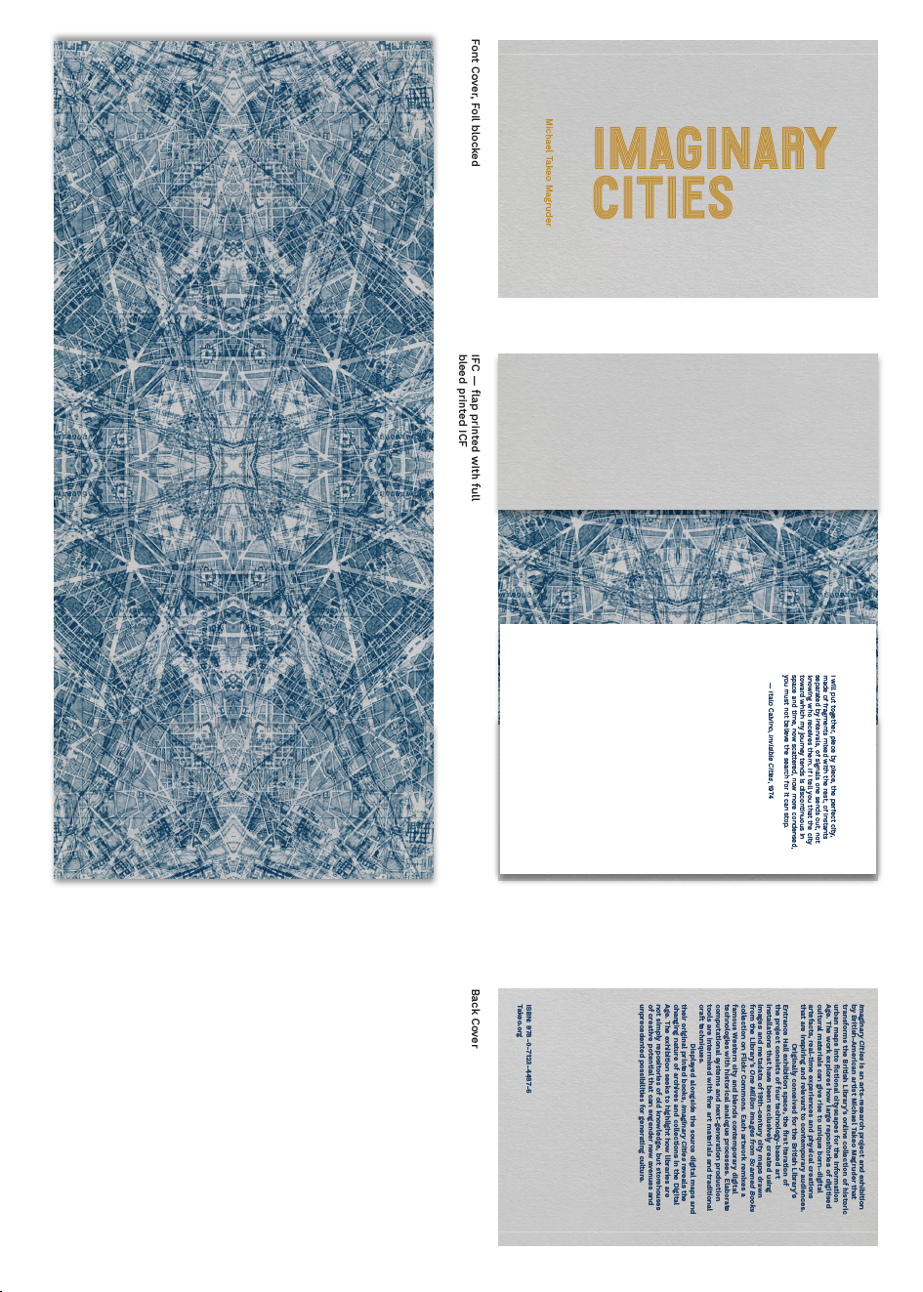
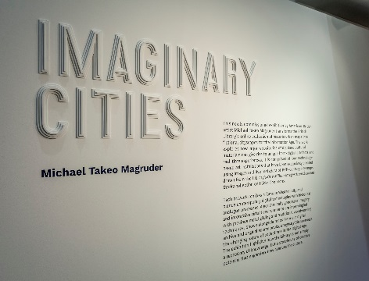
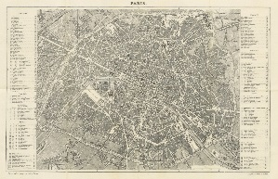
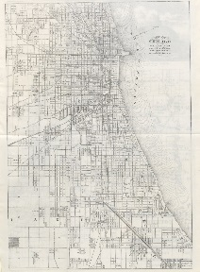



Imaginary Cities Exhibition
Michael Takeo Magruder – Artist / Researcher / Cultural Re-mixer
Using historic urban maps, public interaction & algorithms to create new art
150,000 visitors
Talks and events
Limited edition Imaginary Cities book
New York, 1861
London, 1834
Paris, 1872
Chicago, 1874
4 city maps from 50,000
found by volunteers
https://www.youtube.com/watch?v=BwHVWw4hPzw&feature=emb_logo

Slide 28






Vittoria’s World of Stories – Primary School
1 million images
from scanned
books
https://goo.gl/mYw7UM

Slide 29


Curating Finnish Titles
Working with Senior schools
https://goo.gl/8rQWo7
Ruby Dixon – School work experience https://goo.gl/AniJiP

Slide 30



Australian National University Canberra (ANU)
Centre for Digital Humanities Research
British Library Labs Data Projects – using different kinds of data
Collaboration with Terhi Nurmikko-Fuller & Katrina Grant, I was a visiting research fellow
Centre for Digital Humanities Research
Projects which use British Library data
  Chinatown tours
  Augmented Reality App for experiencing depression of composer
  App for endangered species detection in Botanical Gardens

Slide 31


Estonian Museum of Literature
Hack Event – April 2026
Renewed interest in Cultural Heritage in Estonia
Weekend Hackevent
Preparation of Datasets
Winning team were not Estonians
International team: Göktürk, Inna, and Hikmat. Photo: Hikmat Azimzade.
https://www.etkad.ee/uudised/rahvalaulude-kaardistamine-hum-andmelabori-hakatoni-voidutiim-tutvustab-oma-tood/

Slide 32

Finding ‘reuse’ can be like fishing in the sea
https://upload.wikimedia.org/wikipedia/commons/c/c5/Fisherman_throwing_the_net_in_the_Arabian_sea.jpg

Slide 33
Documenting and publishing impact of GLAM Digital Cultural Heritage
GLAMs need to be better at systematically measuring impact of their reuse of digital cultural heritage
GLAMs don’t always document reuse of their digital cultural heritage, don’t always see the value, rely on proxy metrics such as views and downloads, but that does not say much about impact, they don’t tend to publish these accounts often
There are several schemes to help such as excellent D-Craft and inDICEs examines social impact
Collections as Data and Datasheets for Cultural Heritage enable more systematic publication of digital cultural heritage, and make it machine accessible.
Me and colleagues are developing an approach to document reuse of digital cultural heritage to allow comparisons for better planning for digital cultural heritage projects

Slide 34

Towards a Schema for Digital Cultural Heritage Use / Reuse
Article submitted to Heritage Journal Special Issue
By Mahendra Mahey, Pille Pruulmann-Vengerfeldt (Malmo University) and Pille Runnel (Estonian National Museum)

Slide 35
Six Category Framework
Category | Core Questions | What it captures | Example indicators | Why it matters
7 Pre-questions 1. Organisation & Context 6 Questions | Where and under what conditions does reuse occur? | Institution type, funding, resources, skills | GLAM lab, grant-funded, team roles | Explains capacity, constraints, and sustainability
2. Heritage Assets & Technologies 6 Questions | What materials and tools enable reuse? | Data types, formats, Application Programming Interfaces (APIs), platforms, processing | Images, metadata, Machine Learning tools | Shapes what forms of reuse are technically possible
3. Purpose & Process 11 Questions | Why and how is reuse undertaken? | Aims, activities, workflows, motivations | Teaching, remix, analysis | Connects intentions to practices and outcomes
4. Users & Engagement 8 questions | Who participates and how? | Audiences, literacy, interaction modes | Co-creation, viewing, crowdsourcing | Reveals pathways to meaning making and access barriers
5. Nature of Use & Availability 9 Questions | What constraints shape reuse? | Licensing, openness, persistence, access | CC-BY, temporary exhibit | Determines reach, equity and longevity of reuse
6. Impact & Sustainability 8 Questions | What value and longevity result? | Outcomes, beneficiaries, maintenance | Learning, identity, ongoing support | Supports evaluation beyond proxy metrics
50 Questions in total between 30-60 minutes complete

Slide 36





RODEO - RespOnsible Digitalisation in EstOnia
Supporting Social Sciences, Humanities and Arts (SSHA) in
Open and Responsible Research and Innovation at Tallinn University
Co-creating pathways for responsible use of High-Performance Computing (HPC)
Tallinn University (Newcomer Lead)
Mahendra Mahey
Dr Aija Sakova and Kim Kišenja
University of Strathclyde (Experienced Partner)
Dr Milena Dobreva and Kieran Robson
3rd REINFORCING Incubator Call
Funded by the European Union. Views and opinions expressed are however those of the author(s) only and do not necessarily reflect those of the European Union or the REA. Neither the European Union nor the granting authority can be held responsible for them.
Notes:
36

Slide 37



Why RODEO?
Cowperson
Social Science, Humanities and Arts Researchers
Horse
Digitalisation and High-Performance Computing
Digitalisation in its infancy, publishing data,
wanting to do computational analysis and doing
large scale computation for research
https://picryl.com/media/bucking-horse
Postcard showing a man riding a bucking bronco with spectators in the background.
J146826 U.S. Copyright Office.
Copyrighted in 1910, claimant not identified on card
High Performance Computing Centre
https://commons.wikimedia.org/wiki/File:High_Performance_Computing_Center_Stuttgart_HLRS_2015_07_Cray_XC40_Hazel_Hen_IO.jpg

Slide 38

A dozen GLAM Labs Lessons!
https://www.flickr.com/photos/26765085@N08/3365589331
!
Some difficult messages for risk averse institutions

Slide 39

‘GLAM Labs’ lesson 1
Innovation starts with you!
Explore your inner Labber
Explore and face yourself, your fears, your hopes,
your needs and wants
Start a conversation with someone who supports you, generate positive energy, encourage fun/play/experimentation!
Try to support as many ideas as is humanly possible, be kind, nice, want to share and genuinely want to help people

Slide 40

GLAM Labs Values
RADICAL OPENNESS
TRANSPARENCY
GENEROSITY
EXPERIMENTATION
COLLABORATION
CREATIVITY
INCLUSIVITY
FORMALISED DISOBEDIENCE
EMBEDDED ETHICS
ACCESSIBILITY
2027
2057
2029
The future is ours!

Slide 41


‘GLAM Labs’ lesson 2
Start small, baby steps, but think big!
Start with small experiments, digital use can be really simple, but OK to think big quietly!
Vision: ‘Bulgaria to become cultural remix capital of the world!’

Slide 42

‘GLAM Labs’ lesson 3
https://www.theodysseyonline.com/one-size-does-not-fit-most

Slide 43

‘GLAM Labs’ lessons 4
Policies and processes for digital re-use are critical
(Many cultural heritage organisations don’t have any!)

Slide 44

‘GLAM Labs’ lesson 5
Keep it open, simple, don’t overcomplicate / over bake and most of all share!!

Slide 45
‘GLAM Labs’ lesson 6
Be brave, have courage to take risks!
Fail fast!
!
A difficult messages for risk averse institutions

Slide 46
‘GLAM Labs’ lesson 7
Reject perfectionism, enemy of rapid progress!
Good enough is sometimes…good enough!
!
A difficult messages for risk averse institutions

Slide 47
‘GLAM Labs’ lesson 8
Success is rare, failure is common…!
Right people, place & right time…so it won’t always happen…
Embrace failure, learn from it, it’s our best teacher!
!
A difficult messages for risk averse institutions

Slide 48
‘GLAM Labs’ lesson 9
Training or Collaboration?
Exploring data is difficult to do with large datasets
Often requires specific skills and capabilities that many of our users and cultural heritage organisations don’t have.

Slide 49


‘GLAM Labs’ lesson 10
Services that allow useful exploration of cultural heritage data are rare!
Data is often messy for computational analysis
https://openrefine.org/

Slide 50

‘GLAM Labs’ lesson 11
Run Competitions / Awards
Good way to kick start engagement, brings attention.
Ensure entrants own their own IP!
Publish all ideas, good way to generate ideas for use.

Slide 51

‘GLAM Labs’ lessons 12
Celebrate the uses of digital collections!
Run Awards for those already using your digital materials, Great way to find who is doing what with your digital content.
Engages & inspires your users to come up with their own ideas

Slide 52

GLAM Labs creates Magic!
Magic is created by people working and learning from themselves and each other
and having the courage to fail, take risks through experimentation, openness, hard work, kindness, mutual respect and independent thinking.

Slide 53

GLAM Labs community - the beginning…
GLAM Labs are online and/or physical spaces that facilitate experimentation with digital and born digital cultural heritage
BUILDING LIBRARY LABS: 2ND EVENT
(ROYAL DANISH LIBRARY,
COPENHAGEN
DIGITAL CULTURAL HERITAGE INNOVATION LABS BOOKSPRINT
DOHA, QATAR
BUILDING LIBRARY LABS:
1ST EVENT
(BRITISH LIBRARY, LONDON)
2020 - 2023
ONLINE
2018
2019

Slide 54
GLAM Labs - the timeline continued…
GLAM LABS AT DHNB (PRESENTATION & WORKSHOP (WEB ARCHIVES AS COLLECTIONS AS DATA, ESTONIAN NATIONAL MUSEUM, TARTU, ESTONIA
WEBINAR: BRIDGING AI WITH GLAM'S DATA & INFRASTRUCTURE
GLAM LABS WORKSHOP AT DHNB
NATIONAL AND UNIVERSITY LIBRARY OF ICELAND
2024
2025
2026
WEBINAR: AI-POWERED METADATA: HACKATHONS, APIS & NOTEBOOKS
WEBINAR: PUBLICATION AND REUSE OF DIGITAL COLLECTIONS AND DATA
GLAM LABS FUTURES:
3RD EVENT
EDINBURGH, SCOTLAND
WEBINAR: GLAM DATA: ACCESS, REFINING, ANALYSIS AND VISUALIZATION

Slide 55


GLAMLABS.IO/MEMBER-MAP/
GLAMLABS.IO
As of 06/05/2026 92 institutions https://w.wiki/BrEZ Send us Wikidata ID of your institution if you would like to add your Lab or organisation to this list
As of 06/05/2026 403 members on the https://www.jiscmail.ac.uk/GLAMLABS Please spread the word!
Join us on our Slack Channel - https://glamlabs.io/slack-channel-signup/

Slide 56

More about the International GLAM Labs
International GLAM Labs
has an associated non-profit organisation
(GLAM Labs MTÜ)
registered in Estonia (80659291) supporting
the activities of the community when required.
(check the website for more info)
How to get involved?
Submit your projects
Join our mailing list
Check out publications on Zenodo & YouTube
Attend our webinars
Join the Action Group meetings!

Slide 57
GLAM Labs - the future…
Future…
2027
2057
2
Sofia, Bulgaria
Mon Feb 22 to Fri 26, 2027
2029
2031

Slide 58
If you are interested, please contact me @
We are our history!
Image made up of
500 digital heritage images
mahendra.mahey@tlu.ee

Slide 59
http://tiny.cc/GLAM-Labs-Sofia-6-7-26

